Slide 1
Modelling and Mapping Ecosystem Services
Topic 09

Slide 2
Learning outcomes
Explain why modelling plays a key role in mapping and valuing ecosystem services
Compare and contrast the different models used in mapping and valuing ecosystem services (process-based vs proxy-based models)
Develop, analyse and assess the performance of simple ecosystem models using appropriate modelling software

Slide 3
What are ecosystem service models?
Simplified representations of reality
Represent the processes in ecosystems that result in services
Can be conceptual or computer based
Very often focused on creating spatial outputs
Processes can be captured by sets of equations or proxy variables or simply identified as positive or negative
Notes:
In the previous topics, we have seen how ecosystems and ecosystem services are linked to various human wellbeing components and how these are affected either positively or negatively. We have also seen how humans engage in various activities to improve the quality of ecosystems and the ecosystem services, often leading to negative impact on the ecosystems and hence the quality of the services.
Here we would like to turn our attention to how we can map out the linkages between ecosystem services and the target benefits and human beneficiaries; specific ecosystems that are impacted upon by human activities and the process of mapping out possible future impacts based on present and historical data and information.
We begin by looking at models: A model is not the real world but merely a human construct to help us better understand real world systems
In studying ecosystem services, models offer a useful platform since they…..[refer to the slide]
In general all models have an information input, an information processor, and an output of expected results. This can be referred to as a conceptual model…[see next slide]

Slide 4
What is a conceptual model?
“….. precise and complete representations
that are coherent with scientifically accepted knowledge” (Greca and Moreira 2000)
a mental model of how things in our surrounding environment work
based on information received through scientific data and observations
important diagnostic tool, widely used in meteorology
Notes:
Generally, a conceptual model is an external representation created by researchers, teachers, engineers, etc., that facilitates the comprehension or the teaching of systems or states of affairs in the world .
Specifically, the models are considered: ……[see slide, points 1-3]
Conceptual models can be represented as mathematical formulations, analogies, or as material artefacts.

Slide 5
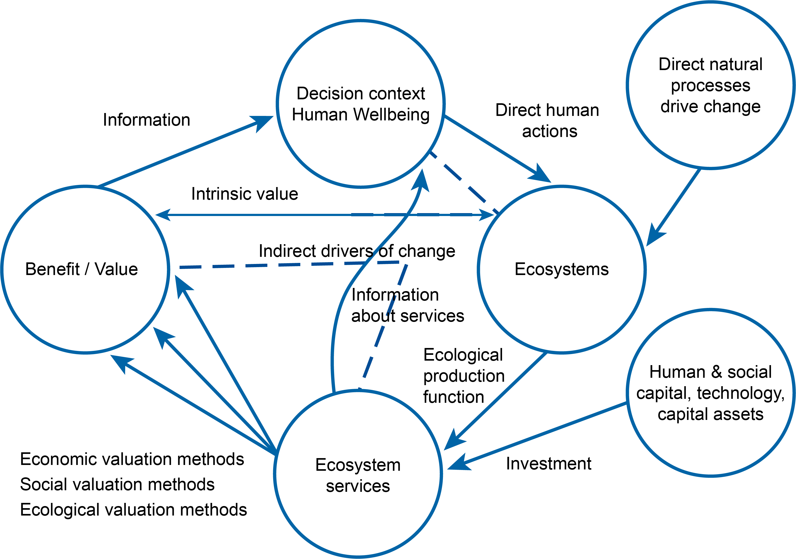
Conceptual model for understanding ecosystem services

Slide 6
Class Exercise:
Imagine a Conceptual Model
Working in groups of three or four come up with various conceptual models for an issue of your interest (make sure everyone contributes)
Notes:
[This exercise is meant to encourage students to think holistically by emphasising the organic or functional relation between parts and the whole.
Things to look out for in the newly created models and the process of model creation:
Models often reflect modeller’s point of view
Some models are quite specific – single detail
Some models are quite general/abstract
Modelling language can differ – natural, picture, song
Hard if you are not familiar with the situation
Not everyone in the group contributes the same
Did someone lead the discussion?
NB. If students need help thinking of an issue, you could suggest: fish stocks, livestock health, market price of a particular crop, risk of wildfire, risk of poaching]

Slide 7
Considerations when modelling to map ecosystem services

Slide 8
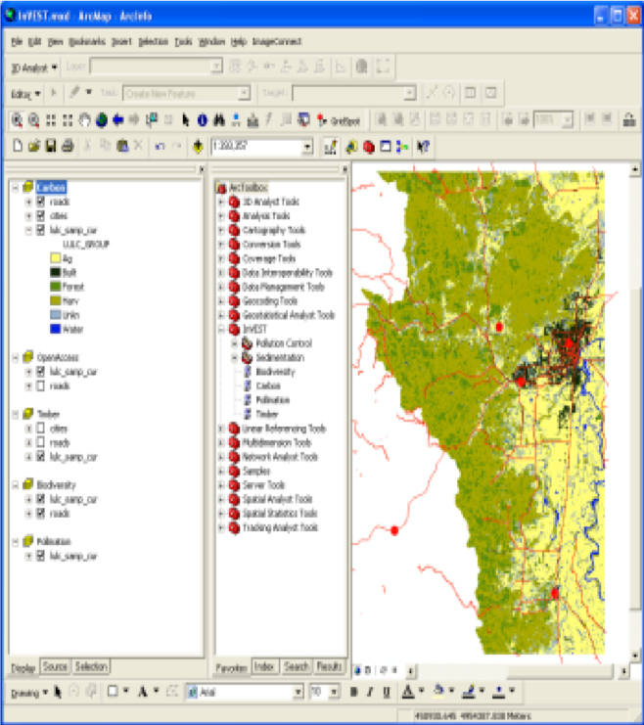
Why do we create models to map ecosystem services?
Change in ecosystem services
Flow of benefits and human wellbeing
Extrapolation to large regions
Limited data
Future scenarios and policy
Resource allocations
Notes:
To improve our understanding of how change in ecosystems affect supply of ecosystem services
How this in turn is linked to understanding the flow of benefits and human wellbeing
To link field measurements to broader ecosystem services – extrapolate to large regions
Provide information on ecosystem services in areas with little data
Allow future scenarios and policy outcomes to be explored
To prioritise resource allocations

Slide 9
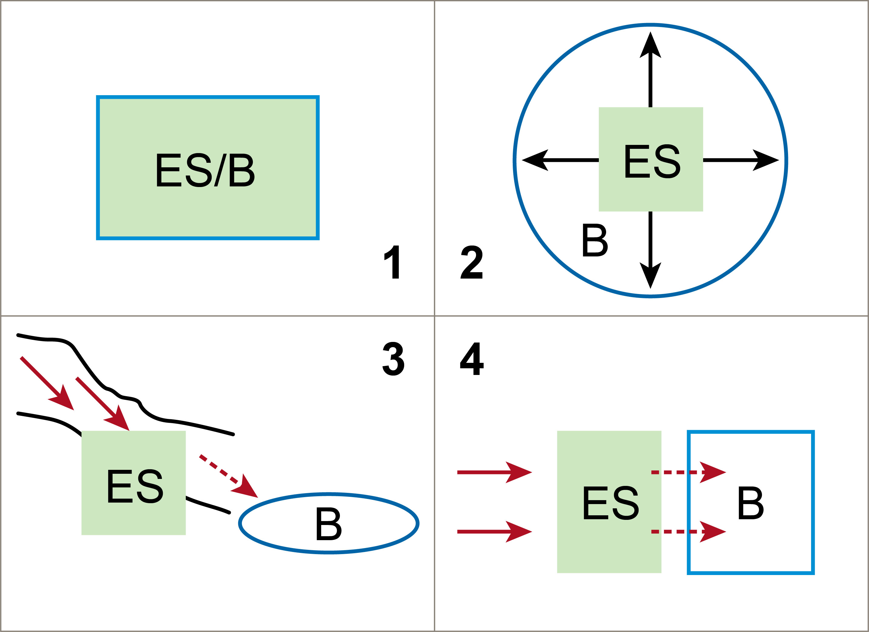
Understanding the spatial flow of benefits (Fisher et al. 2009; Bagstad et al. 2013)
Christopher, T. (2012) © Institute for Natural Resources (http://oregonexplorer.info/content/multiple-facets-ecosystem-services)
Notes:
Possible spatial relationships between Ecosystem Service units (ES) and service benefit units (B).
Panel 1: both the service provision and benefit occur at the same location (e.g. soil formation, provision of raw materials).
Panel 2: the service is provided omni-directionally and benefits the surrounding landscape (e.g. pollination, carbon sequestration).
Panels 3 and 4 illustrate services that have specific directional benefits.
Panel 3: down-slope units benefit from services provided in uphill areas, for example water regulation services provided by forested slopes.
Panel 4: the service provision unit could be coastal wetlands providing storm and flood protection to a coastline (Fisher et al. 2009)

Slide 10

Modelling ecosystem services:
Levels of complexity
Simple models Complex models
Less data (type, resolution, frequency, etc) More data
Less accurate (predictions, representation, etc) More accurate
Less utility (scenario/policy assessment, etc) More utility
Greater ease of use (training, software, etc) Lesser ease of use
Notes:
Compare the two models in terms of
Data
Accuracy
Utility
Application

Slide 11
Process-based models and simpler proxy-based approaches
Notes:
In general, the methods used to produce ecosystem service models can be broadly divided into:
Those that are based on at least some primary data from within the study region. These are called process-based models and can be drawn from a representative sampling across the whole study region and/or modelled surfaces based on primary data.
Those that are not based on primary data. These rely on proxies and prior knowledge to develop modelled surfaces. They are therefore called Proxy-based Models (Eigenbrod et al. 2010).

Slide 12
Process-based models
Models that aim to provide a framework for
  Assessing
  Mapping
  Valuing specific ecosystem services
Often used for modelling
  Ecological processes
  Social processes
  Economic processes
Notes:
Models that aim to provide a framework for assessing, mapping or valuing specific ecosystem services
Used for modelling ecological processes (and some social processes) and can incorporate economic assessments
[Class exercise
Before going on to the next slide, ask the students to imagine they are managers of a large area of sloping land with a river at the bottom. Unfortunately, there is a lot of sediment run-off into the river which causes a problem for a hydroelectric dam further downstream. Ask the students to brainstorm what information they would need to minimise sedimentation.
Some of the answers are provided on the next slide.]

Slide 13

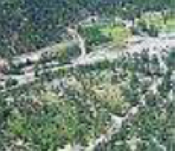
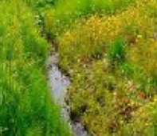
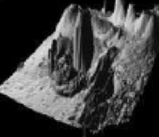
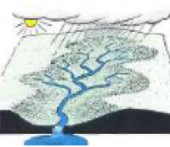

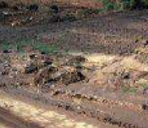
Biophysical inputs
Land use/Land cover
+ associated factors affecting soil loss and retention
Streams
Slope
Watersheds
Sediment thresholds
(of reservoirs or water
quality requirements)
Rainfall erosivity
Soil erodibility
© Natural Capital Project 2013
Notes:
The InVest Sediment Retention model provides the user with a tool for:
Calculating the average annual soil loss from each parcel of land,
Determining how much of that soil may arrive at a particular point of interest,
Estimating the ability of each parcel to retain sediment, and
Assessing the cost of removing the accumulated sediment on an annual basis.
The model considers important biophysical determinants of soil retention capacity including:
Land use and land cover patterns
Soil properties (erodibility),
Digital elevation model (slope),
Rainfall and climate data.
These are modelled at the sub watershed to watershed scale.

Slide 14
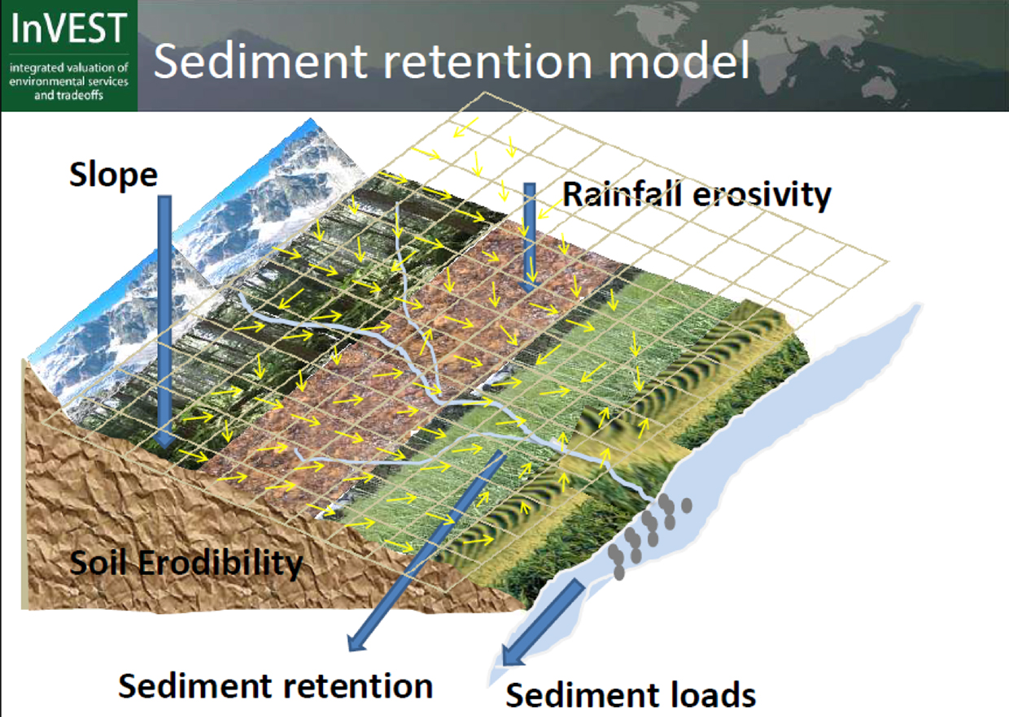
© Natural Capital Project 2013
Notes:
The Sediment Retention model is based on the Universal Soil Loss Equation (USLE) [see next slide] which provides the foundation of the biophysical step.
This diagram represents the first four factors in the equation
Rainfall erosivity,
Soil erodibility, and the
Length
Slope factor.
This part of the model accounts for two key relationships.
In areas where rainfall intensity is high, there is a high chance that soil particles will become detached and transported by overland runoff.
In areas where the soil has a high proportion of sand, the erodibility is high which means soil particles are easily detached from the soil pack and transported by overland runoff

Slide 15
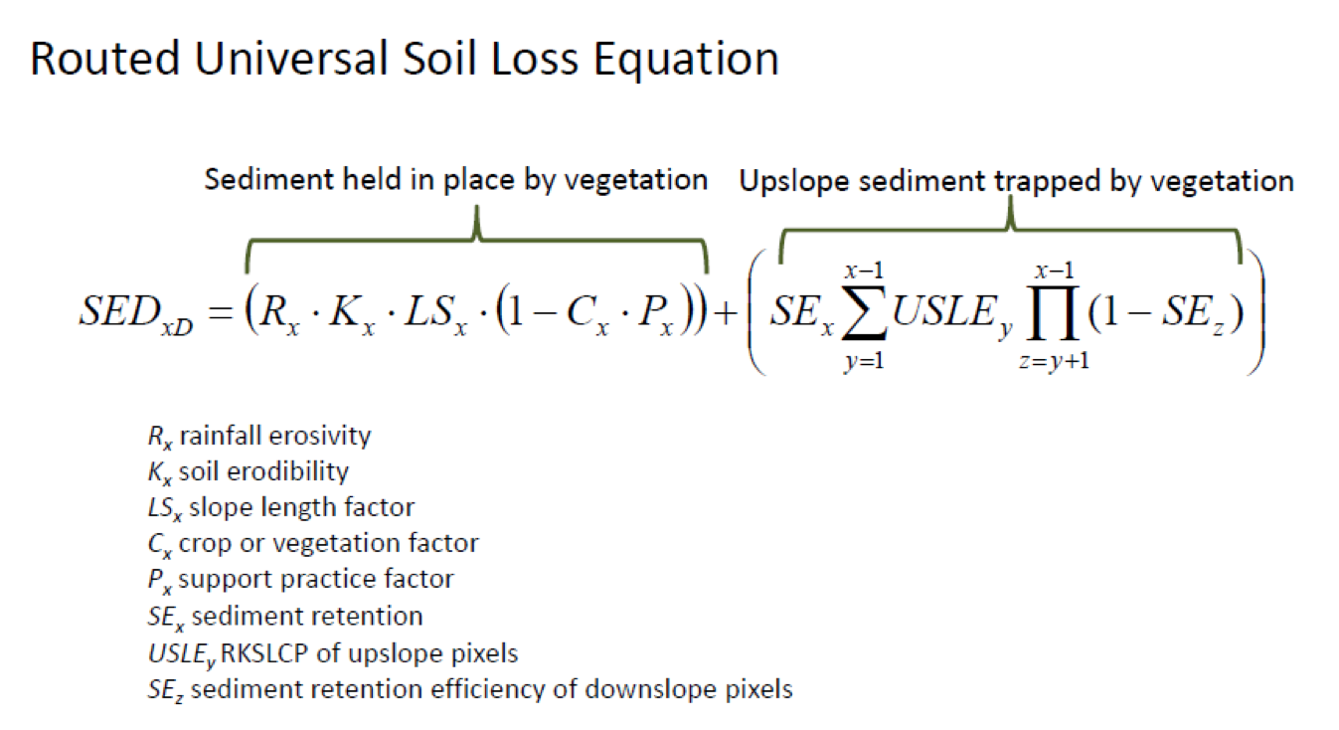
© Natural Capital Project 2013
Notes:
From the previous slide, we have noted that the USLE provides the foundation of the biophysical step of the InVEST sediment retention model.
The Slope Length Factor (LS) is the distance from the origin of overland flow along its flow path to the location of either concentrated flow or deposition.
It reflects the indirect relationship between slope and land management (terracing, ditches, buffers, barriers).
The LS factor is essentially the distance that a drop of rain/sediment runs until its energy dissipates.

Slide 16
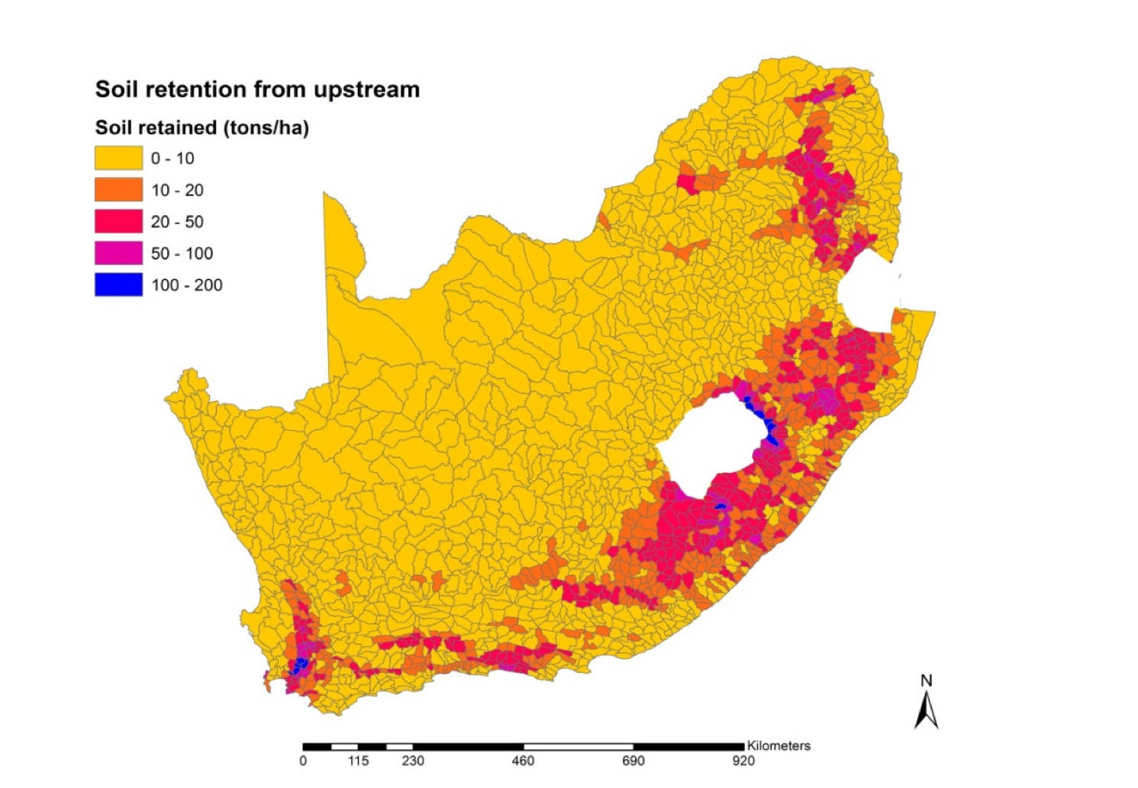

National land cover retention benefits (example of South Africa)
Notes:
The model provides the option to consider two services associated with the retention of sediments on the landscape;
Improved water quality: When considering improved water quality, there may be an allowed annual amount of sediment load for the water body of interest (just as in the water purification model for nutrients). This annual load may be specified by national or local drinking water standards.
Avoided sedimentation of reservoirs.

Slide 17
Proxy-based models
Simplest approach to modelling or representing a service
More commonly available than maps based on primary data
  Often based on digital raster land cover maps, e.g.
    ‘spatial value transfer’ (Troy and Wilson 2006) / ‘benefits transfer’ (Plummer 2009),
  May integrate knowledge from multiple existing datasets, e.g.
    Mapping the distribution of flood control and rural recreation services (Chan et al. 2006)
    Accounting for proximity to settlements near water bodies (Troy and Wilson 2006)
    Soil retention in South Africa (Egoh et al. 2008)
Notes:
In instances where there is a paucity of data, proxies (e.g. estimates of a service for a particular land cover type) are frequently used to map and model ecosystem services.
Such proxy-based models are the simplest approach to modelling / representing a service
These are often based on digital raster land cover maps due to the widespread availability of such data. Examples include ‘spatial value transfer’ (Troy and Wilson 2006), otherwise known as ‘benefits transfer’ (Plummer 2009), where a monetary value for an ecosystem service is assigned to each land cover class based on estimates from prior studies.
A number of studies have incorporated existing knowledge about causal relationships from multiple existing datasets into a proxy layer. For example,
Chan et al. (2006) weighted land use by its proximity to human population centres when mapping the distribution of flood control and rural recreation services.
Troy and Wilson (2006) subdivided some land cover classes to account for proximity to settlements (e.g. beach vs. beach near human dwelling).
Egoh et al. (2008) combined maps of soil erosion potential and vegetation cover to create a map of soil retention for South Africa.

Slide 18
Modelling and mapping ecosystem services in practice
Case study of Cape Town
Notes:
This case study is based in Cape Town, South Africa, a city which is a globally recognised biodiversity hotspot but which is facing numerous competing land uses. The city is plagued with a tightly constrained budget and aims to establish the links between ecosystem services and biodiversity conservation within its municipal area. The next slides will discuss the process and the outcome of a study that was commissioned to inform the decisions above.

Slide 19
Case study: Modelling ecosystem services in Cape Town (O’Farrell et al. 2012)
Aim
  To provide information for city planners and biodiversity managers about the value of natural green spaces in terms of provision of ecosystem services
Method:
  Land use and land cover change assessment
  Potential contributions of natural vegetation remnants to specific ecosystem services
Notes:
The study developed and tested a simple and rapid ecosystem service assessment method to determine the contribution of natural vegetation to ecosystem service provision in Cape Town.
The study took a two pronged approach:
1. Land use and land cover change assessment
Modelled past, present and future scenarios of vegetation cover
Used available proxy data to quantify four ecosystem services: agricultural provision, water run-off regulation, groundwater, and coastal zone protection
Used expert opinion to identify the effects of changes in land class (vegetation cover) on ecosystem services
2. Potential contributions of natural vegetation remnants to specific services (pollination, cultural ES, tourism and education)
Used distance from vegetation remnants to potential beneficiaries as a proxy value for ecosystem services (e.g. distance to farmland gives a proxy value for pollination services)
[Refer to subsequent slides and O’Farrell et al. (2012) for a detailed methodology]

Slide 20
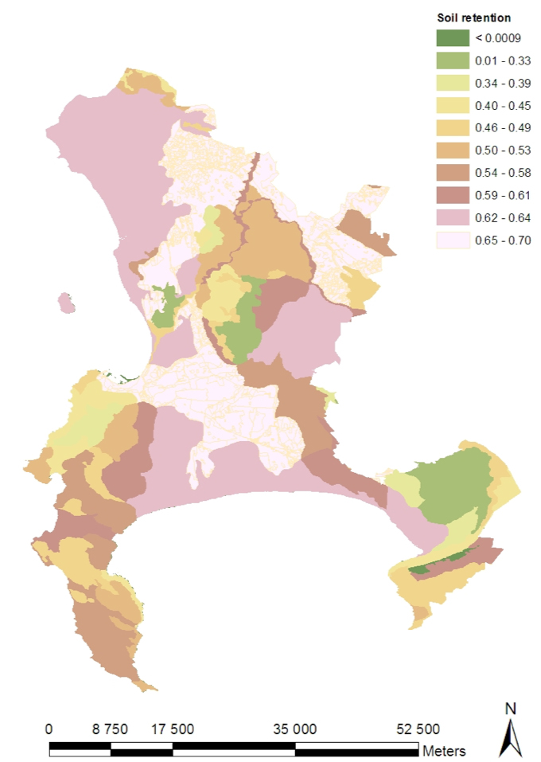
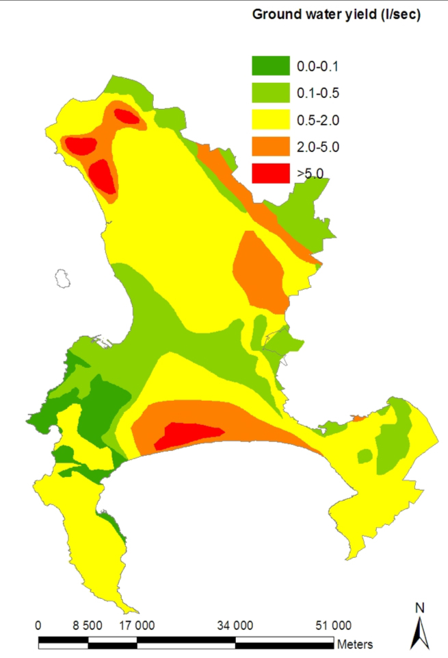
Assessing ecosystem services in the City of Cape Town

Slide 21
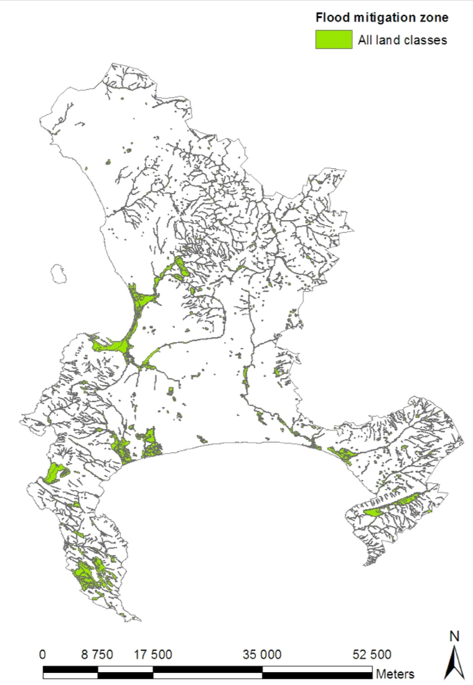
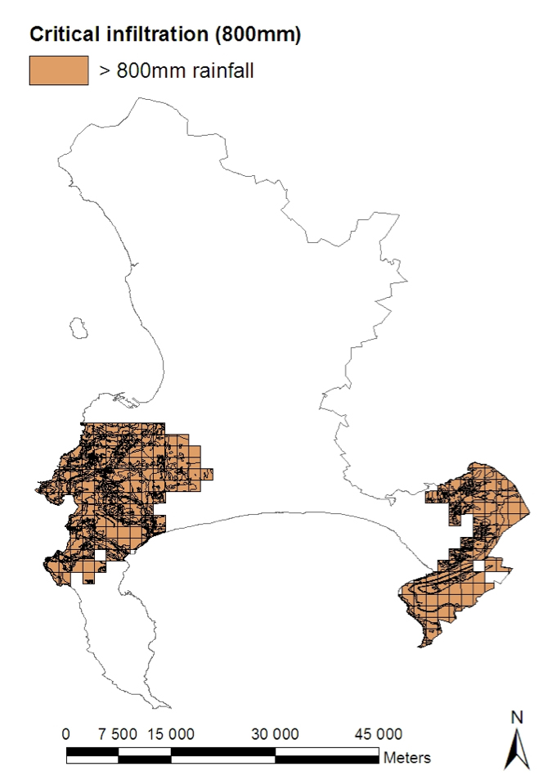
Assessing ecosystem services in the City of Cape Town

Slide 22
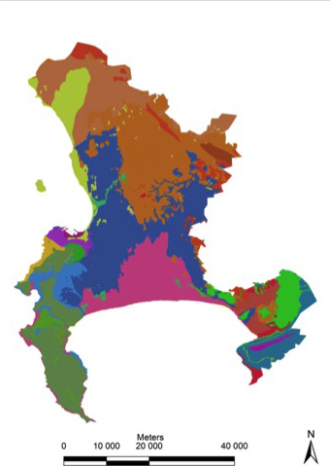
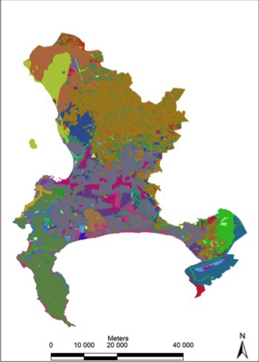
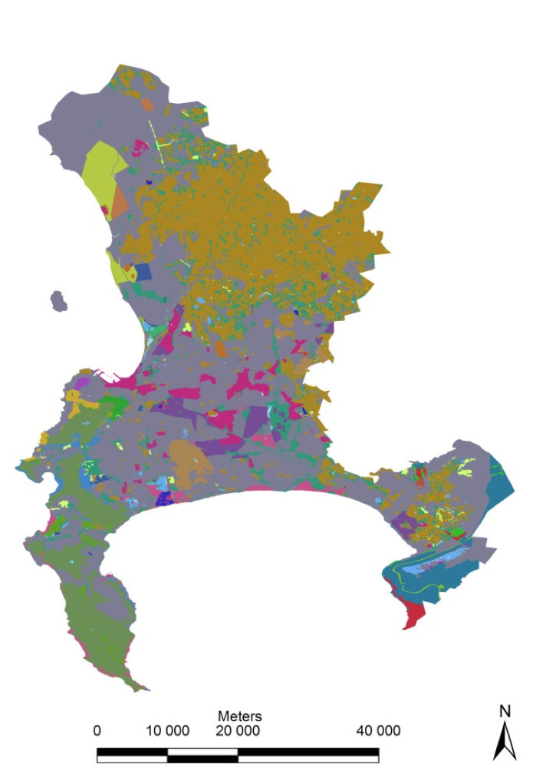
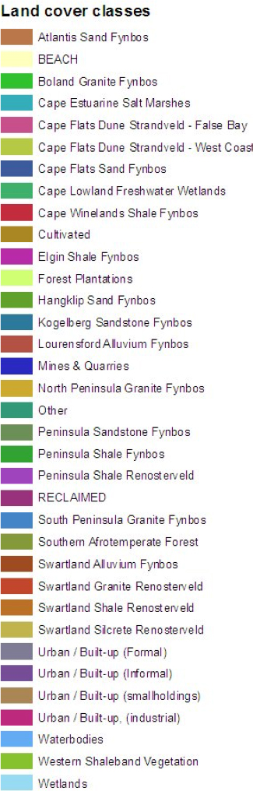
Assessing ecosystem services in the City of Cape Town
Past land use
Present land use
Future land use
Notes:
Past land use = based on various maps to represent vegetation before colonial settlement
Future land use = assumes that all current natural vegetation that is not formally protected will be converted into housing

Slide 23
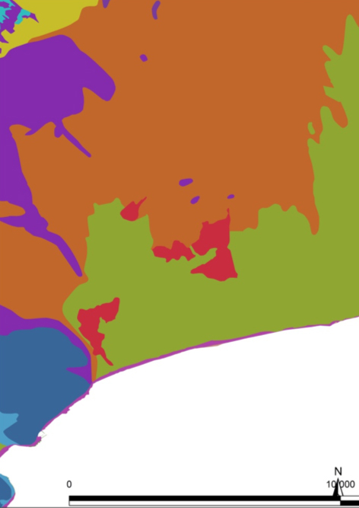
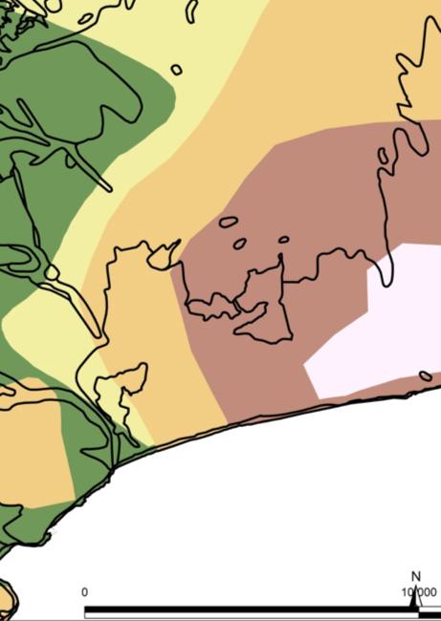
Assessing ecosystem services in the City of Cape Town
Vegetation types
Vegetation types with services values / measures / proxies

Slide 24
Ecosystem services scored for different land-use classes based on expert opinion
Ecosystem service | Natural vegetation good condition (High) | Natural vegetation average condition (Medium) | Natural vegetation poor condition (Poor) | Cultivated | Forest Plantations | Urban / Built-(up industrial) | Urban / Built-up (Formal housing) | Urban / Built-up (Informal housing) | Urban / Built-up (smallholdings) | Mines & Quarries
Land capability | 10 | 9 | 8 | 10 | 10 | 0 | 0 | 0 | 10 | 0
Grazing | 10 | 6 | 3 | 0 | 0 | 0 | 0 | 0 | 0 | 0
Flood mitigation | 10 | 9 | 7 | 5 | 9 | 0 | 5 | 3 | 8 | 0
Soil retention | 10 | 8 | 7 | 7 | 9 | 10 | 9 | 5 | 9 | 0
Critical infiltration | 10 | 8 | 5 | 8 | 9 | 0 | 8 | 5 | 8 | 0
Coastal zone protection | 10 | 8 | 5 | 2 | 7 | 5 | 3 | 2 | 3 | 0
Groundwater recharge | 10 | 9 | 7 | 7 | 5 | 2 | 6 | 4 | 6 | 5
Ground water yield | 10 | 9 | 7 | 9 | 5 | 2 | 6 | 4 | 9 | 5
Ground water quality | 10 | 10 | 10 | 6 | 9 | 4 | 7 | 5 | 5 | 5
Notes:
Scores were rated on a scale from 0 to 10 where 0 represented no service and 10 the maximum potential service.

Slide 25
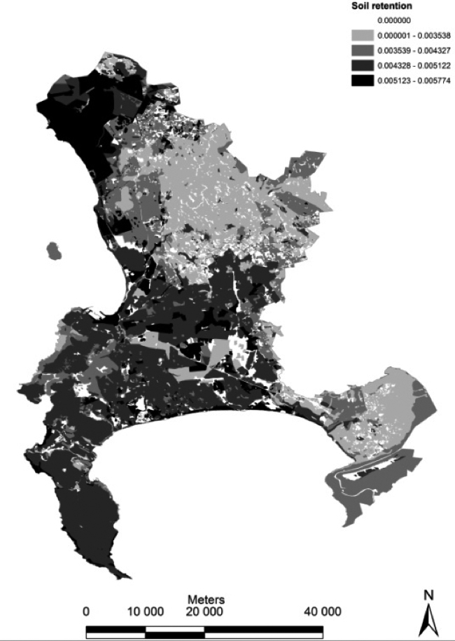
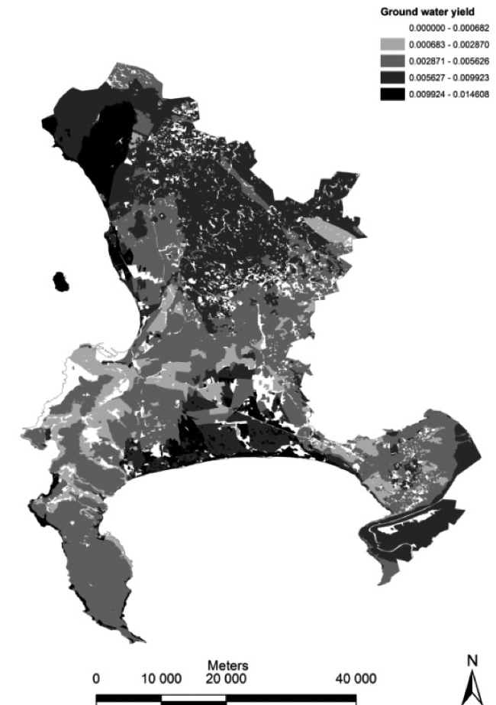
Assessing ecosystem services in the City of Cape Town
Notes:
Based on the expert scores, these maps show the value of different parts of the city for soil retention and ground water yield.

Slide 26
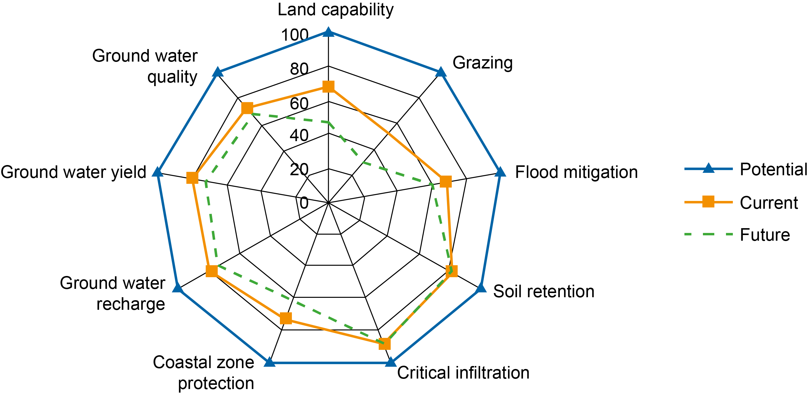
Provisioning and regulating services
Notes:
The radar diagram shows the different levels (in percentage terms) of ecosystem services provided in three scenarios:
Potential, i.e. the original vegetation that would have been present in the past
Current vegetation
Future vegetation, assuming all currently unprotected areas have been converted to formal housing
Note the large past and future changes in Grazing and Land capability – in line with most agriculture and herding being moved outside the city.

Slide 27
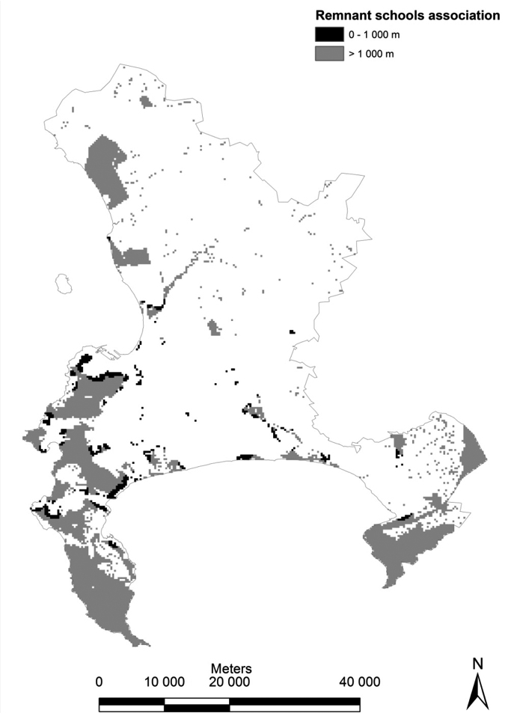
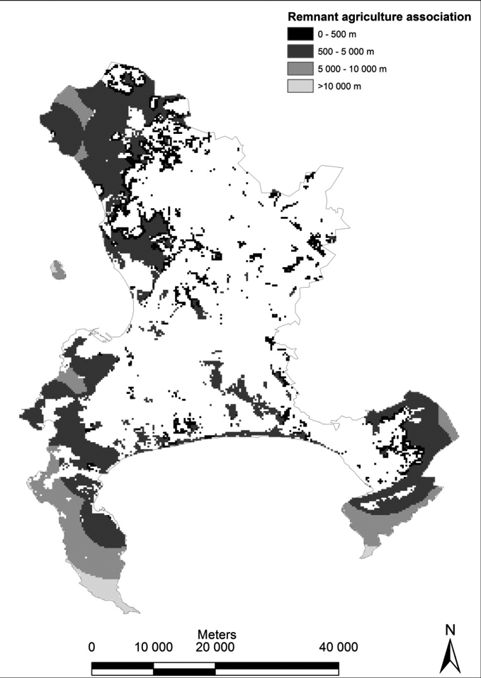
Assessing ecosystem services in the City of Cape Town
Notes:
These maps show how close natural vegetation remnants are to schools (left) and agricultural sites (right).
Very few remnants are within walking distance (set at 1km) of schools. This suggests there are diminishing opportunities for the numerous schools in the lowland areas to access natural land and the associated cultural services.
The majority of remnants are within 10km of agricultural land and are therefore a potentially important source of pollinators (some honey bees can fly up to 10km).

Slide 28
Cape Town: Some conclusions regarding simple approaches to ecosystem service assessment
Natural vegetation remnants vary in importance for ecosystem services
  Provisioning – declining importance
  Regulatory – very important but being eroded
  Cultural – potential for greater importance
Arguments for conservation
Value of a simple rapid assessment tool
“Introduction to” tool and getting conversations going between departments
Notes:
The study shows that the vegetation remnants are of varying importance for different ecosystem services:
Provisioning services like grazing, water and agricultural produce are now largely obtained from outside the city
Regulatory services can only be delivered in situ – but buffering capacity is reduced, flood mitigation and coastal protection are compromised
Cultural services are important – but there is pronounced loss of services on the lowlands; win-win opportunities with regulating services exist
The ecosystem services assessment informs arguments for conservation:
Highlights the value of a multiple services approach (casting the net wide is good)
However, given the high biodiversity value of Cape Town’s vegetation, it would not be appropriate to rely on high ecosystem service values to choose conservation areas
Value of a simple rapid assessment tool - no training required, quick derivation of the status quo, can direct detailed investigations, rapid scenario generation

Slide 29
References
Key readings
Bagstad, K.J. et al. (2013) Spatial dynamics of ecosystem service flows: a comprehensive approach to quantifying actual services. Ecosystem Services 4: 117-125.
Chan, K.M.A. et al. (2006) Conservation planning for ecosystem services. Plos Biology 4: 2138-2152.
O’Farrell, P. et al. (2012) Insights and opportunities offered by a rapid ecosystem service assessment in promoting a conservation agenda in an urban biodiversity hotspot. Ecology and Society 17: 27.
Plummer, M.L. (2009) Assessing beneﬁt transfer for the valuation of ecosystem services. Frontiers in Ecology and the Environment 7: 38-45.
Other readings
Egoh, B. et al. (2008) Mapping ecosystem services for planning and management. Agriculture Ecosystems and Environment 127: 135-140.
Fisher, B., Turner, R.K. and Morling, P. (2009) Defining and classifying ecosystem services for decision making. Ecological Economics 68: 643-653.
Greca, I.M. and Moreira, M.A. (2000) Mental models, conceptual models, and modelling. Int. J. Sci. Educ. 22(1): 1- 11.
Tallis, H.T., et al. (2011) InVEST 2.1 beta user’s guide. the natural capital project.
Troy, A. and Wilson, M.A. (2006) Mapping ecosystem services: practical challenges and opportunities in linking GIS and value transfer. Ecological Economics 60: 435-449
Notes:
References cited in the speakers’ notes:
Eigenbrod, F. et al. (2010) The impact of proxy‐based methods on mapping the distribution of ecosystem services. Journal of Applied Ecology, 47: 377–385.

Slide 30
Class exercise for further discussion
Identify a situation in your country, town or region in which decision-makers might need information about a specific set of ecosystem services. Based on your knowledge of the data that might be available, work through the 5 steps in Bullock and Ding (2018) and decide which ecosystem service model would be most useful for the decision-makers.
Bullock, J.M. and Ding, H. (2018) A guide to select ecosystem service models for decision-making. WRI, CEH and ESPA. Available at:
  https://www.espa.ac.uk/files/espa/18_Guide_Ecosystem_Services_web_Feb8.pdf

