Slide 1
Payment for Ecosystem Services, Ecosystems and Poverty Alleviation
Topic 08
© Natura Bolivia

Slide 2
Learning outcomes
Discuss different ways of assessing and valuing ecosystem services
Define and distinguish Payments for Ecosystem Services (PES) and Conditional Transfers
Analyse the enabling conditions for PES
Discuss challenges and issues relating to payments for ecosystem services

Slide 3
Valuation and assessment of ecosystem services

Slide 4
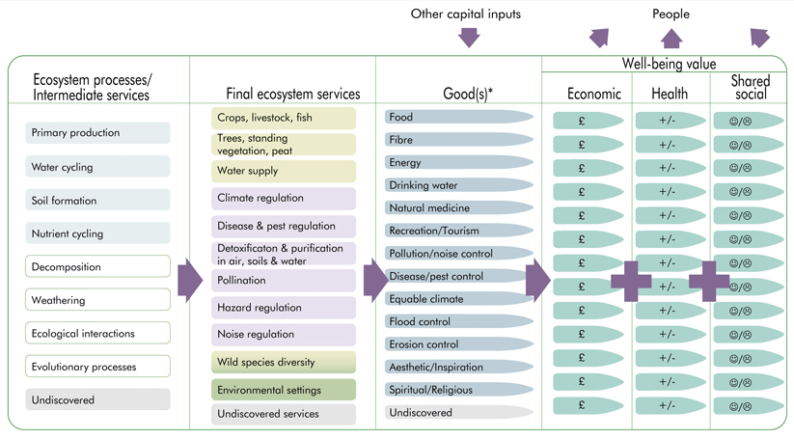
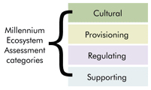
Valuation in the UK National Ecosystem Assessment
© 2011 UK National Ecosystem Assessment
Notes:
Following the Millennium Ecosystem Assessment (2005), the UK was the first country to undertake a national ecosystem assessment.
The left-hand column shows the different kinds of ecosystem processes which contribute to achievement of the ecosystem services.
Next column – colours indicate whether ES are regulating, provisioning or cultural.
To turn these ecosystem services into the final ‘goods’ that people use you need some capital input. This can be financial or labour input, e.g. the need for a boat/net to catch fish from the river and make it available for a person to eat.
Note that at the bottom of each column, there is an ‘undiscovered service’. This acknowledges the fact that we do not have complete knowledge about the services provided by any one ecosystem.
The most important part of the diagram is the final set of columns which comprise the ‘wellbeing value’. This approach highlights that ecosystem services cannot only be measured in cash value but may also have a less tangible health value (indicated by a positive or negative trend) and an even less tangible shared (or cultural) value (indicated by a smiley/sad face). Although it is important to have monetary values for ES to discuss with decision-makers, we need to be aware that there are many values which are not easy to put a monetary value on.
UK National Ecosystem Assessment http://uknea.unep-wcmc.org/Home/tabid/38/Default.aspx

Slide 5
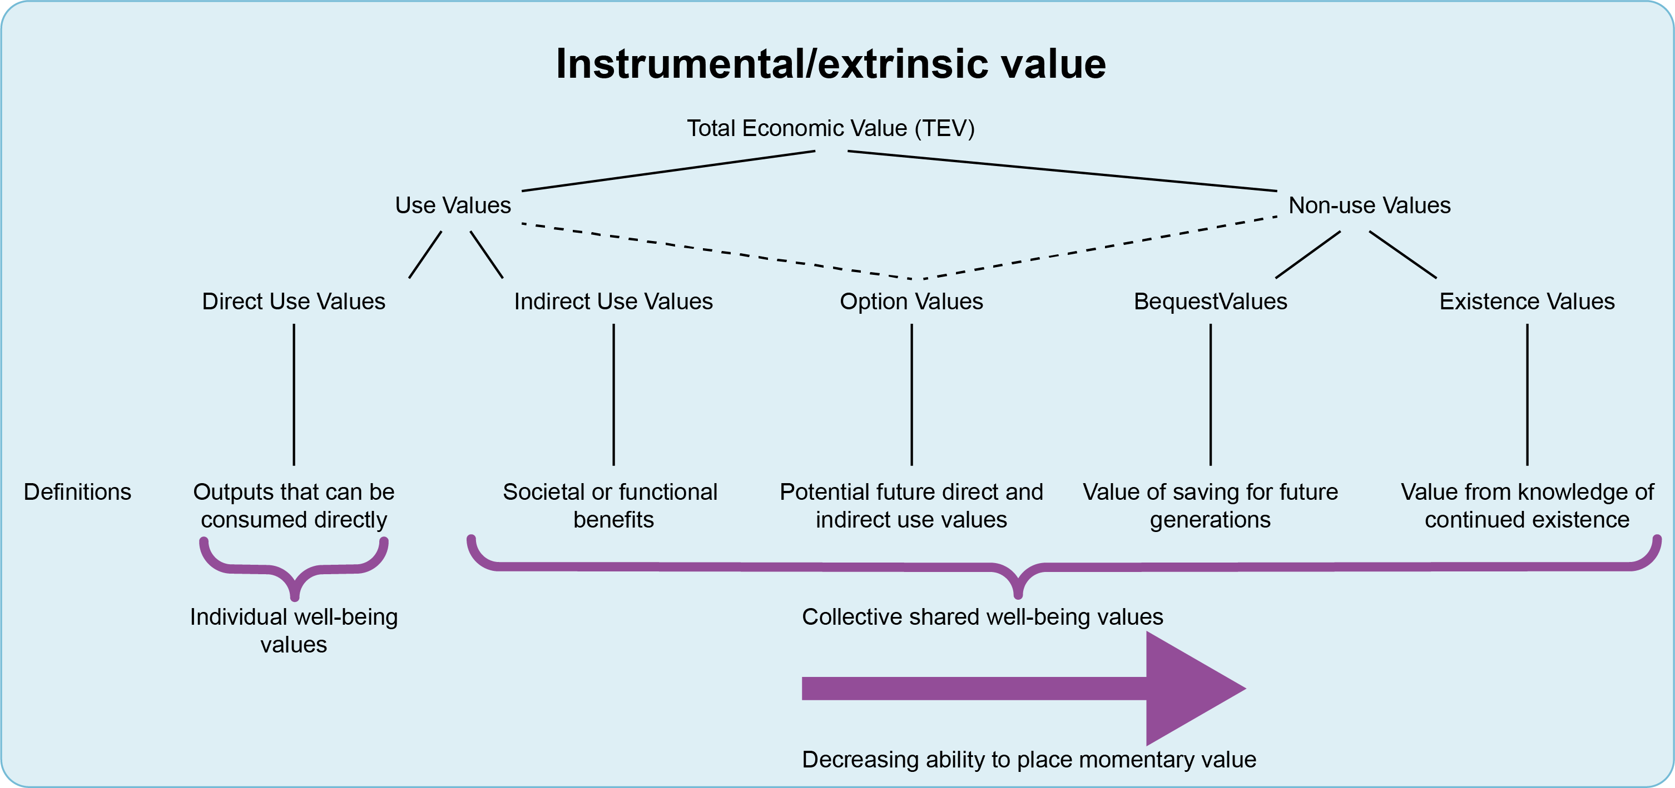
Valuing ecosystem services
© 2011 UK National Ecosystem Assessment
Notes:
Valuing ecosystem services is a difficult business. The diagram shows a spectrum from direct uses (easily valued in monetary terms) to existence value (very hard to put a monetary value on).
How you value the ecosystem services depends on the perspective of the people doing the valuing and what they consider to be important.

Slide 6
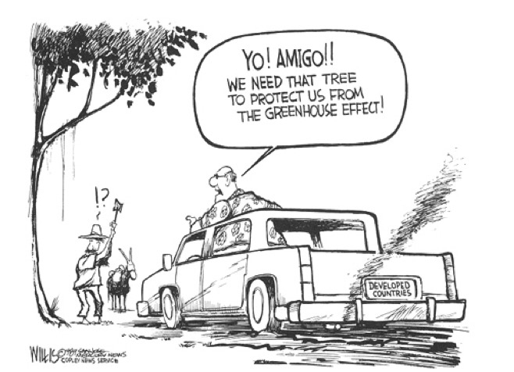
Whose voice/view counts?
Notes:
Different people value different ecosystem services. Issues of power are very important in determining who decides which value (e.g. of trees in this cartoon) to prioritise.
It is important to note that there is a critical area of debate which argues that we shouldn’t put a monetary value on nature at all. By putting a monetary value on ecosystem services we end up commodifying nature.
There is a risk that environment is seen only in monetary terms which may be based on just a few easy-to-value ecosystem services, ignoring many others unvalued ones.
Paying people may also undermine their intrinsic interest in contributing to environmental activities (Schröter et al. 2014)

Slide 7
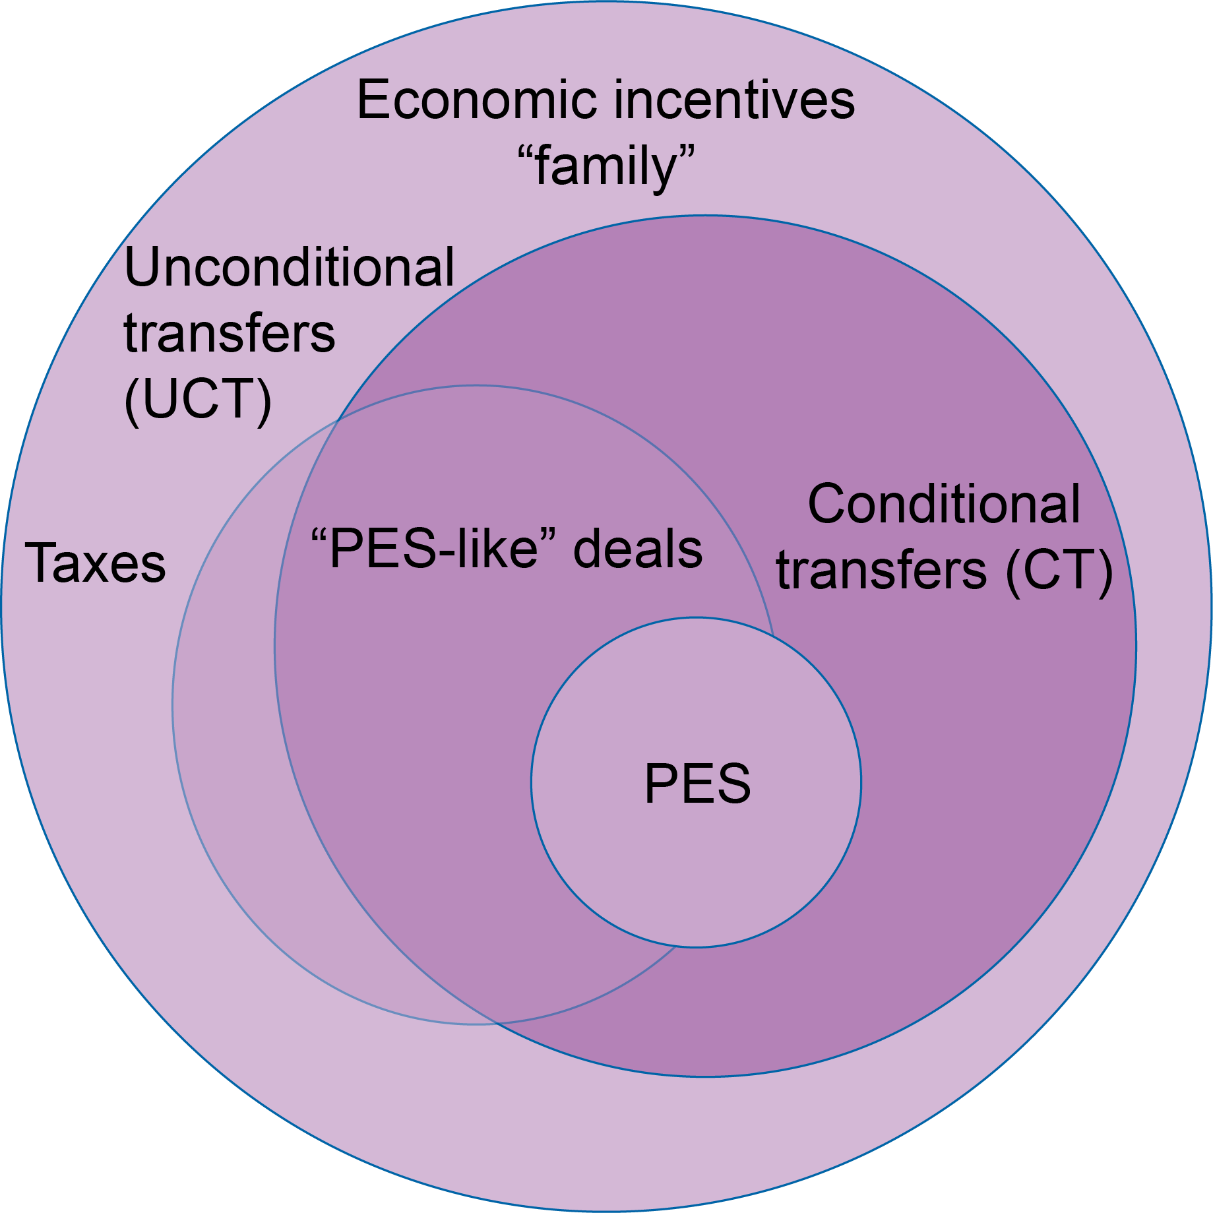
Payment for Ecosystem Services: a type of conditional transfer
Source: Focus group at ESPA Science Conference, Edinburgh 2017
Notes:
Conditional transfers (CT), such as guaranteed job schemes, pensions and food transfers, have been used for achieving social objectives and raising the living standards of vulnerable people. Conditional transfers are also used to pursue environmental objectives, for example promoting agroforestry or forest protection with incentives such as environmental subsidies and payments for ecosystem services (PES).
Economic incentives include a whole set of incentives that aim at motivating people to behave in certain ways. In the diagram above these include conditional and unconditional transfers and in some instances, subsidies.
Conditional transfers (CTs) introduce “conditionality” to the incentive.
Economic ‘disincentives’ Unlike the incentives, disincentives aim at curbing negative behaviour by imposing certain charges and taxes on people.
‘PES-like’ deals involve various types of institutional arrangements that often have conditional and/or unconditional components,
As we are going to see in the next slides, PES (e.g. defined by Wunder 2005) are thus a subcomponent of these CT agreements and essentially are a form of CT used to introduce positive rewards for better environmental management.

Slide 8
What are Payments for Environmental (or Ecosystem) Services (PES)?
According to Wunder (2005): PES is ….
a voluntary transaction where
a well-defined environmental service (ES) or a land use likely to secure that service
is being ‘bought’ by a (minimum one) service buyer
from a (minimum one) service provider
if and only if the service provider secures service provision (conditionality).
PES can only help secure those environmental services for which environmental service users are willing to pay
Notes:
PES schemes were developed – as a market-based approach to environmental governance – to fill what seemed to be a governance gap. Regulatory approaches seemed to be failing to achieve environmental conservation so PES theory argues that a market-based approach may be more effective.
However, it is important to note that PES can help in securing only those environmental services for which environmental service users are willing to pay.
The slide shows the best-known definition of PES provided by Sven Wunder in 2005 (though he recently updated his definition in Wunder, 2015).

Slide 9
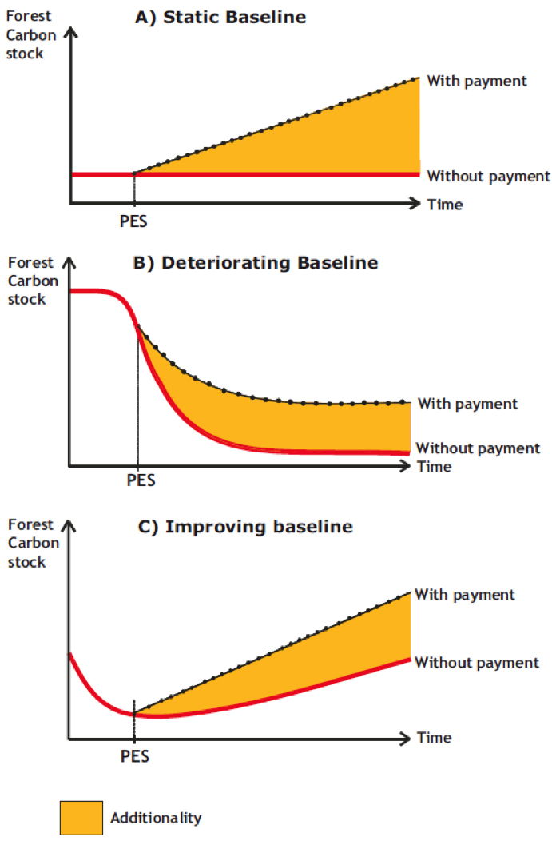
Other requirements
Additionality
No leakage
Permanence
(Wunder 2005)
Notes:
There are 3 other requirements for PES schemes:
Additionality, which requires that the payment should yield environmental benefits that would have not have been realised without it. The 3 graphs show different additionality scenarios depending on the baseline, e.g. the top graph shows a baseline (in this case of carbon stock) over time, where introduction of payments lead to an increase in carbon stocks. In the middle graph, the baseline is declining and the introduction of a payment scheme cannot reverse the decline, but can ameliorate the situation slightly. In the bottom graph, the baseline is already improving but payments can increase the rate of change.
Leakage happens when a landowner receiving a payment simply shifts the activity that causes the environmental problem to another piece of land that is not under contract.
Permanence refers to the sustainability of the environmental service.

Slide 10
4 main services included in PES
Carbon stocks
Water quality and quantity
  Regulation of hydrological flow and control of soil erosion by wetlands or forests
  Protection of water quality (e.g. no agricultural chemicals,
  no siltation)
Biodiversity
Landscape beauty and recreation
…and ‘bundled services’
  Recognise multiple services provided by one ecosystem
  Reduce transaction costs
Notes:
To date the main ecosystem services that have been included in PES schemes are:
Carbon stocks, e.g. through tree planting to sequester carbon, or policies to reduce land uses that cause carbon emissions.
Water quality and quantity. This may involve changes in farming systems to reduce water pollution, and forestry activities to reduce siltation in watersheds which may affects downstream power plants, irrigators, etc. Possibly the most famous watershed scheme is the New York Watershed system in which New York City water users pay farmers in the surrounding catchment to modify their farming systems to maintain water quality.
Biodiversity, e.g. through protecting areas.
Landscape beauty: Natural areas provide aesthetic beauty, which is treasured by most human societies. Local land-use practices can enhance or destroy scenic beauty, affecting local quality of life and affecting nature-based tourism opportunities. Tourism companies and even private foundations are paying local farmers or other landowners to preserve this valuable environmental service.
There is growing interest in having bundled ecosystem services, e.g. forests can provide biodiversity, carbon, recreation and possibly water. Do we need separate PES schemes for each of these or can we have a single scheme to cover all the activities? Problems of bundles: Some services are rival (e.g. trees and water, or fast-growing monocultures for carbon and biodiversity), while some are local and others global and therefore appeal to different buyers.

Slide 11
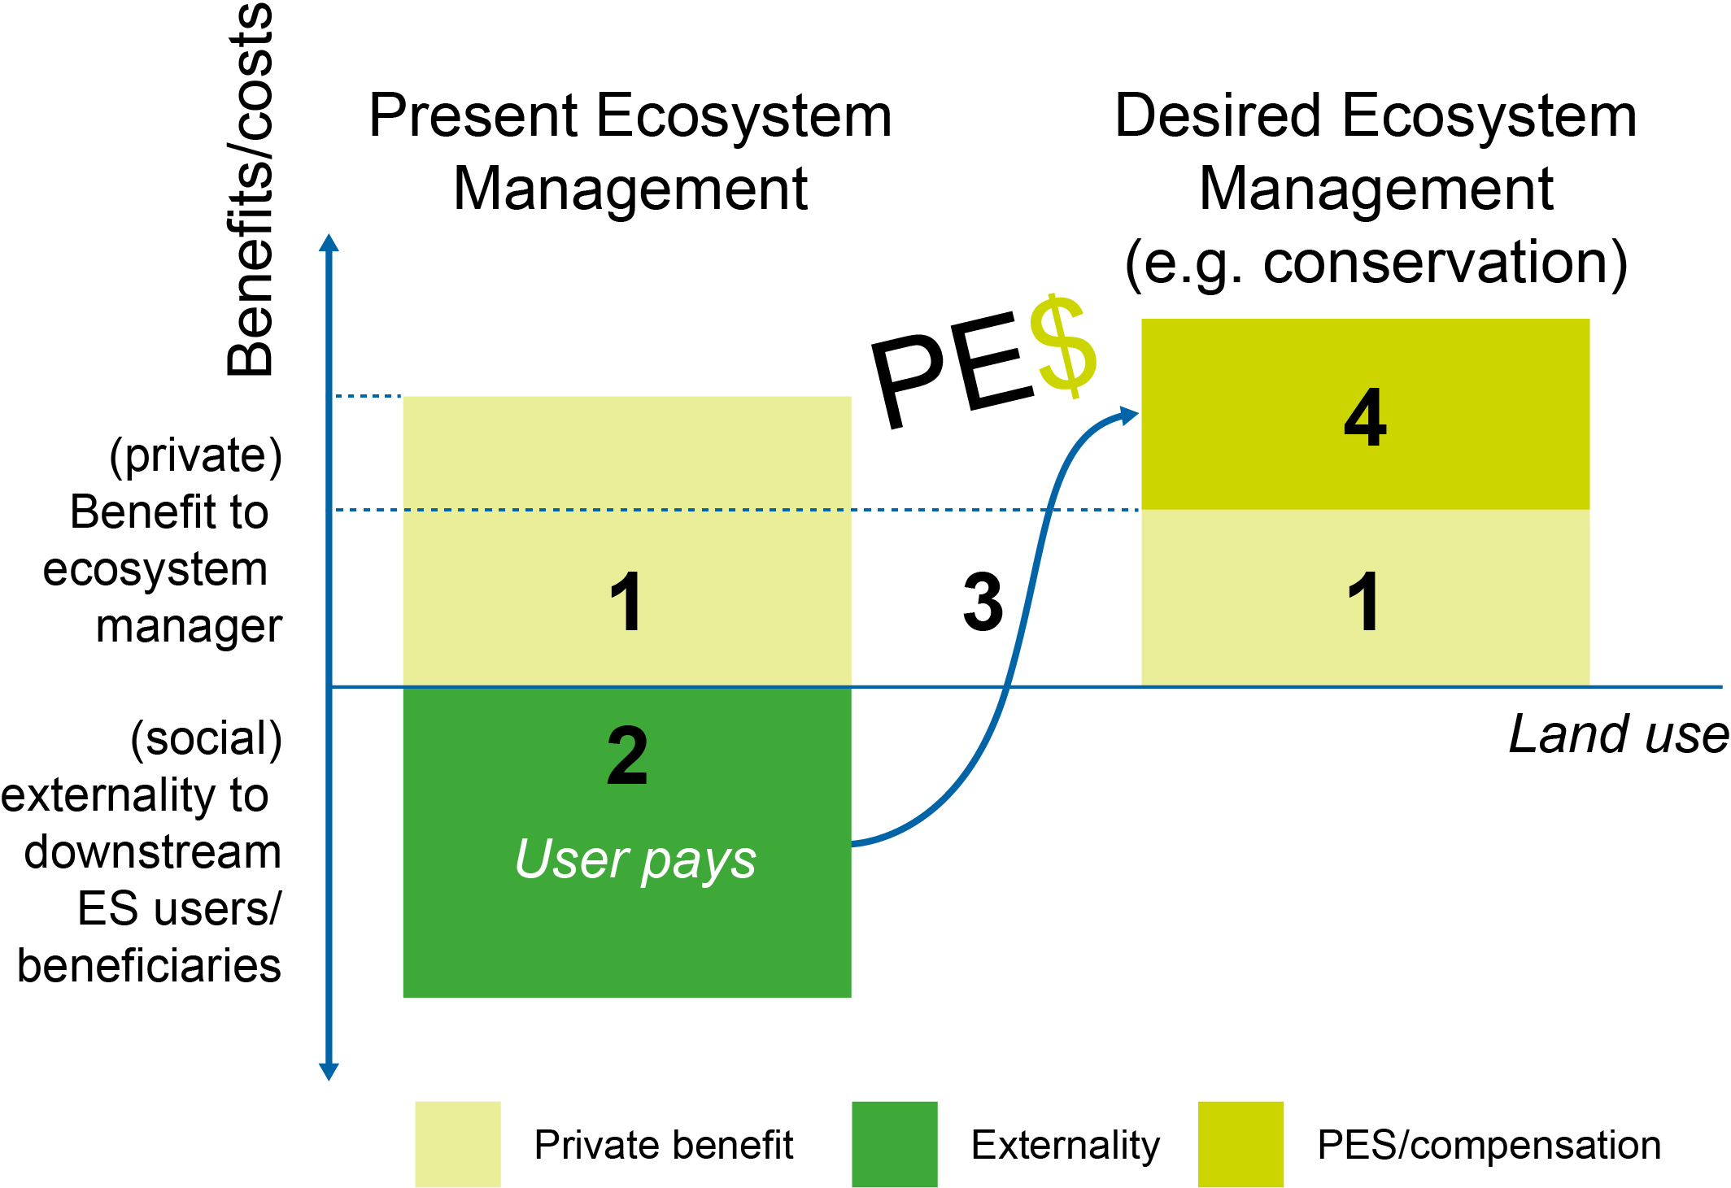
PES and externalities
Existing payoffs do
not reflect value of ES, making conservation unattractive
Lack of ES provision results in negative environmental externality
‘User-pay’ principle suggests that those who benefit from ES pay for their provision
The incentive from ES (‘provider gets’) helps make conservation more attractive
Source: Adapted from: Pagiola and Platais, 2007; Engel et al. 2008
Notes:
Pagiola’s basic figure provides the logic underlying PES:
Under the current policy structures, the value of ecosystem services is not included in private decisions making conservation economically unattractive.
The private gains of existing management are higher than conservation. But often result in high societal costs (externalities).
PES proposes transfers from the costs/losses from externalities to make conservation more attractive.

Slide 12
Comparing Conditional Transfers and Payments for Ecosystem Services
Conditional Social Transfers tend to: | PES tend to:
Have a clear social objective and are able to focus on the poor and ultra-poor | Have rural development as a secondary objective, but often as an afterthought
Support direct, one-off interventions with short-term impacts, which may not change long-term behaviour | Provide continuous low-level support that can change social norms and behaviour over the long term
Provide tangible benefits to the ultra-poor, including people without land | Support landowners and land managers, and so cannot effectively alleviate extreme poverty
Undertake environmental projects at large scale, but struggle to do so efficiently. | Have environmental objectives as their primary goal
Source: Porras and Asquith 2018
Notes:
While PES and CT look very similar, there are differences:
CTs and PES have the same starting point: the assumption that direct, conditional incentives are the most effective way to change behavior.
However, although many PES schemes have rural development as an objective, they have struggled to implement mechanisms to engage the poor and alleviate poverty. In contrast, CTs have made great strides in promoting social protection and income stability, but their environmental impact has been limited.
This slide highlights the differences between CTs and PES, but also suggests that there is significant scope for developing hybrid programmes that take advantage of model complementarities. Indeed, such hybrids are already being tested in the Bolsa Floresta (Brazil), Watershared (Bolivia) and Jatka (Bangladesh) conservation programmes.

Slide 13
Example of a Conditional Transfer
Environmental Public Works Programme, South Africa
Provides jobs for vulnerable groups
  Low income workers
  Single-parent families
  HIV/Aids affected people
Alleviates poverty through provision of
  Temporary work
  Skills development
Impact
  About 30,000 jobs/year
  About 1 million hectares of invasive alien species cleared
Notes:
Examples of CTs/PES exist in Bangladesh, Brazil, China, Costa Rica, Uganda, Kenya and Mexico (all described in Porras and Asquith 2018).
Environmental Public Works Programme, South Africa: A social Conditional Transfer based on US$33 million/year from central government’s Social Responsibility and Environmental portfolio.

Slide 14
Enabling conditions for PES
Notes:
The following slides summarise five key conditions that helped existing CT and PES programmes emerge and thrive. They are drawn from descriptions of how PES has been implemented in practice (e.g. Asquith and Wunder (2008), as well as practical knowledge of CT/PES practitioners and researchers shared at an international workshop (Porras et al. 2016; Porras et al. 2017).

Slide 15
Political support
Contributions from national governments can help leverage funding from private sources.
Revenues from taxes
Voluntary contributions and
Donor funding
Independent trust funds
Notes:
For national programmes, pegging contributions to tax allocations can be a softer (and often more doable) form of earmarking. For example, in Costa Rica and Mexico, allocations are linked to fuel and water tax collection and are written into national law.
Large countries like China, Mexico, India and Brazil use match contributions from national government with those from provincial/local budgets. This can help leverage funding from the private sector –almost 80% of Bolsa Floresta in Brazil is from private sources, which include Coca-Cola, Samsung, Abril Media Group and Marriott International working as a REDD+ project and selling voluntary over-the-counter carbon offsets (Virgilio Viana pers. comm.).
Combining revenues from taxes, voluntary contributions and donor funding has been successfully used in Costa Rica.
Useful innovations to manage these financial flows include developing secure finance management systems, such as creating independent trust funds, and diversifying the portfolio of economic instruments for capitalization.
Importantly, the link to social protection has significantly increased the resources available for environmental management. This has occurred at large scale in South Africa through the Working for Water programme.

Slide 16
Sustainable financing
Government budget (New taxes, re-pricing, earmarking, fiscal reform, linking directly to social protection)
Direct deals (Voluntary contributions following negotiation (e.g. water funds) and sales directly in market (e.g. carbon offsets))
Risk-sharing instruments (Adding value through value chains, mainstreaming eco-investments in infrastructure)
Concessional loans (Alongside grants, and government investments)
Notes:
Political support is important, but ultimately sustainable finance will determine whether a programme emerges and reaches sufficient scale.
Making financing sustainable is critical if projects and programmes are to take the step from one-off, usually donor-funded pilots, to a programme with financial stability that allows for replication and scaling-up.
Grants and other forms of donor-funding have been very useful to kick-start projects like Watershared, and to partially cover entry costs to international carbon markets (technical studies, registration fees, etc).
But it is important to have a clear strategy for ongoing revenues. Local governments and water users in Bolivia now provide 80% of Watershared payments (Asquith 2016), and sales from carbon offsets generate important revenues in Mexico, Uganda and Kenya.

Slide 17
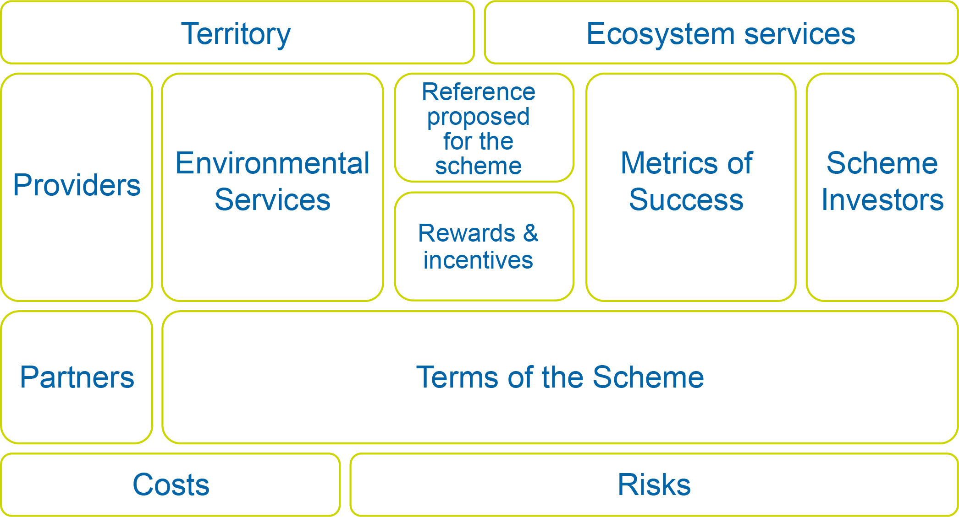
Lean Institutional set up
Develop a clear PES design following a business canvas
Source: Business Model Generation, 2010
Notes:
The design of PES schemes could follow a business approach, based around the business canvas model.
This is a business tool used to visualise all the building blocks of starting a business, including customers, route to market, value proposition and finance
In the next slide, we will look at the business canvas for the Bolsa Floresta Programme.

Slide 18
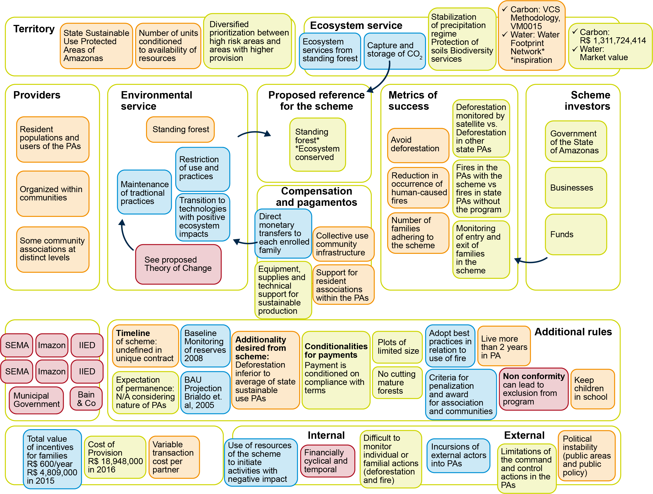
Bolsa Floresta Programme, Brazil
© Bolsa Floresta
Notes:
Brazil’s Bolsa Floresta Programme (BFP)
The BFP is a public policy, instituted by the Government of Amazonas state, Brazil, in 2007. It combines multiple streams of funding from the public and private sector to make transfers at household and community level to conserve forests and improve people’s wellbeing in sustainable development reserves in the Amazon. It combines conditional transfers and PES. To join the programme, there are conditions: riverine participants should not deforest pristine forest, should send their children to school, and should live at the reserve for at least two years.
Targeting and prioritisation. Within the BFP, areas are prioritised as follows:
identification of relevant areas, focusing on Sustainable Use Protected Area as well as the presence of potential providers (e.g. forest guardians and riverine communities, for environmental services) in the area;
Identification of critical areas where the risk of reduced provision of ecosystem services is high
Type of transfers: It involves a mix of direct cash rewards and community-based investments in income-generating activities, social empowerment and capacity building, and social infrastructure. The structure of BFP began with three components considered fundamental for quality of income: community infrastructure, cash reward, and community empowerment. After 2008, following a series of workshops and consultations, the programme was re-organised, with additional components aimed at promoting sustainable income, supporting grassroots organisations and social investments (education, transportation, health, and communication).
The programme’s theory of change is based on four points:
Intermediate results that should be achieved by the providers in terms of changes in practices,
Direct results anticipated from rewards foreseen in the scheme;
Complementary actions to be realized by the leader of the scheme or partners; and
Complementary actions outside the governability of the scheme.

Slide 19



Tools and systems for effective implementation a. PES in Costa Rica
Economy
Ecosystem services as inputs to production or for final users
Regulation:
Reduces opportunity
cost of forests,
Places protection costs
on the landholder.
Rules on rent capture:
Rules and the system to extract rents from users and polluters, and international sources.
National programme manager:
Manages and monitors systems
Local facilitators:
Provide technical and logistic support to landowners and first stop for monitoring.
Reward:
Cash payment to landowner Annual
Conditional payments helps compensate for costs of protection
Ecosystems Fund:
Collects revenues from multiple sources
Provides financial sustainability
Notes:
Tools and systems can include different types of:
Prohibition
Institutions and tools
Rewards
We can examine these in three case studies from Costa Rica, South America and East Africa (Uganda and Kenya).
The basis of the Costa Rica PES programme
Financial sustainability is assured by drawing on fuel tax revenues, as well as by allowing the managing institutions to capture payments from direct users (make international sales, deals with local users, etc.)
Legal framework: Forest Law 7575 provides the backbone of the PES programme. It states that forest ecosystems are providers of biodiversity protection, water protection, landscape beauty and carbon sequestration and recognises that forest owners should be compensated for these services
Institutional framework to administer the programme, allows for the financial and technical groups to work together.
Political support from the highest to the lowest levels – the Programme has ‘survived’ several changes in administration and political parties
Participation of civil society has been key at all stages, and provides important feedback to the programme
Transparency and credibility from monitoring, administration, forest ‘regents’, audits, GIS, etc.
Porras et al. (2013) outline how the Costa Rica PES scheme made several changes to increase participation by smaller landowners, e.g.:
Weighting applications from small landowners higher than others
Reducing transaction costs for small landowners by providing group contracts and simplifying the contracts and the application process
Including asset-building activities like agroforestry and reforestation in addition to the original focus on use-constraining activities like forest protection

Slide 20
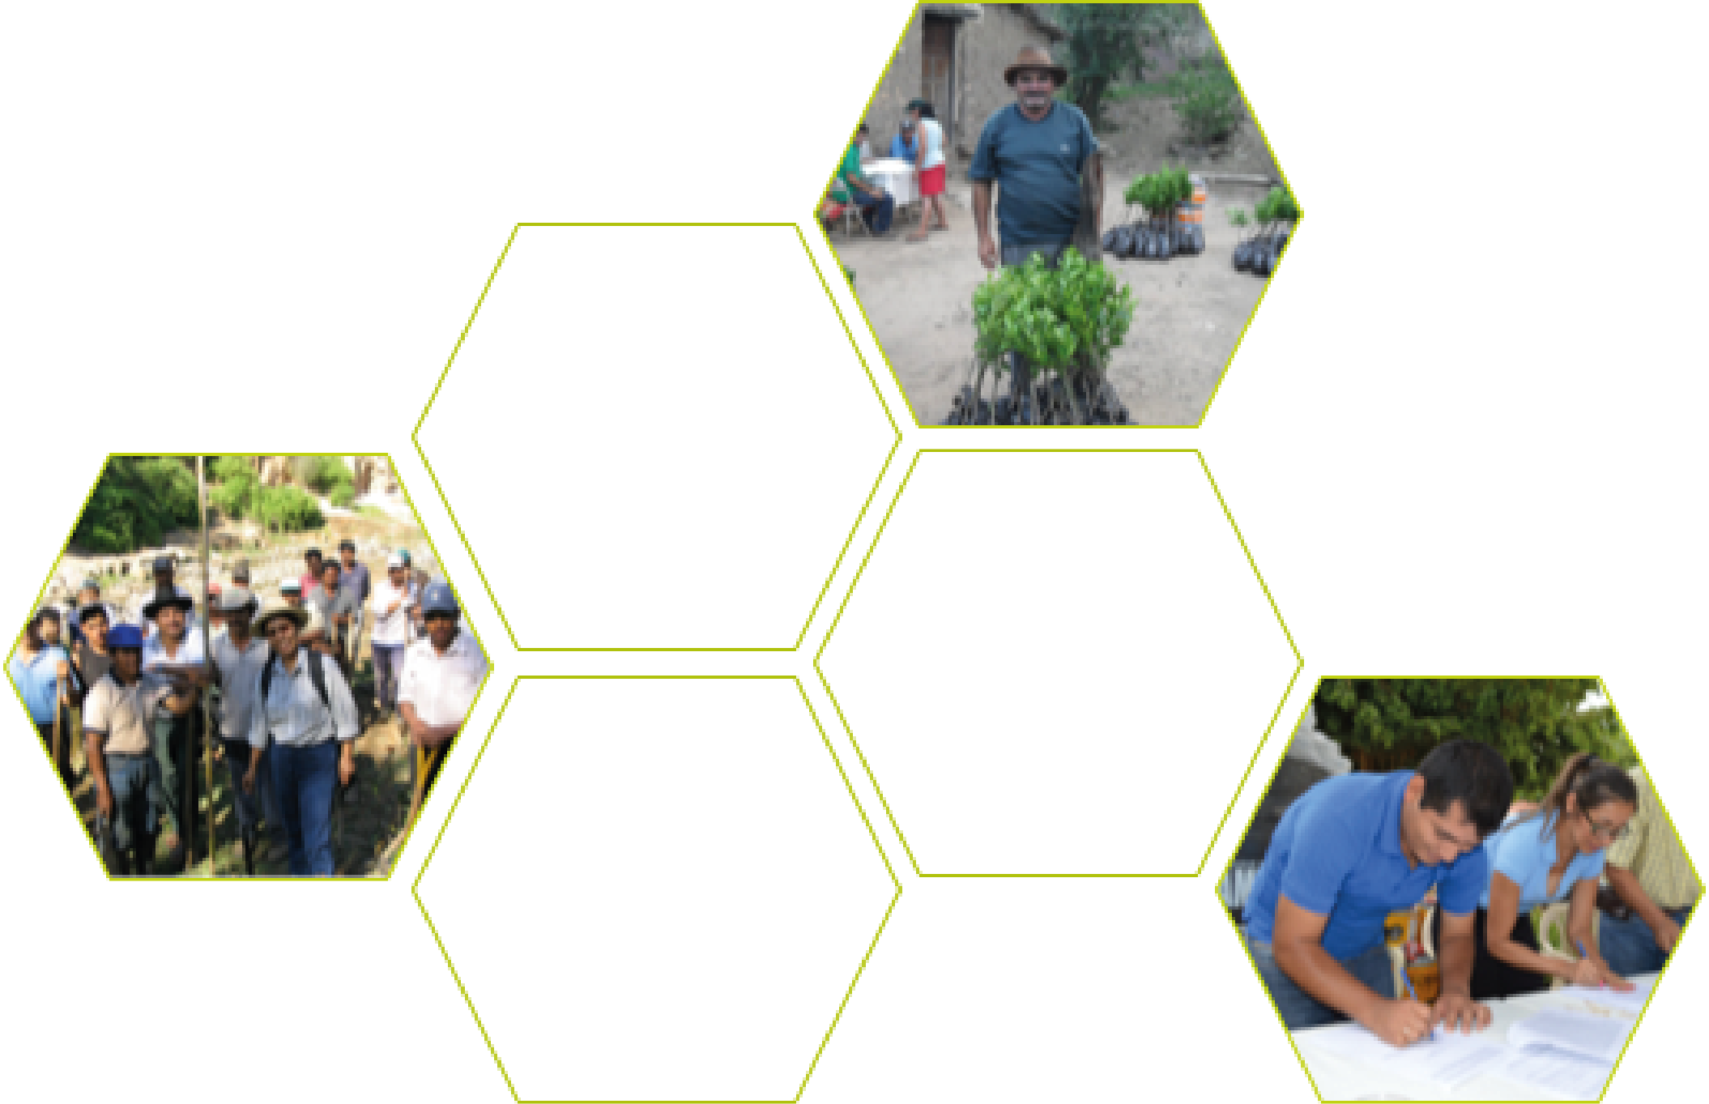
b. Watershared, South America
Rewards: Selection criteria are a simple mix of hydrological rules of thumb, conservation priorities and downstream requirements, with light-touch monitoring.
Upstream communities provide and
protect water
quality and
quantity
Downstream
local fund: commitment to local, long-term financing
Conflict
resolution by talking, raising awareness and small reward
Water
Conflict:
Solutions reached
by negotiation
Rewards are social recognitions of mutually beneficial deals
Institutions and tools:
Water utilities
Municipal governments
NGO (Natura)
Notes:
The principles of a Watershared agreement
The development NGO, the Municipal Government and the Water Cooperative each invest in – and play a decision-making role in – the Water Fund.
The three-institution board of the Water Fund decides annually how money will be spent: in annual payments, in-kind support, land purchases, etc. These compensation payments are paid to upstream landowners, who in turn sign contracts to guarantee land use, and (supposedly) provision of the water service.
Conflict resolution is by negotiation, not prohibition or regulation.
The system is financially sustainable with long-term downstream contributions, supported by NGO/donor contributions.
Positive rewards act as social recognitions of the mutual benefits of upstream protection. The activities and target areas follow simple, clear guidelines to understand hydrological linkages.

Slide 21
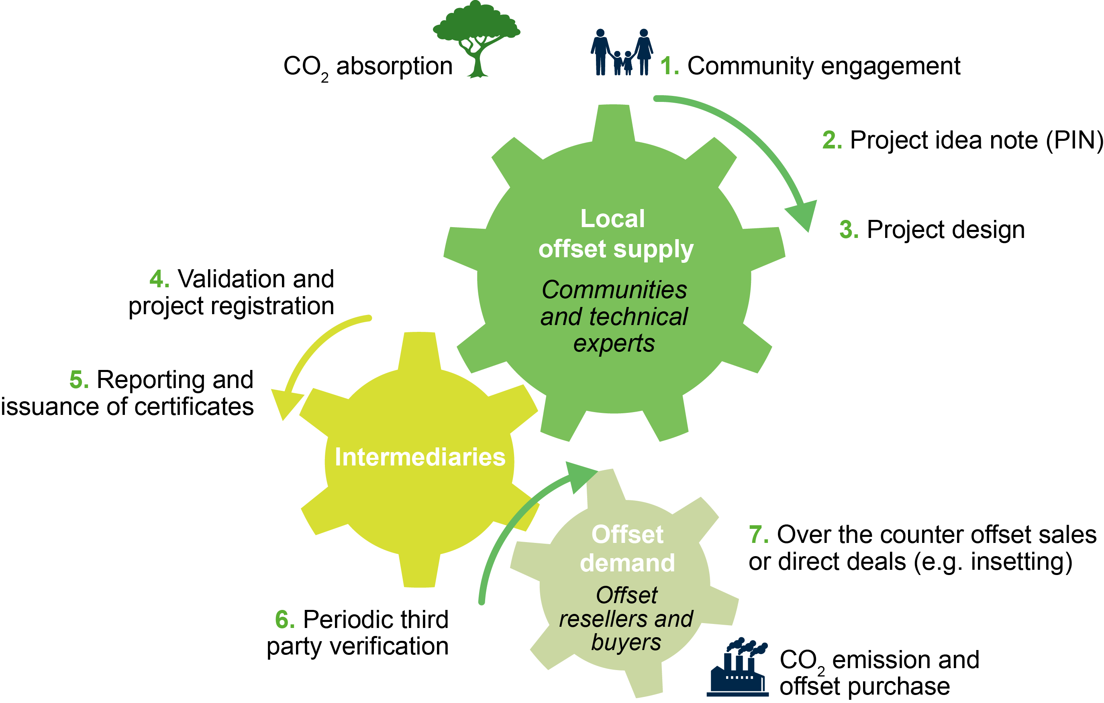
c. Smallholder carbon offset chains in Kenya and Uganda
Notes:
Plan Vivo carbon offset projects in Kenya and Uganda
Any growing tree can fix and reduce carbon emissions. But it takes a series of extra steps to make this action into a commodity that can be traded in carbon markets:
1 and 2: A project developer works with smallholders, communities and supporting agencies to develop a project idea note (PIN).
3 and 4: The PIN is is submitted to Plan Vivo where it is initially checked against the eligibility criteria set out by the Plan Vivo Standard. Amongst other key aspects, the Plan Vivo Standard has a particular focus on whether the project secures land tenure or carbon rights for participating communities and uses native or naturalised species in its project activities.
5: Through the submission of annual reports, projects can demonstrate compliance with their project design and monitoring targets, which will lead to the issuing of valid carbon certificates.
6: Regular third-party evaluation takes place to ensure the validity and permanence of carbon sequestration rates and that the proper dispersal of funds to communities in an equitable benefit sharing that is fair and transparent.
7. The project developer is able to sell the certificates in voluntary carbon markets.

Slide 22



Ability to demonstrate impact: monitoring
Voluntary carbon offset
buyers
 | Farmers | Project developers | Independent standards | Buyers
Who are they? | Heterogeneous. Seek added value to agriculture. Carbon-generating activities must combine with existing farming activities. Commitment: long-term to access project | Absorb risk of price volatility. Carbon as single activity or part of portfolio. Must comply with requirements. Manager and seller. | Standardisation of carbon as over-the-counter commodity. Establish criteria to provide credibility. | Offsets as compliance or CSR. Heterogeneous and not grouped. Individuals or companies. Respond to shareholder and public pressure.
Link to M&E | Useful feedback on the quality of their activities but may divert from other activities. Helps understand when they may be at risk of default and why. | Legitimacy to access international markets but need to keep transaction costs down. | Trust that is reflected in market share. | Trust re. legitimacy of transaction is reflected in prices and repeat purchases.
Notes:
Continuing our Africa examples….
Monitoring and evaluation (M&E) becomes the tool by which projects prove the existence of a carbon offset and its co-benefits. International certification bodies such as the Plan Vivo Foundation or the Gold Standard act as independent agents that ensure transparency and credibility of these transactions. Monitoring is important along the chain for several reasons:
For farmers, it checks compliance of agreed activities, and provides useful feedback to them on the quality of their activities – for example, how well their trees are growing.
For project managers, it helps align incentives and triggers payments.
For transferring technology, capacity and feedback related to the activities promoted from project developers to farmers, creating a wider community of practice and sharing lessons and strategies with other smallholder projects.
For validating assumptions for model development.
For supporting transparency and credibility for buyers to foster sales.
Community monitoring plays an important role in REDD+ projects in monitoring carbon stocks. For example, communities can provide a large workforce to facilitate collection of large amounts of data at large scales; they can bring their local skills and knowledge to complement expertise and they can provide ecological data where there are gaps in academic studies. The cost of hiring local labour is, for the most part, relatively cheap.

Slide 23
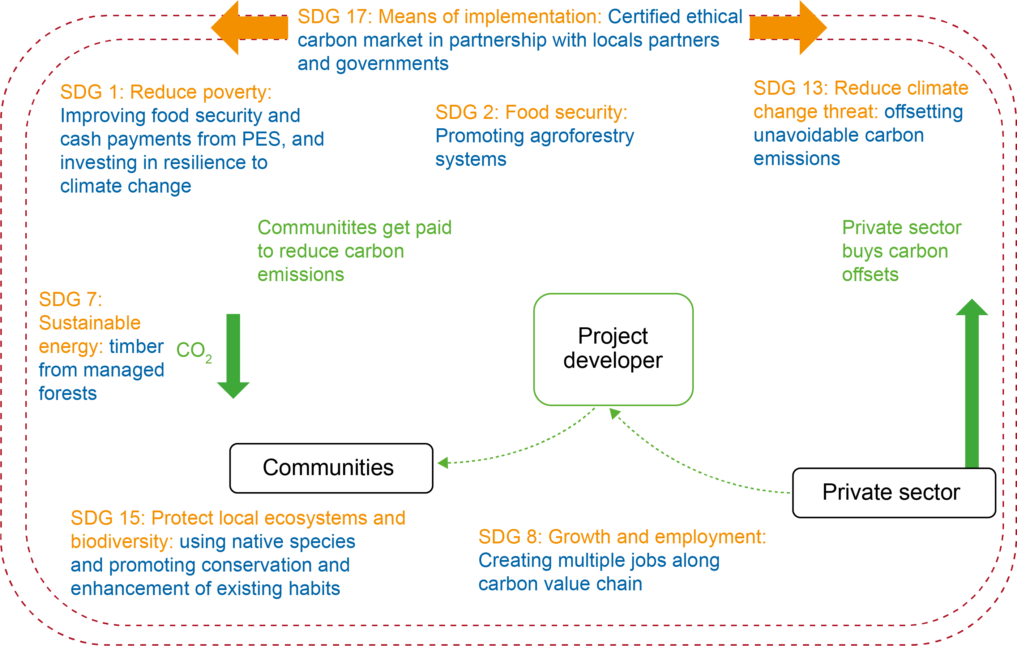





Ability to demonstrate impact: ethical smallholder carbon and Plan Vivo
CSR
Source: Porras 2015
Notes:
The Sustainable Development Goals (SDGs) are a universal set of targets and indicators which UN member states are expected to incorporate into their agendas and political policies by 2030. They include a commitment to end poverty and hunger, improve health and education, make cities more sustainable, combat climate change and protect oceans and forests. The investment required will run into trillions of US dollars. This will mean forming partnerships across the whole spectrum of society: government, the private sector, international and local NGOs, and communities.
The mutually beneficial, ethical partnerships promoted by Plan Vivo are well placed to support the implementation of at least seven of the SDGs, as shown on the slide.

Slide 24
Ensuring that PES schemes are pro-poor and equitable (Menton and Bennett 2018)
Context: Account for locally specific contextual dimensions (e.g. politics, institutions, pre-existing policies)
Language: Be specific about the precise nature of the PES scheme, e.g. desired behavioural change, degree of conditionality, type and scale of incentives,
Equitable outcomes: Consider pro-poor and equity-based objectives as central tenets from the outset.
Power matters: Recognise and explicitly address local power dynamics which can influence land management decisions and determine who benefits from PES schemes
Notes:
Menton and Bennett (2018) discuss some of the concerns in the literature about PES, and provide this summary of lessons learned for ensuring that PES schemes are pro-poor:
Context: Rather than apply generic blue-prints, it is important to work with existing institutions in order to design locally adapted PES but also recognise how existing power structures and social norms embedded within those institutions can influence pro-poor/equity outcomes.
Language: ‘PES’ is used as an umbrella terms for so many different types of interventions that it is easy for stakeholders to speak at cross-purposes. It is very important to clarify objectives in relation to social and environmental outcomes, particularly for the poorest and most marginalised.
Equitable outcomes: Projects must address both direct and indirect impacts on the poorest, e.g. are poor land owners able to participate? Do they need formal land tenure? Are the transaction costs of participating too high? Are the payments sufficient to overcome the opportunity costs (of the required behaviour change)?
Power matters: To achieve long-term sustainability and local legitimacy, PES schemes must recognise and address the roles of both informal and formal institutions in influencing how ecosystems are managed and who can access and benefit from PES schemes.

Slide 25
In summary
Ecosystem services can have different values (monetary and non-monetary) to different people
PES schemes are a market-based form of environmental governance to make conservation more attractive
Both CT and PES schemes aim to change behaviour by providing direct, conditional incentives. CT focuses more on social protection, PES focuses more on environmental aims
Enabling conditions for PES schemes include political support, sustainable financing, effective institutions, efficient implementation, and the ability to demonstrate impact
To be pro-poor, PES schemes need to make this a central objective from the start

Slide 26
References
Key readings
Engel, S., Pagiola, S. and Wunder, S. (2008) Designing payments for environmental services in theory and practice: an overview of the issues. Ecological Economics 65: 663-675.
Menton, M. and Bennett,A. (2018) PES: Payments for ecosystem services and poverty alleviation? Chapter 12 in: Schreckenberg, K., Mace, G. and Poudyal, M. (eds), Ecosystem services and poverty alleviation: Trade-offs and governance. Routledge, Abingdon.
Porras, I. and Asquith, N. (2018) Scaling-up conditional transfers for environmental protection and poverty alleviation. Chapter 13 in: Schreckenberg, K., Mace, G. and Poudyal, M. (eds), Ecosystem services and poverty alleviation: Trade-offs and governance. Routledge, Abingdon.
Wunder, S. (2005) Payments for environmental services: some nuts and bolts. Occasional Paper No. 42. Bogor: CIFOR.
Other readings
Pagiola, S. and Platais, G. (2007) Payments for Environmental Services: From Theory to Practice. World Bank, Washington DC.
Porras, I. (2015) The Plan Vivo proposal towards the Sustainable Development Goals. Concept note. IIED, London.
UK National Ecosystem Assessment (2011) The UK National Ecosystem Assessment Technical Report. UNEP-WCMC, Cambridge.
Notes:
References cited in the speakers’ notes:
Asquith, N. and Wunder, S. (2008) Payments for watershed services: the Bellagio Conversations. IIED, London.
Porras, I., Barton, D.N, Miranda, M. and Chacón-Cascante, A. (2013) Learning from 20 years of Payments for Ecosystem Services in Costa Rica. IIED, London. Available at http://pubs.iied.org/16514IIED/
Porras, I., Steele, P. and Essam, Y.M. (2016) Upscaling solutions: The role of conditional transfers for poverty reduction and ecosystem management. IIED, London.
Porras, I. et al. (2017) Policy workshop: Conditional transfers for poverty reduction and ecosystem management. Cambridge, UK.
Schröter, M. et al. (2014) Ecosystem services as a contested concept: A synthesis of critique and counter-arguments. Conservation Letters 7: 514-523.
Wunder, S. (2015) Revisiting the concept of payments for environmental services. Ecological Economics, 117: 234-243.
For more training materials and case studies on PES and CTs, go to:
Porras, I. and Asquith, N. (eds) (2018) Ecosystems, poverty alleviation and conditional transfers. IIED, London. Available at: http://pubs.iied.org/16639IIED/
Many case studies from different countries available at: https://www.iied.org/conditional-transfers-for-poverty-reduction-ecosystem-management

Slide 27
Guided reading
Please read:
Poudyal, M. (2017) Ensuring participatory and pro-poor Payment for Ecosystem Services (PES) schemes: Insights from ESPA research. ESPA Policy and Practice Briefing, April 2017. Available at: https://www.espa.ac.uk/files/espa/ESPA PES Brief.pdf
Kovacs, E.K. et al. (2016) The politics of negotiation and implementation: A reciprocal water access agreement in the Himalayan foothills, India. Ecology and Society, 21(2):37. https://doi.org/10.5751/ES-08462-210237
Hejnowicz, A.P., Kennedy, H., Rudd, M.A. and Huxham, M.R. (2015) Harnessing the climate mitigation, conservation and poverty alleviation potential of seagrasses: prospects for developing blue carbon initiatives and payment for ecosystem service programmes. Frontiers in Marine Science 2, 32. doi: 10.3389/fmars.2015.00032
Questions for discussion:
Considering the challenges and evidence outlined in these readings relating to the implementation of Payment for Ecosystem Services schemes that also include poverty alleviation objectives, outline the key elements that you would need to consider in designing a national PES policy for your own country.
What are the key challenges for implementing PES in your country context and how could these be overcome?
How would you make a national PES policy for your country inclusive and equitable?

