Slide 1
Ecosystem Services:
Equity and Justice
Topic 07
© Steven Greenberg

Slide 2
Learning outcomes
Explain the need for an equity approach in the context of ecosystem services
Define the components of equity and justice as they relate to ecosystem services and poverty alleviation
Apply the concept of equity in the context of protected areas
Notes:
In particular we will look at some of the issues surrounding recognition of marginalised communities and the challenges of achieving effective participation in decision-making.

Slide 3
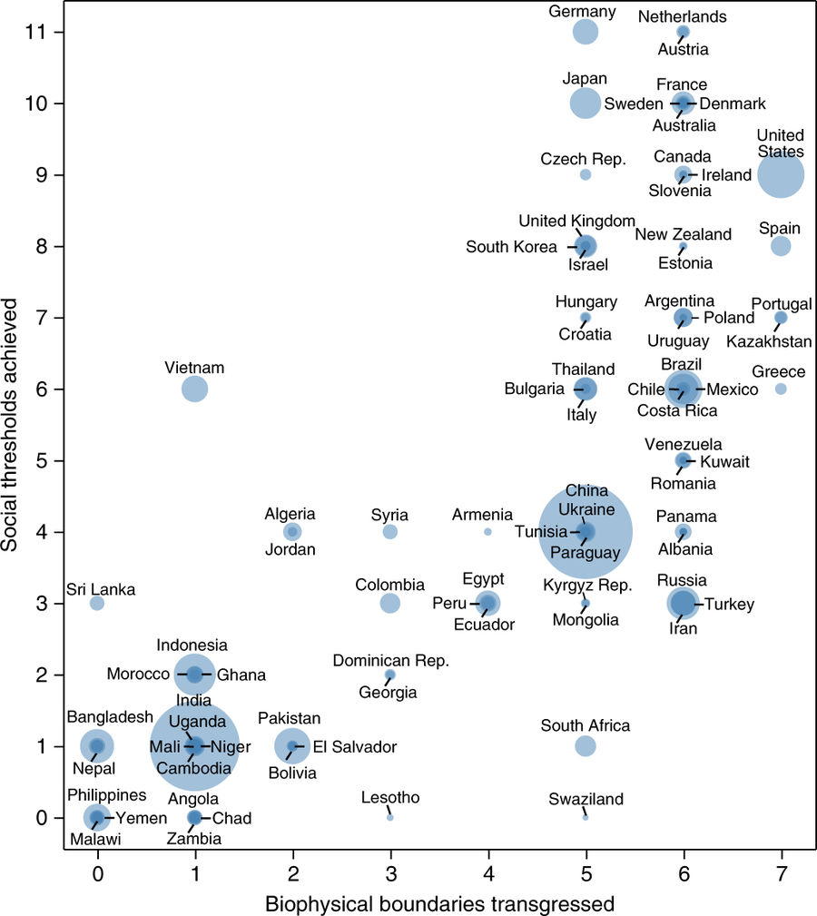
Why is equity important in Ecosystem Services for Poverty Alleviation?
Ecosystem services play a significant role in human wellbeing – but benefits are not always distributed fairly
  ‘Safe and just operating space’ (Dearing et al. 2014)
Ecosystem-based interventions create justices and injustices (Sikor 2013)
Need to think about who benefits, where, how, and who may be worse off.
O’Neill et al. (2018)
Reprinted by permission from Springer Customer Service Centre GmbH: Springer Nature,
Nature Sustainability, 'A good life for all within planetary boundaries', Daniel W. O'Neill,
Andrew L. Fanning, William F. Lamb, Julia K. Steinberger © 2018
Notes:
As we saw in Topic 3, the planetary boundaries concept combined with Kate Raworth’s ‘doughnut’ defines a ‘safe AND just operating space for humanity’ (Dearing et al. 2014). O’Neill et al. (2018) have calculated how well different countries are doing in terms of meeting the social threshold, and how badly they are doing in terms of overstepping ‘their share’ of the biophysical boundaries. The graph shows that Malawi scores zero on both counts while most OECD countries score very highly on both axes.
This recognises that some people have already developed well beyond their ‘fair share’ of the planet’s resources while many people haven’t yet reached the basic for survival.
Ecosystem service-based interventions simultaneously create justices and injustices for different groups of people, including impacts on the rights and basic needs of some of the poorest and most vulnerable people on the planet (Sikor 2013)
Ecosystem service frameworks have been criticised for targeting improvements in aggregate human wellbeing and overlooking precisely which people benefit, where, in what ways, and who may be made worse off and how (Lele et al. 2013).
A growing interest in addressing the complex interrelations between social and ecological systems reveals the diverse ways in which people are affected by ecosystem services (and disservices) and the importance of political factors in mediating whether and how different groups benefit (Fisher et al. 2014).
This enhanced picture of the ways in which governance affects different people’s wellbeing, and the types of trade-offs which result, reveal the need to approach ecosystem governance as a matter of justice.

Slide 4
Environmental justice movement
(Schlosberg 2013)
Grass-roots movement rooted in the US civil rights movement; narrow focus on environmental ‘bads’ soon gave way to progress in 3 areas:
  Redefining ‘environment’ from wilderness to ‘where we live, work and play’
  Unpacking underlying causes of environmental injustice, e.g. racism, poverty
  Pluralistic definition of environmental justice as combing distribution, recognition and procedure
Vertical expansion, e.g. environmental justice used as an organising principle by food security, and indigenous rights global movements
Concerns framed in both individual and collective senses
Recognition of impacts of humans on the environment
Notes:
The environmental justice movement started in the US, very much focused on urban areas where poor, often African-American, communities found that they were suffering disproportionately from the environmental externalities (pollution) of industry.

Slide 5
What are justice and equity?
Difficult to find any clear or agreed definition
Both terms imply fair treatment:
  By an impartial person/body
  with no self-interest in the matter
‘Equity’ is favoured in policy circles
  Mentioned many times in the SDGs
  and in the CBD targets
‘Justice’ is favoured by social movements
Notes:
Fairness and the lack of self-interest are also emphasised in the Oxford English Dictionary (2010) definition of equity as ‘‘the quality of being equal or fair; fairness, impartiality; even-handed dealing’’
‘Equity’ is referred to many times in the SDGs, also in the CBD Aichi targets whereas ‘justice’ is rarely mentioned. It seems that the term ‘equity’ is more palatable in policy circles. However, in this session, unless otherwise stated, we use the terms interchangeably.

Slide 6

Are poverty alleviation and equity the same?
Does the intervention change:
The size of the pizza?
The size of the slices for different people?
The topping on the pizza?
Risks – do you:
Protect pizza
Or protect slice?
Notes:
Can we assume that interventions to achieve poverty alleviation will necessarily be equitable?
Any intervention could have multiple impacts. Think of it as a pizza:
Does the intervention increase or decrease the size of the pizza? Even if the pizza is increased (e.g. GDP increases overall), the share going to the poor may not change, so their relative poverty is still the same.
Alternatively, the project could make everyone worse off (the pizza shrinks), but improve equity by reducing wealth disparities (more equally sized slices).
Lastly, the intervention could change the topping on the pizza to something that some people really don’t like or can’t eat.
For example, in Nepal community forestry, the initial approach to sharing the products from the forest was that they should be equally shared, However, it turned out that some people did not need as much firewood as others because they had trees on their own land. Similarly, in those user groups where timber was a product, some users did not need timber (or did not have the equipment to harvest it and take it back to their houses), but preferred a cash income. User groups therefore had to come up with more differentiated approaches which recognised the different wellbeing needs of different social groups and provided them with access to the appropriate products, while still maintaining a fair approach overall.

Slide 7
Interventions should have clear equity goals
(McDermott et al. 2013)
What are the (explicit/implicit) equity-related goals?
  maximize equity
  advance equity (e.g. fair trade)
  do no harm
  equity impacts not under consideration?
Equity and poverty do not necessarily co-vary
  Some initiatives can alleviate poverty (by raising aggregate income) while increasing inequity (excluding landless)
Equity highlights the distribution of power & resources underlying poverty
Notes:
Initiatives that change the value of ecosystem services directly or indirectly may have explicitly articulated equity goals or none at all
Setting the equity goals of a policy, project or initiative makes it possible to design systems to monitor progress towards achieving those goals.
These may be non-existent (i.e., equity is not considered) or they may aim to maximise equity, improve it or merely ‘do no harm
Failure to set goals with respect to equity
Leaves implicit equity goals unexamined, and precludes the consideration of equity standards or targets.
Thwarts the monitoring and evaluation of such impacts.
Disguises instances where trade-offs are required along multiple dimensions or scales of equity.
Closes off the possibility for the ‘subjects’ of equity to participate in formulating the objectives of interventions affecting their lives.
As highlighted in the previous slide, equity and poverty do not necessarily covary.
For instance, REDD+/PES interventions may benefit the moderately poor, e.g. by providing tree seedlings, but leave out the poorest, i.e. those without land to plant them on (Peskett et al. 2011).
Equity is an important consideration because it highlights the distribution of power & resources that underlie poverty.

Slide 8
The three dimensions of equity and justice

Slide 9
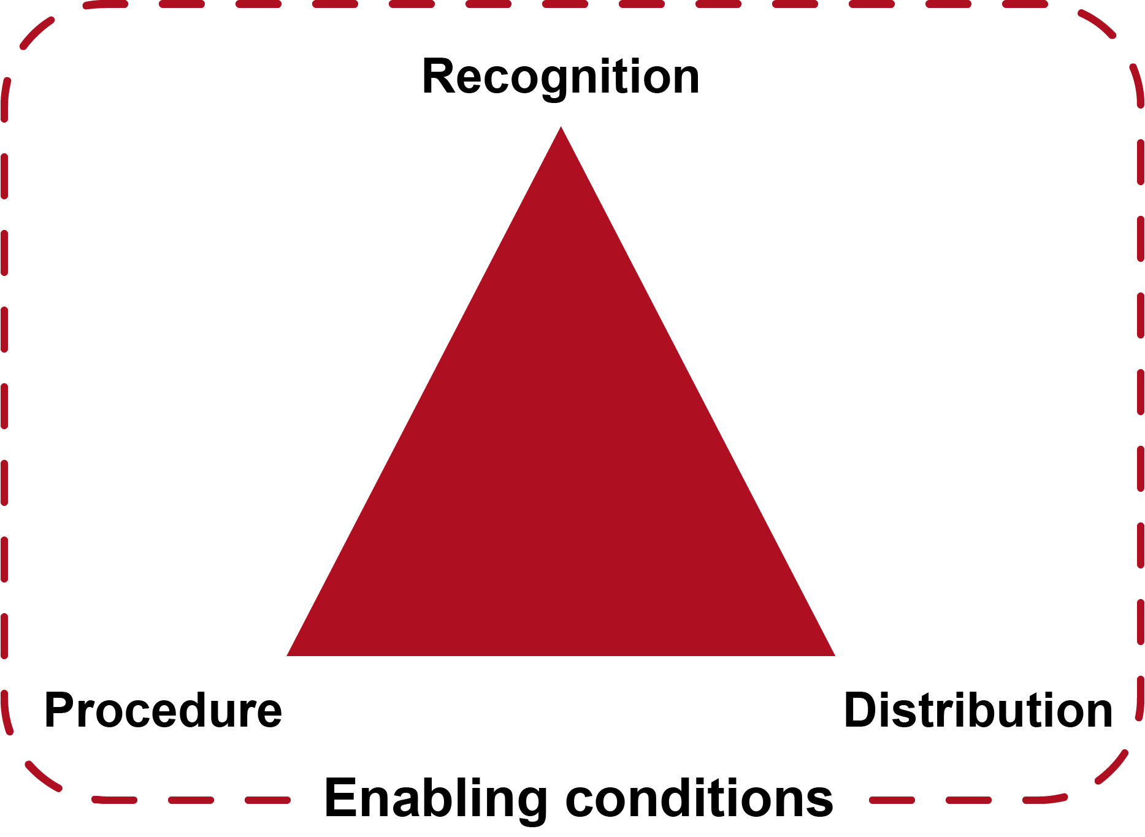
Three dimensions of equity and justice
(Schreckenberg et al. 2016)
© Schreckenberg et al. 2016, IUCNparksjournal
Notes:
The three dimensions are inextricably linked.
In this diagram, there is also a set of ‘enabling conditions to recognise the fact that some factors that affect equity at local levels may not be within the remit of local-level decision-makers to change.
We will come back to this.

Slide 10
Recognition
Recognition revolves around the status afforded to different social and cultural values or identities and to the social groups who hold them (Martin et al. 2016)
Who gets to have a say?
Relates to growing interest in rights-based approaches to governance of land and resources
Particularly important to ensure that marginalised people have a voice
Notes:
There is growing interest in rights-based approaches to governance where wellbeing, equity and rights are central considerations in the design and implementation of interventions
Research on justice and equity suggests that whatever institutional approach is pursued for the governance of land and resources it is critical that it be situated in a broader understanding of the distribution of power and resources across multiple social scales (McDermott et al. 2013; Sikor 2013; see also Dawson et al. 2018).
Rights-based governance cannot eliminate all trade-offs but can ensure that all interventions identify and respect the rights of all affected actors.

Slide 11
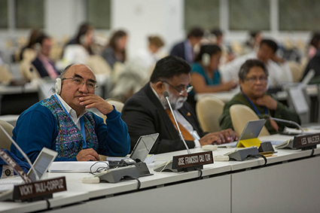
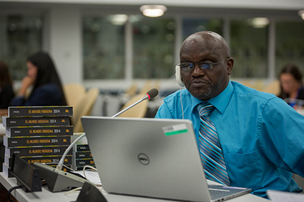
UN Declaration of the Rights of Indigenous Peoples (2007)
UNDRIP Article 33:
Indigenous peoples have the right to determine their own identity or membership in accordance with their customs and traditions. This does not impair the right of indigenous individuals to obtain citizenship of the States in which they live.
Indigenous peoples have the right to determine the structures and to select the membership of their institutions in accordance with their own procedures.
A movement of ‘culturally distinct’ non-Western societies: about 370million people.
© Global Coordinating Group
© Global Coordinating Group
Notes:
UNDRIP 2007. No universally adopted definition of ‘indigenous people’. A single definition will inevitably be either over- or under-inclusive, making sense in some societies but not in others. Debate over whether Africans are all indigenous (easier to see difference between indigenous peoples in America and colonisers)
Working definitions of indigenous peoples:
By Jose R. Martinez Cobo (http://indigenouspeoples.nl/indigenous-peoples/definition-indigenous)
Indigenous communities, peoples and nations are those which, having a historical continuity with pre-invasion and pre-colonial societies that developed on their territories, consider themselves distinct from other sectors of the societies now prevailing on those territories, or parts of them. They form at present non-dominant sectors of society and are determined to preserve, develop and transmit to future generations their ancestral territories, and their ethnic identity, as the basis of their continued existence as peoples, in accordance with their own cultural patterns, social institutions and legal system.
By R. Niezen: ‘Their territories are imposed upon by extractive industries; their beliefs and rituals imposed upon by those who would convert them; and their independence is imposed upon by states striving for social and political control. They are those people whose position in the modern world is least tenable’. (Niezen 2003:5)

Slide 12
UNDRIP and resource rights
Articles 25-32 all deal with rights to land and resources
Indigenous peoples have the right to own and develop their land and resources. Governments will take action to respect indigenous peoples’ laws and traditions in non-indigenous legal systems.
Free, Prior and Informed Consent (FPIC) required prior to:
Any relocation of indigenous people (article 10)
Approval of any project affecting their lands or territories and other resources, particularly in connection with the development, utilisation or exploitation of mineral, water or other resources (article 32).
Notes:
UNDRIP insists that: Indigenous people must be consulted before development occurs on their land, and compensated. They should not be relocated. There should be no military action on their land without consent. Governments should protect their rights.
FPIC is specifically required in relation to interventions that might affect Indigenous peoples, but is also increasingly being applied where interventions affect local communities who do not self-define as indigenous.

Slide 13
Free, Prior and Informed Consent
(Edwards et al. 2012)
FPIC is about indigenous communities and local people having a specific right to determine their own development that others should respect. It is a collective right.
Free from force, intimidation, coercion, or pressure by anyone (government, company or organisation).
Prior implies that consent has been sought sufficiently in advance of authorisation of any project. Communities must have enough time to consider all information
Informed – the community must be given all the relevant information to make its decision about whether or not to agree to the project.
Consent – local communities must be allowed to say Yes or No to the project, according to the decision-making process of their choice.
  [Note that Consent is interpreted as Consultation by some]
Notes:
FPIC is about indigenous communities and local people having a specific right that others should respect. It is a collective right. This means a community as a whole has the right to give or deny its Free, Prior, and Informed Consent.
FPIC is not participatory engagement, neither is it consultations, nor negotiations. Rather, these are just means and tools through which FPIC can be achieved.
FPIC is an important social safeguard for mining and infrastructure projects, especially in the context of protecting indigenous peoples’ rights and territories. It has also been introduced in the forestry sector, through international forest certification processes.
However, some challenges exist:
The World Bank and other main financial lenders interpret the ‘C’ as meaning Consultation. Their argument is that democratically elected governments represent all their people, so no single group should have the right to prevent development the govt considers appropriate for the country.
It is relatively easy for those making and implementing policy to focus on FPIC as an instrumental process. However, if contextual factors that influence meaningful participation are ignored, such a focus can serve simply to legitimize inequitable power dynamics and outcomes. (Mahanty and McDermott 2013)

Slide 14
Recognition – who counts as a subject of equity?
Target: Specify who counts as a subject of justice
Scale: Specify social and temporal scale
  Individual
  Household
  Community
  Along value-chain
  National/international/global
  Ecosystems
  Intergenerational
Notes:
There is need to specify ‘who counts as a subject of justice?’ and at ‘what social and temporal scale should equity be assessed?’ (McDermott et al. 2013). These can include:
Individual. comparing the differential capabilities, costs, benefits, risks and opportunities experienced by individuals within larger social units, factoring in variables like gender and age.
Household. consider the extent to which households benefit or lose from distributions according to markers of social difference, such as class, caste, race, ethnicity, and occupation.
Community. Inequities between localities – e.g. rural to urban, upstream to downstream, protected to degraded, and high to low commercial value – need to be considered at this scale.
Along value chain. Ecosystem service value chains may be short and direct (e.g. upstream water producers to downstream users) or long and convoluted (e.g. tropical timber processed in China for sale as furniture in the UK). Institutional arrangements and differing levels of political and market power enable actors along value chains to benefit differentially from the process of value creation around a commodity.
(Inter)national-Global. The uneven distribution of natural resources and the historical effects of industrialisation, colonisation, extraction and trade have given rise to global inequities that give nations differential roles and power.
Ecosystems. Justice is not limited to human society, but must also embrace non-human species and/or ecosystems as a whole.
Intergenerational. The interests of future generations are fundamental to ‘sustainable development’. We need to secure ecosystem services for future generations.

Slide 15
Procedure
Procedure refers to how decisions are made and by whom, whether formal rules and processes or informal interactions, necessitating attention to unequal power relations and differential ability to assert or oppose different claims (Dawson et al. 2017).
[Who makes decisions and how?]
Fairness in political processes to:
  Allocate resources
  Resolve disputes
Consideration of power issues
Importance of governance principles: accountability, transparency, participation in decision-making
Notes:
Procedural equity refers to fairness in the political processes that allocate resources and resolve disputes.
It involves representation, recognition/ inclusion, voice and participation in decision-making
Includes the influence of power and the politic
The governance principles discussed in the previous topic are very applicable here:
Accountability for decisions made and their implementation
Transparency: Highlights the importance of what information goes into decision making, whose perspectives are represented, and whose and which values influence decision-making processes at various scales
Participation – see next slide

Slide 16
Participation
…is effectively taking part in decision-making and implementation, either directly or through legitimate representatives
Are there rules (statutory and/or customary) about participation of women and minorities?
Some international and national laws require participation
Barriers to participation:
  Vested interests that do not benefit from participation
  Lack of transparency (e.g. of time/place of meetings)
  Lack of skills to facilitate participatory processes
  Difficult logistics
  ‘Assumed’ representation
Notes:
NB Note that there are many definitions of participation. Also a huge literature on the ‘tyranny’ of participation.
Can also include participating in enforcing laws (e.g. in community forestry)
‘Assumed’ representation – do so-called representatives really consult their people and take back the consultation results?

Slide 17
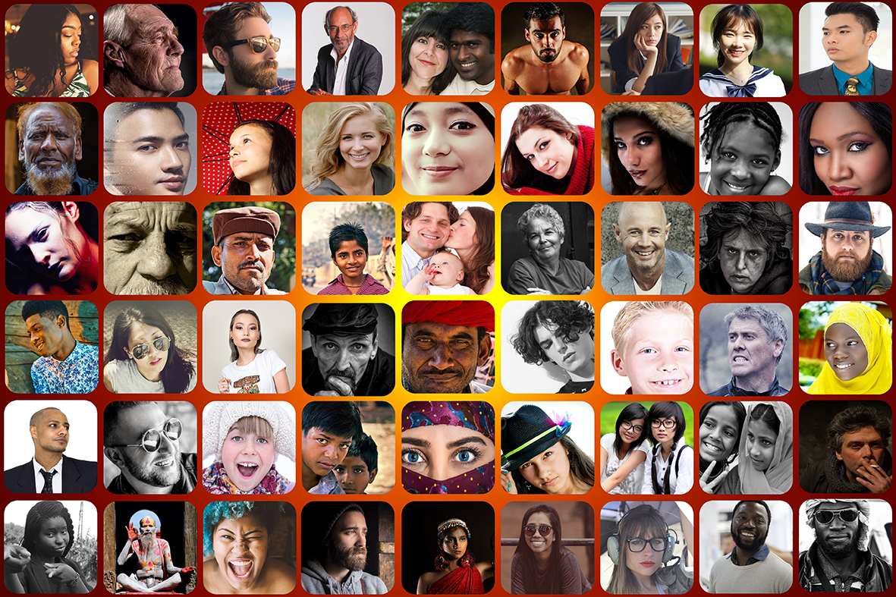
Class exercise: What is participation?
Consider the communities you are part of and think about the different ways you participate in them
Notes:
Question to students: Talk to your neighbour for 5 minutes. List the different communities you are part of and think about how you participate in them. What role do you play?
[Possible answers: communities could be anything from family to football team to university cohort to global community – and note that everybody is part of multiple communities Communities are not necessarily homogeneous unless very small and self-selected. Roles in each community could be very different: passive, leading, decision-making……]

Slide 18
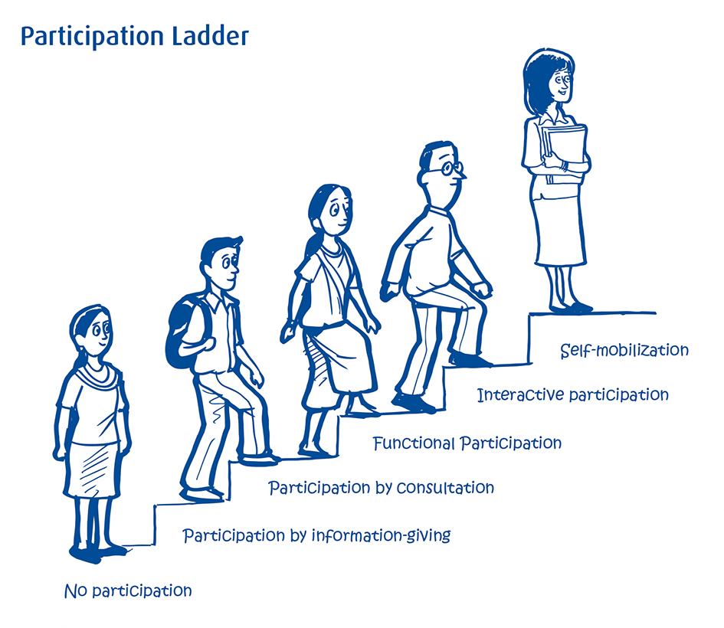
What is participation?
‘Almost anything that
involves people’?
“There is a critical difference between going through the empty ritual of participation and having the real power needed to affect the outcome of the process”
(Arnstein 1969)
© Moore et al. (2011)
Notes:
What is participation? This term is used differently by many people and can lead to false expectations of what kind of participation is actually on offer/required.
There is a big literature on what participation means in the context of development. Different people mean very different things so a typology can be helpful to ensure that we are all talking about roughly the same thing. One of the best known is the ladder of participation by Sherry Arnstein from 1969. Read paper by Andrea Cornwall (2008) for a good summary of the issues and the differences between different approaches to the ‘ladder’.
The ladder approach is normative – it suggests that more participation is good. Question to students: What does everybody think? Much depends on context and the starting point – if you have never had any kind of engagement then even consultation may be a good first step.
Cornwall (2008) outlines some of the challenges of participation:
What is full participation? ‘Wide and shallow’ versus ‘Deep and narrow’
Selection of representatives from heterogeneous groups
Who is included/excluded?
Inappropriate timing, duration or format of participation
Lack of confidence in oneself, Lack of confidence in the process
Participation fatigue
Translating involvement into voice
[Picture is from: Moore et al. (2011) and is loosely based on the ladder by Pretty et al. (2005)]

Slide 19
Barriers to women’s participation in community-based resource management (Agarwal 2010)
Membership criteria
  1 person per household? Or all adults?
Membership of executive committee
  Gender composition of executive committee (up to 30% women) is a good proxy for women’s ‘effective participation’ (attending, speaking and holding office)
Social norms that define women’s appropriate roles and behaviour
Social perceptions regarding women’s abilities
Control of community forums by men
Personal and household endowments and attributes (education and status; class and caste)
Notes:
Membership criteria can vary: one person per household is most exclusionary for women; while the most inclusive approach allows for all adults in a household to be members.
Executive committee membership shows a threshold effect. Women’s effective participation increases until the executive committee has 30% women members, and then plateaus.
Social norms – domestic chores not shared so women have no time to attend; female seclusion norms; social emphasis on self-effacement and soft speech; sitting on the floor while men sit on chairs
Abilities – women often considered to be less able, have nothing useful to say, etc
Control of community forums by men – particularly difficult if community-based resource management starts as a male activity
Personal endowments can also affect how effectively women participate.

Slide 20

Distribution
Distribution is concerned with the allocation among stakeholders of costs, risks and benefits resulting from environmental policy or resource management decisions
Are the outcomes fair?
  e.g. in terms of benefits,
  costs, risks
Are the processes for
deciding the outcomes fair?
  Q: How could you divide this cake?
© Liliana Fuchs
Notes:
When talking of equity and justice, many people focus on just one dimension and often do not proceed past a one-dimensional focus on distribution
Distributive equity is concerned with the allocation among stakeholders of costs, risks and benefits resulting from environmental policy or resource management decisions
Can be considered as the economic dimension of equity.
Equitable distribution of benefits can be justified on the basis of the outcomes, or the process.
The latter can be based on one of several different principles
Question to students: think about different principles by which you could divide up this cake. [Possible answers: equality (everybody gets the same size), rights-based (bigger slices for those with a right to a slice, perhaps only those who own the building?), merit (bigger slices for those who baked the cake or produced the ingredients) and need (bigger slices for the hungry)]
Would you be happy with unequal slices if you felt that the process of arriving at that decision was fair? This is what some research on conservation benefits has found – as long as people consider the process to be fair, they will abide by the outcomes.

Slide 21
Enabling factors
Some factors may be beyond the control of local-level decision-makers
Individual capabilities
  Education
  Political recognition
Access
  Natural resources
  Capital
  Labour
  Market networks
Power
Notes:
Enabling factors are ones that are beyond the ability of local-level decision-makers to deal with. This is relevant when one is considering local interventions, like a protected area. Protected area managers can do a lot to make processes more fair but they may not be able to overcome entrenched inequities, like discrimination against particular societal groups, or lack of capabilities by some stakeholders to participate through lack of education or political recognition.
i.e. we need to take into account the pre-existing political, economic and social conditions under which people engage in procedures and benefit distributions – and which limit or enable their capacity to do both.
It incorporates the concepts of individual capabilities (e.g. education, political recognition), access (to natural resources as well as to capital, labour, market networks, etc.) and power (to gain and maintain access to resources).

Slide 22
The challenge of achieving equity and justice

Slide 23
Barriers to implementation of equity and justice approaches (Dawson et al. 2018)
‘Justice gap’ between implementing institutions (national and international) and affected communities
  Implementation gap – good policies not implemented because of governance deficiencies, lack of capacity, knowledge, resources
  Normative gap – different ideas about what should be done and how
Unequal power between interest groups
  e.g. along value chains (community to company)
Complexity: governance approaches focus on access restrictions and financial compensation; at expense of dealing with complex issues like rights, tenure, cultural practices, participation
Notes:
The application of equity and justice approaches to ecosystem governance is a frontier with great potential impact on the practice of ecosystem governance. However, certain issues still hinder smooth application of these principles:
The ‘justice gap’: differences exist regarding the equitability of ecosystem governance, particularly between implementing institutions (at international and national levels) and the indigenous and local communities most affected. This arises for 2 reasons:
Difficulties in implementing policies negotiated at the global or state-level,
Normative differences in how ecosystems should be equitably governed
Unequal power between interest groups is a common and persistent feature of environmental management in developing countries (Sikor 2013). Examples include forest certification schemes where there are large power inequalities between international companies, timber producers, land owners and local communities which tend to reproduce the same social and environmental injustices (McDermott 2013).
Complexity: Emphasis on access restrictions and financial compensation as central elements of governance, while complex issues relating to rights, tenure, cultural practices and participation are compartmentalised and deprioritised as safeguards or principles to be addressed through technocratic exercises comprising minimal monitoring and evaluation or accountability (Sikor 2013)

Slide 24
Conclusions
Not all poverty alleviation activities are equitable.
The equity framework highlights the distributive, procedural and recognition dimensions of equity
The equity framework is useful for both planning and assessment of policies and initiatives.
Ideally, it would be used in an inclusive process in which participants at all levels from local to nation states have a say in determining a context-specific definition of equity.

Slide 25
References
Key readings
Dawson, N. et al. (2018) Justice and equity: Emerging research and policy approaches to address ecosystem service trade-offs. Chapter 2 in Schreckenberg, K., Mace, G. and Poudyal, M. (eds) Ecosystem services and poverty alleviation: Trade-offs and governance. Routledge, Abingdon.
Dearing, J. et al. (2014) Safe and just operating spaces for regional social-ecological systems. Global Environmental Change 28: 227-238.
Schlosberg, D. (2013) Theorising environmental justice: the expanding sphere of a discourse. Environmental Politics 22: 37-55.
Schreckenberg, K. et al. (2016) Unpacking equity for protected area conservation. Parks 22: 11-26.
Other readings
Agarwal, B. (2010) Gender and green governance. Oxford University Press, Oxford.
Arnstein, S. (1969) A ladder of participation. Journal of the American Institute of Planners 35: 216-224.
Dawson, N. et al. (2017) Assessing equity in protected area governance: Approaches to promote just and effective conservation. Conservation Letters 11: 1-8.
Edwards, K. et al. (2012) Putting Free, Prior, and Informed Consent into Practice in REDD+ Initiatives. A Training Manual. RECOFTC, IGES and Norad, Bangkok, Thailand.
Martin, A. et al. (2016) Justice and conservation: the need to incorporate recognition. Biological Conservation 197: 254-261.
McDermott, M. et al. (2013) Examining equity: A multidimensional framework for assessing equity in payments for ecosystem services. Environmental Science and Policy 33: 416-427.
O’Neill, D.W. et al. (2018) A good life for all within planetary boundaries.. Nature Sustainability 1: 88-95.
Sikor, T. (2013) The Justices and Injustices of Ecosystem Services. Routledge, Abingdon.
Notes:
References cited in the Speakers’ notes:
Cornwall, A. (2008) Unpacking ‘Participation’: models, meanings and practices. Community Development Journal 43: 269-283.
Fisher, J.A. et al. (2014) Understanding the relationships between ecosystem services and poverty alleviation: A conceptual framework. Ecosystem Services 7: 34-45.
Lele, S. et al. (2013) Ecosystem services: origins, contributions, pitfalls, and alternatives. Conservation and Society 11: 343-358.
Mahanty, S. and McDermott, C.L. (2013) How does Free, Prior and Informed Consent (FPIC) impact social equity? Lessons from mining and forestry and their implications for REDD+. Land Use Policy 35: 406-416.
Niezen, R. (2003) The Origins of Indigenism. University of California Press, Berkeley, CA
Peskett, L. et al. (2011) Institutional approaches for carbon financing in the forest sector: learning lessons for REDD+ from forest carbon projects in Uganda. Environmental Science and Policy 14: 216–229.

Slide 26
Case studies for further discussion
Case study E: Justice and Equity in Conservation – Understanding trade-offs in a Protected Area in Laos
Dawson, N., Martin, A. and Danielsen, F. (2018) Assessing equity in protected area governance: Approaches to promote just and effective conservation. Conservation Letters 11: 1-8.
Guided Reading: Read the following two papers
Bidaud, C. et al. (2017) The sweet and the bitter: intertwined positive and negative social impacts of a biodiversity offset. Conservation and Society 15: 1-13.
Schreckenberg, K. et al. (2016) Unpacking equity for protected area conservation. Parks 22: 11-26.
Now consider a protected area you know. Think through the principles (in the Schreckenberg et al paper) in relation to ‘your’ protected area.
Who is recognised as having a say in decision-making (consider both formal and informal power)?
What are the benefits and who are the beneficiaries?
What are the costs (or risks) and who bears them? Is there compensation?
What procedures exist for dispute resolution?
Notes:
[Please refer to the accompanying case study summaries for case study E]

