Slide 1
Land Use
Intensification
Topic 05
© Neil Dawson

Slide 2
Learning outcomes
Outline the main drivers for land use intensification
Describe different components of land use intensification
Analyse the impacts of agricultural intensification in relation to ecosystem services and human wellbeing
Notes:
In the previous topic we discussed the need to improve food security and the quality of the environment. One of the suggested approaches is land use intensification. In this topic we will discuss in detail the subject of land use intensification and its impacts on ecosystem services and poverty.

Slide 3
Increasing pressure and demands on ecosystems
Human population is expected to reach 9 billion by 2050
  Higher incomes, changing lifestyles and dietary preferences
May need a doubling of food crop production between 2005 and 2050 (Tilman et al. 2011)
  Regional variation, e.g. 150% rise in demand for cereal crops expected in Ethiopia, Ghana, Tanzania (Franks et al. 2017)
Land for production is declining in quantity and quality
Competition for land for energy, fibre, biodiversity
Notes:
In the last topic on food security we highlighted the links between Ecosystem Services, Agriculture and Human Wellbeing
As the population increases and becomes more demanding in its tastes, we need to produce more and different food.
There is a debate about just how much additional food will need to be produced (and much depends on dietary habits), but a doubling by 2050 is quoted frequently. Note that this may be very variable between countries and one study highlights the possibility of 150% rise in demand for cereal crops in several sub-Saharan African countries.
At the same time, agriculture is also expected to provide increased animal welfare and more ecosystem services, and must play a major role in producing renewable energy, including bioenergy.
These new demands will intensify competition for land around the world and will put the role of agricultural intensification at center stage.
[Students should be encouraged to question power relations and equity issues within this context – for example who / what markets is biofuel being produced for? Where is consumption taking place and what is creating this pressure?]

Slide 4
Options for dealing with these pressures
Reduce demand through behavioural change
Ensure more equitable distribution of existing production
Reduce waste
Extensification (still possible in a few areas)
Increase yields through intensification
Notes:
In order to meet the increased demand for products from land, there are a number of options:
The one that is pursued most vigorously – and which we will focus on in this session – is intensification of land use to increase yields
However, there are other options like reducing demand, or reducing waste (about 30 to 40% of food in both the developed and developing worlds is lost to waste (Godfray et al. 2010)), or ensuring that existing production is distributed more equitably.
Note also that there are still opportunities for extensification (i.e. clearing more land) in some areas – notably in Sub-Saharan Africa and Latin America.

Slide 5
What is land use intensification?

Slide 6
What is land use intensification?
(Martin et al. 2018)
“activities undertaken with the intention of enhancing the productivity or profitability per unit area of rural land use, including intensification of particular land uses as well as changes between land uses”
3 main types of land use intensification:
Land use conversion (e.g. from fallows to permanent crops)
Increased inputs (labour, irrigation, chemicals, machinery)
Crop or product change (often involving high yielding varieties, and shifts from subsistence to cash crops)
Notes:
Intensification is not a new issue.
Intensification of management of land already under agriculture, accomplished through the use of high-yielding crop varieties, chemical fertilisers and pesticides, irrigation, and mechanisation, was achieved in developing countries (particularly Asia and Latin America) under the general heading of “the Green Revolution,” which began in the 1960s with the transfer and dissemination of high-yielding seed (for a limited number of key crops – rice, maize and wheat).
Agricultural intensification includes increase in the productivity of existing land and water resources in the production of food and cash crops, livestock, forestry, and aquaculture.

Slide 7
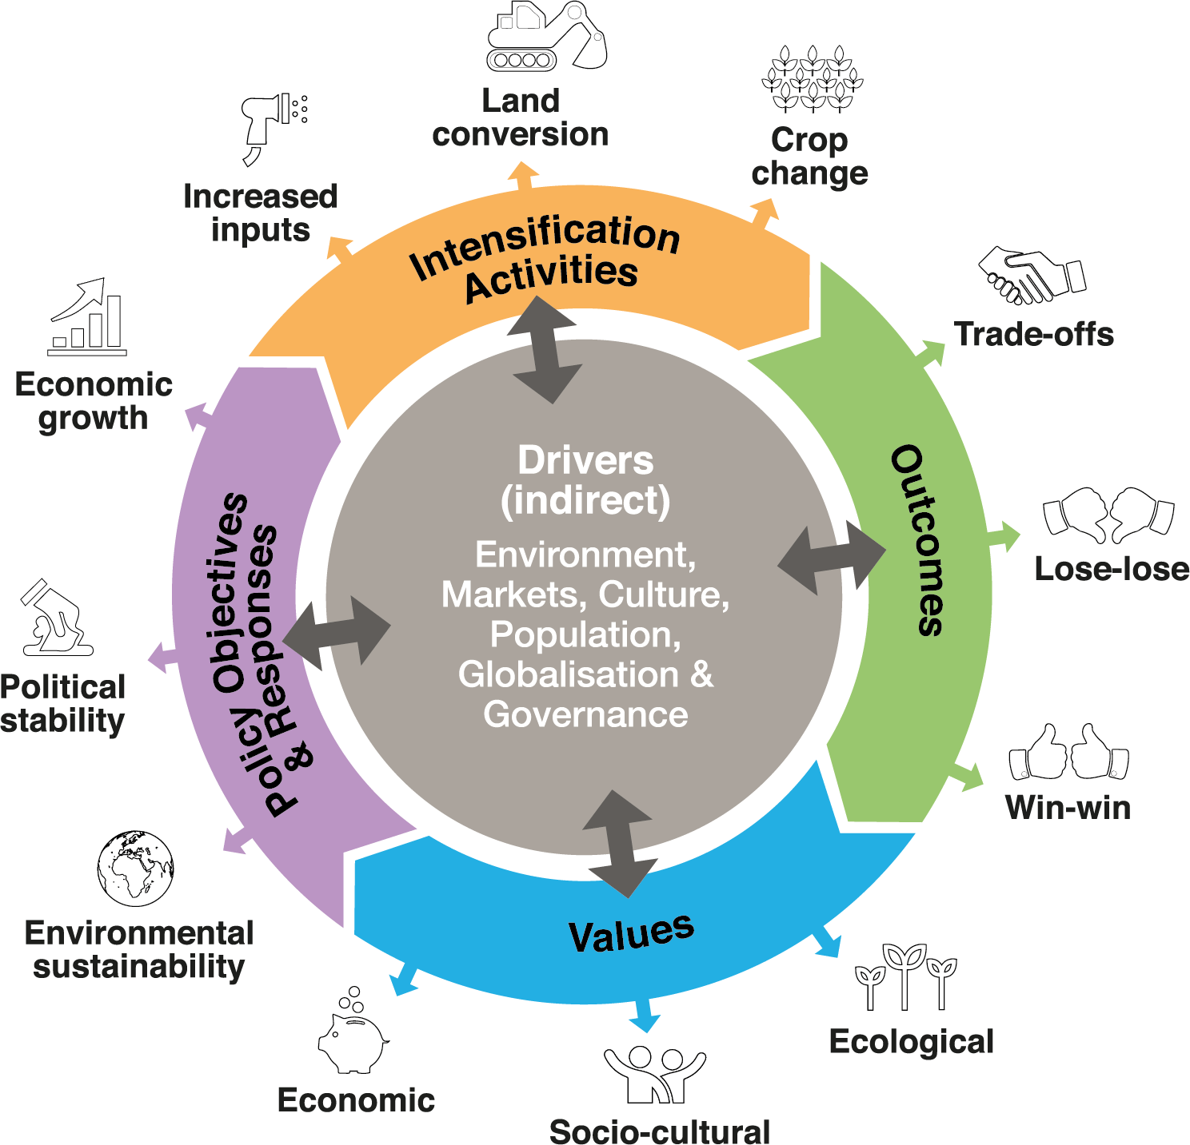
Land use intensification process
(Martin et al. 2018)
© Martin et al. 2018
Notes:
Based on a synthesis of work on land use intensification, Martin et al. (2018) identify three main types of land use intensification activity, which are driven by a mixture of local and global drivers (objectives and values). Intensification activities lead to a range of outcome pathways, broadly grouped in the diagram as win-win, lose-lose or trade-off. How the outcomes are perceived depends on people’s values (they also favour and promote certain values), and may differ between people. These also determine the policy objectives and responses which initiate intensification or respond to its outcomes.

Slide 8
Factors promoting intensification
Increased demand for outputs
Population growth, in-migration, urbanisation
Increased market demand (local to global)
Demand for higher value added outputs
Production factors
Scarcity of land, water, labour – intensified by climate change
Availability of capital, entrepreneurship (skills and knowledge)
Policies and institutions (formal and informal)
Facilitating access to credit
Land tenure and labour contracts
Notes:
Policies and Institutions determine who can access which kinds of intensification strategy:
For example, institutions may either facilitate a decision for an individual or household to intensify (for example institutional arrangements within a lineage may enable someone to borrow livestock from a lineage member to get the benefits of manure), or may make such a strategy impossible by being exclusive (for example by excluding women from being able to borrow livestock)
Land tenure system must be such that people feel secure in their decisions to invest in land
Labour contracts – formal or informal (e.g. access to community reciprocal working groups)
Access to credit
Consideration needs to be given to a) whether existing institutions encourage or discourage the process of agricultural intensification; and b) the extent to which institutions are flexible and can change sufficiently fast to facilitate changes to intensification in response to changing relative factor scarcity.
Are the driving polices local or international that are driving the shift towards intensification? And are these short or long-term in their thinking?

Slide 9
Impacts of land use intensification

Slide 10
Impacts of intensification
Social impacts (Martin et al. 2018)
Win-Win outcomes are rare: few cases alleviate poverty and protect biodiversity and ecosystem services
Complex trade-offs: benefits and losses are not evenly distributed between social groups
Poor people are less able to access benefits of land use intensification
Notes:
Recent research shows that land use intensification efforts rarely achieve the twin objectives of alleviating poverty and protecting biodiversity and ecosystem services. Intensification often involves losses to ecosystem services that allow some groups to benefit from land use change while others (for example downstream users or future users) find their livelihoods undermined.
Common trade-offs include efficiency/equity, specialisation/flexibility, profits/environmental benefits, and long-term/short-term paybacks.
A range of structural and institutional barriers, like access to land, capital and expertise, can prevent poorer people from benefiting from intensification interventions.

Slide 11
Rwandan ‘Green Revolution’ case study (Dawson et al. 2016)
2008 Crop Intensification Program (CIP) aimed to transform agriculture
Designated regions for 6 edible crop types and some cash crops, made approved seed types and subsidised fertilisers available
Local officials had targets to meet, and could impose fines or reallocate land from farmers who fail to comply
National statistics show that from 2006/7-11:
  Income-based poverty fell from 57% to 45%
  % of households using supplied seeds rose from 3% to 40%
  Fertiliser use rose from 8 to 23kg/ha
BUT 165 respondents in 8 villages in Western Rwanda:
  Perceived wellbeing to be declining (though education & health were positive)
  12% had become landless in past decade
  84% had changed the food they ate (or ate fewer meals)
  37% ceased trading edible crops
CIP disadvantaged marginalised groups because of economic barriers to comply, reduced tenure security and prohibited traditional agriculture
Notes:
This case highlights the trade-offs (or unintended consequences) that may result from policies that focus too narrowly on food security (through increased production) and don’t consider how the costs and benefits will be experienced by different social groups.
Rwanda has the highest population density in Africa, 89% of labour force is involved in agriculture.
2004 Land Policy states that all land belongs to the state and citizens hold it conditionally and it can be reallocated if they do not use it.
In conclusion – such intensification programmes are not necessarily pro-poor.

Slide 12
Environmental impacts
Catchments and water management affected
Soil disturbance and potentially increased soil erosion
Loss of landscape diversity
Negative impacts of higher fertiliser production and application (e.g. eutrophication)
Positive impacts of fertilisers leading to increased crop yields which may have reduced greenhouse gas emissions
Opportunity to set aside non-agricultural land for conservation
Notes:
The long-term sustainability and environmental consequences of the intensification of agricultural systems include local, regional and global consequences
Local: increased erosion, lower soil fertility, and reduced biodiversity
Regional: pollution of ground water and eutrophication of rivers and lakes
Global: impacts on atmospheric constituents and climate
No form of land use has had more influence on nature than agriculture, and therefore ecosystems have changed considerably as a result of agricultural intensification
Interference in water management, to regularise the water table: generally this has meant levelling off the differences between dry and wet areas and decreasing the spring floods by canalising streams and lowering the water table in areas where it used to be high.
Soil disturbance: As a result of measures like deep ploughing (disturbance of B horizons) of sandy soils, levelling the relief, etc., existing and potential spatial differences in the soil are greatly decreased. The disturbance of B horizons can destroy a perched water table. Levelling the relief often wipes out micro-differentiation in ecosystems.
The loss of soil organic matter with conversion of natural ecosystems to permanent agriculture is one of the most intensively studied and best documented ecosystem consequences of agriculture.
High fertiliser applications add significant and harmful amounts of nitrogen and phosphorus to terrestrial and aquatic ecosystems (Tilman et al. 2002)
Possible positive environmental impacts of intensification:
While emissions from fertiliser production and use increased, the net effect of higher yields prevented GHG emissions of up to 161 gigatons of carbon over 44 years (Burney et al. 2010).
Intensification may lead to sparing of non-agricultural land, which can be used for other human uses and environmental preservation, allowing more species to survive into the future (Fischer et al. 2014) [But see also slide 20]

Slide 13
Biodiversity and ecosystem service impacts
More specialised production process reduces crop and livestock species, often leading to monocultures
High-yielding varieties replace traditional crop varieties, leading to a loss of genetic diversity
Reduced plant species richness changes composition of the pest complex
Nutrient inputs and chemical applications affect the competitive balance between different soil microbes
Loss of local habitats and broader ecosystems
Reduction in number and diversity of important species like pollinators
Notes:
One key feature of agricultural intensification has been increasing specialisation in the production process, resulting in reduction in the number of crop or livestock species, or both, that are maintained, often leading to monoculture
The introduction of a limited number of high-yielding varieties results in the loss of countless traditional varieties available for natural selection and breeding, thereby increasing crop vulnerability to stresses.
Reduced plant species richness leads to changes in the community composition of the pest complex—herbivorous insects are less diverse but more abundant and can no longer be easily controlled by their natural enemies (predators and parasites)
Substantial impacts on soil nutrients and soil structure change the competitive balance between different soil microbes and invertebrates – potentially causing problems to the crops
In Europe, intensive production systems have had measurable adverse effects on farmland bird populations by reducing habitats and available food (Donald et al. 2001).
Intensification has reduced the number and diversity of native bees, thus requiring the introduction of managed species, which are now threatened in part by pesticides and disease (Kremen et al. 2002)

Slide 14
Laos case study: Land use intensification and disaggregated wellbeing outcomes
(Broegaard et al. 2017)
Land use intensification involves: (i) adoption of new cash crop (maize) in 2010, (ii) reduced fallows, (iii) increased inputs
2004-14: Poverty rates decreased from 59 20%, but food security also declined
Phon Sang village (most intensified)
  Significantly fewer wild foods including rodents
  77% of villagers did not replace lost protein through purchases
  Wild plants (valued for medicine and greens) became weeds
  Wild rodents (valued for food) became pests (of maize)
  Fallows reduced yields declined farmers took out loans to buy inputs and began to illegally clear land in the protected area
Notes:
This case shows how agricultural policies can change people’s perceptions of (and access to) various traditional ecosystem services.
The study took place in 3 villages in NE Laos, adjacent to a national protected area. Land use intensification was promoted in order to ‘save land’ for tiger conservation.
2 villages integrated the maize into their shifting cultivation system, while one (Phon Sang) adopted continuous maize cultivation.
Intensification created major changes in the social-ecological system. For example rodents were previously eaten as a protein source; after intensification rodents became a pest (of maize) and farmers were forced to apply large scale poisoning programmes rendering this source of protein lost. It was not replaced with purchased alternatives so people were nutritionally worse off.
In the longer term, therefore, it is questionable whether this intensification will be sustainable and – particularly – it is not clear that it will achieve its original aim of preventing extension of agriculture into the tigers’ territory.

Slide 15
Class exercise: Land use intensification in your environment
Talk to your neighbour and look at slide 7
Can you think of an example of each of the following intensification types in your country?
  Increased inputs
  Land conversion
  Crop change
For each example, what are:
  The main policy objectives?
  The main social and environmental outcomes? Are these different for different people?
Notes:
[You could also assign the students into groups to discuss specific land use intensification types that are common in your country and get them to report back to the class.]

Slide 16
Looking forward

Slide 17
What is sustainable intensification?
“agriculture in which yields are increased without adverse environmental impact and without the cultivation of more land”
(Royal Society 2009)
Notes:
The report by the Royal Society (2009) makes clear that there is no single way of achieving sustainable intensification.
Taking a global systems perspective, Rockström et al. (2017) define sustainable intensification as “adopting practices along the entire value chain of the global food system that meet rising needs for nutritious and healthy food through practices that build social–ecological resilience and enhance natural capital within the safe operating space of the Earth system.”

Slide 18
Characteristics of sustainable agricultural intensification
(Pretty and Bharucha 2014)
Utilises crop varieties and livestock breeds with a high ratio of productivity to use of externally and internally derived inputs;
Avoids the unnecessary use of external inputs;
Harnesses agroecological processes such as nutrient cycling, biological nitrogen fixation, allelopathy, predation and parasitism;
Minimises use of technologies or practices that have adverse impacts on the environment and human health;
Makes productive use of human capital (knowledge and capacity to adapt) and of social capital to resolve landscape-scale issues
Minimises the impacts of system management on externalities such as GHG emissions, clean water, carbon sequestration, biodiversity, and dispersal of pests, pathogens and weeds.
Notes:
Based on holistic systems approaches. an understanding of the interrelationships between environmental, social and economic factors. For example, introduction of a new production system or an innovation in an established system will often require attention to the policy environment, agroecology, market systems, social system (including how gender and social group influence the division of labour and access to resources), and the farm/household economy. In addition, marketing, supply chains, and a wide range of stakeholders are part of the holistic approach required for sustainable agricultural systems
Environmentally sound. neither depleting the natural resource base on which they depend nor contributing significantly to the depletion of downstream resources; reduce soil erosion and land degradation, avoid loss of biodiversity, and improve the efficiency of land and water resource use.
Equitably shared by all gender and minority groups. socially sustainable only when all members of society share in the benefits.
Built on knowledge-intensive innovations. strong understanding of the system and its components. “Precision farming” systems will help apply the knowledge to field-level production.
Sensitive to social change. sound social analysis should be included in agricultural intensification.
Targeted to specific production environments. designed within the context of established agricultural systems and the level of technology, resource availability, and market opportunities in the area.

Slide 19
Interventions for sustainable agroecosystems
(Pretty and Bharucha 2014)
Crop variety improvements
Integrated pest management
Management-intensive rotational grazing systems
Conservation agriculture
  minimise soil disturbance, maintain soil cover and rotate crops
Agroforestry
System of rice intensification
  low planting density, improvement of soil with organic matter, reduced water application and early seedling transplantation

Slide 20
Land sparing or sharing?
Land sparing = separation of conservation and (intensive) production
Land sharing = integration of conservation and (less intensive) production
Talk to your neighbour and discuss the merits and drawbacks of land sparing versus land sharing for:
  Biodiversity
  Ecosystem services
  Human wellbeing
Notes:
This is an opportunity for the students to really engage with these two issues and to grapple with the pros and cons of each system. This can be made specific to contexts they are more familiarly with ideally.
[See Fischer et al. (2014) for a good summary of the issues.]

Slide 21
Conclusions
Ecosystem services, agriculture and human wellbeing are interlinked
Intensification is a result of increased demand for output, changes in production factors and institutions and policies
It is achieved through different processes (land use conversion, increased inputs, change in crops)
Impacts on people and natural environments vary
  Very few cases of intensification achieve both poverty alleviation AND maintain ecosystem services
  Short-term income or productivity gains often lead to long-term loss of biodiversity and ecosystem services which lead to negative feedback on the wellbeing of marginalised groups
Sustainable intensification might provide a way forward

Slide 22
References
Key readings
Martin, A. et al. (2018) Land use intensification: The promise of sustainability and the reality of trade-offs, Chapter 6 in Schreckenberg, K., Mace, G. and Poudyal, M. (eds) Ecosystem services and poverty alleviation: Trade-offs and governance. Routledge, Abingdon.
Pretty, J. and Bharucha, Z.P. (2014) Sustainable intensification in agricultural systems. Annals of Botany 114: 1571-1596.
Royal Society (2009) Reaping the benefits: science and the sustainable intensification of global agriculture. The Royal Society, London.
Tilman, D. et al. (2011) Global food demand and the sustainable intensification of agriculture. Proceedings of the National Academy of Sciences 108: 20260-20264.
Other readings
Broegaard, R.B. et al. (2017) Wild food collection and nutrition under commercial agriculture expansion in agriculture-forest landscapes. Forest Policy and Economics 84: 92-101.
Dawson, N., Martin, A. and Sikor, T. (2016) Green Revolution in Sub-Saharan Africa: Implications of imposed innovation for the wellbeing of rural smallholders., World Development 78: 204-218.
Franks, P. et al. (2017) Reconciling forest conservation with food production in Sub-Saharan Africa: Case studies from Tanzania, Ethiopia and Ghana. Research Report, IIED, London.
Notes:
References cited in the Speakers’ notes:
Burney, J.A., Davis, S.J. and Lobell, D.B. (2010) Greenhouse gas mitigation by agricultural intensification. PNAS 107: 12052-12057.
Donald, P.F., Green, R.E. and Heath, M.F. (2001) Agricultural intensification and the collapse of Europe’s farmland bird populations. Proceedings of the Royal Society B: Biological Sciences 268: 25-29.
Fischer, J. et al. (2014) Land sparing versus land sharing: Moving forward. Conservation Letters 7: 149-157.
Godfray, H.C.J. et al. (2010) Food Security: The challenge of feeding 9 billion people. Food Security 327: 812–818.
Kremen, C., Williams, N.M. and Thorp, R.W. (2002) Crop pollination from native bees at risk from agricultural intensification. PNAS 99: 16812-16816.
Rockstrom, J. et al. (2017) Sustainable intensification of agriculture for human prosperity and global sustainability. Ambio 46: 4-17
Tilman, E. et al. (2002) Agriculture sustainability and intensive production practices. Nature 418: 671-677.

Slide 23
Guided reading
Please read:
Mudombi, S. et al., (2018) Multi-dimensional poverty effects around operational biofuel projects in Malawi, Mozambique and Swaziland. Biomass and Bioenergy 114: 41-54.
Questions for discussion:
What impact has the intensification of land use for biofuel cultivation had on food security and multi-dimensional poverty in Malawi, Mozambique and Swaziland?
How do the impacts of jatropha and sugarcane differ and why?
What actions could governments take to minimise trade-offs from biofuel production?

