Slide 1
Ecosystem Services,
Food Security and Health
Topic 04
© IFPRI

Slide 2
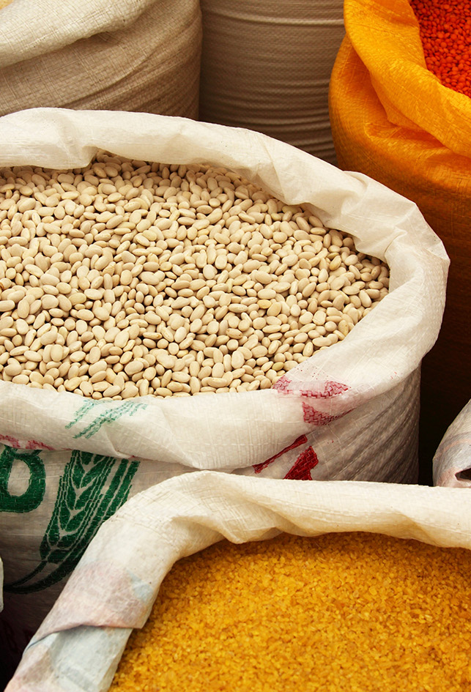
Learning outcomes
Explain the key concepts relating to food security and nutrition
Describe the multi-dimensional links between ecosystem services, food security and health outcomes
Critically analyse different approaches to achieving sustainable food systems
© PublicDomainPictures / Pixabay

Slide 3
Introduction to Food Security

Slide 4
What is food security?
“Food security exists when all people, at all times, have physical, social and economic access to sufficient, safe and nutritious food to meet their dietary needs and food preferences for an active and healthy life”
(FAO 1996)
Notes:
In 1950s and the 1960s, food security was equated with self sufficiency in major staples
Following the FAO World Food Conference of 1974, Food Security was defined as access to sufficient food
Current definition is from the World Food Summit in 1996 (FAO 1996)…….
[Maybe do a quick Q&A here to ask about certain components of the definition. Some of the components can be understood as:
All people – not just the rich or just adults
At all times – i.e. all year round (even in the ‘lean’ season between harvests) and every year
Physical, social, economic access – can either produce food themselves or exchange it or buy it
Sufficient, safe and nutritious – all fairly obvious
Dietary needs and food preferences – people only feel full if they have eaten the kinds of foods they want to eat, e.g. many Asians need rice to feel satisfied, vegetarians prefer non-meat, people may not be able to eat certain foods because of religious or medical restrictions.]

Slide 5
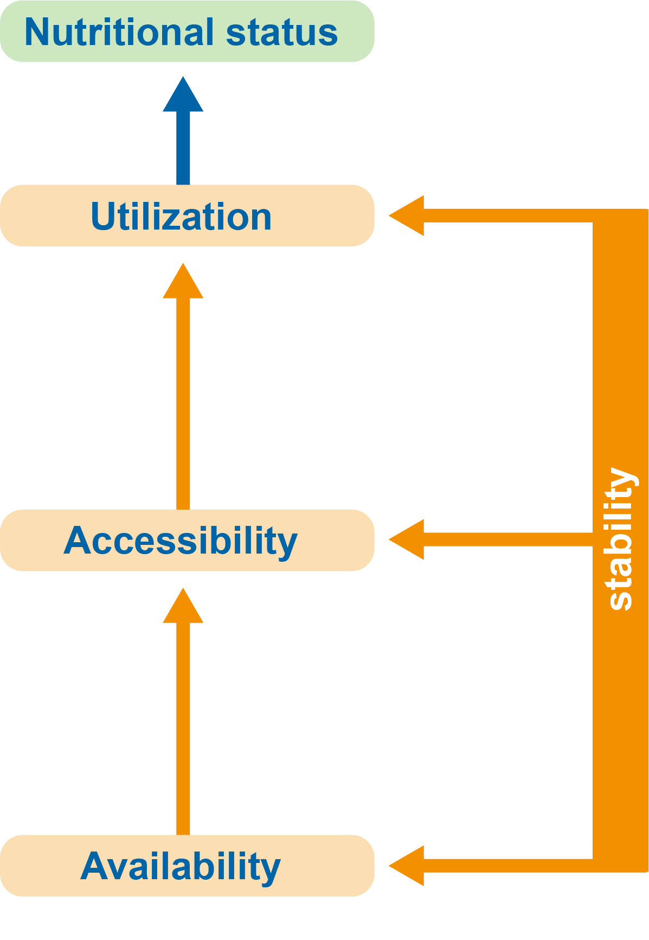
The dimensions of food security
Comprises
Three physical determinants
One temporal determinant
Nutritional status (Barrett 2010)
Notes:
In addition, as the 1996 World Food Summit declared and subsequently reconfirmed in 2002, food security consists of four essential dimensions
Availability: The amount of food that is present in a country or area through all forms of domestic production, imports, food stocks and food aid.
Accessibility: household’s ability to acquire adequate amount of food regularly through a combination of purchases (i.e. affordability), barter, borrowings, food assistance or gifts
Utilization: safe and nutritious food which meets a household’s dietary needs and includes factors such as safe drinking water and adequate sanitary facilities, as well as social value
Stability: disruption to regular flows caused by climate change, conflict, unemployment, disease, price fluctuation or other factors. Lack of stability can affect any or all of the other three components of the food insecurity framework
Nutritional status: consequence of the intake of food and the utilisation of nutrients by the body. An integral part of the multi-dimensional nature of food security (FAO 2009).

Slide 6
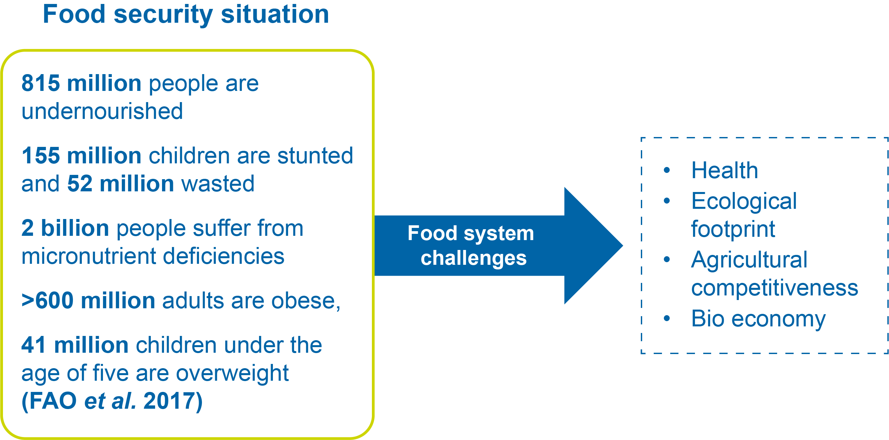
Global food insecurity and malnutrition
Notes:
“The State of Food Security and Nutrition in the World 2017” report by FAO, IFAD, UNICEF, WFP and WHO highlight in details the food security situation globally and by regions.
Key statistics are presented in the slide and include undernourishment, stunting (short height for age) and wasting (low weight for height), micronutrient deficiencies and obesity.
Food security challenges include:
Health: Food safety, nutrition, obesity, type II diabetes, cardiovascular disease, dementia, stroke, cancer, hunger, poverty, families/children
Ecological footprint: Water/land use, natural resource and environmental stewardship, greenhouse gas, global climate change, depleted soils
Agricultural Competitiveness: Improve crop and animal agriculture; enhance farm productivity and income; policies; supply chain; storage; transportation
Bio economy: Replacements for petroleum-based products and enhance community economic well being

Slide 7
Food and health linkages
HEALTH SPECTRUM
Food insecurity
Excess
food
Health challenges:
Chronic diseases;
Food insecurity/hunger;
Food safety;
Environmental challenges
  Food security and measurable improvements in health
  Nutritious and safe food; Community efforts to fight hunger and food insecurity; Strategies to combat childhood obesity
Notes:
Two ends of the health spectrum
[Discuss the negative and positive linkages between food and health; consider issues linked to food insecurity and its impacts on health and excess food and its impacts on health
Health challenges – provide some examples]
Various ways of addressing these challenges include food security and improvements in health

Slide 8
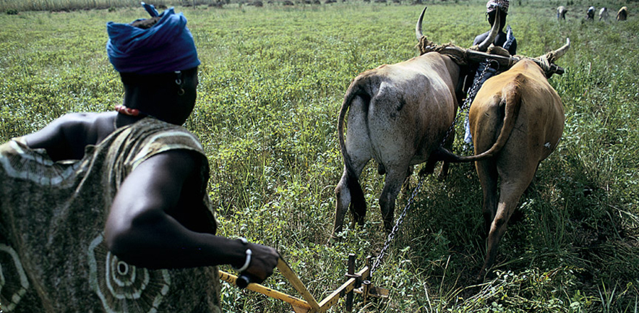
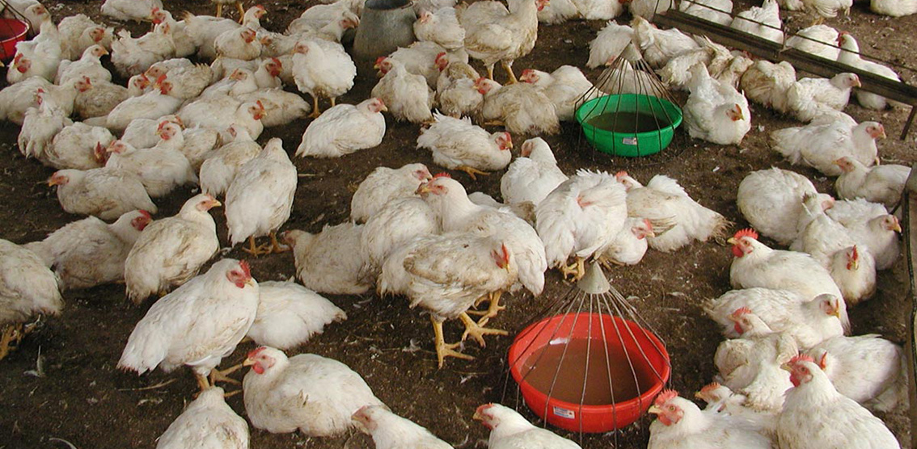
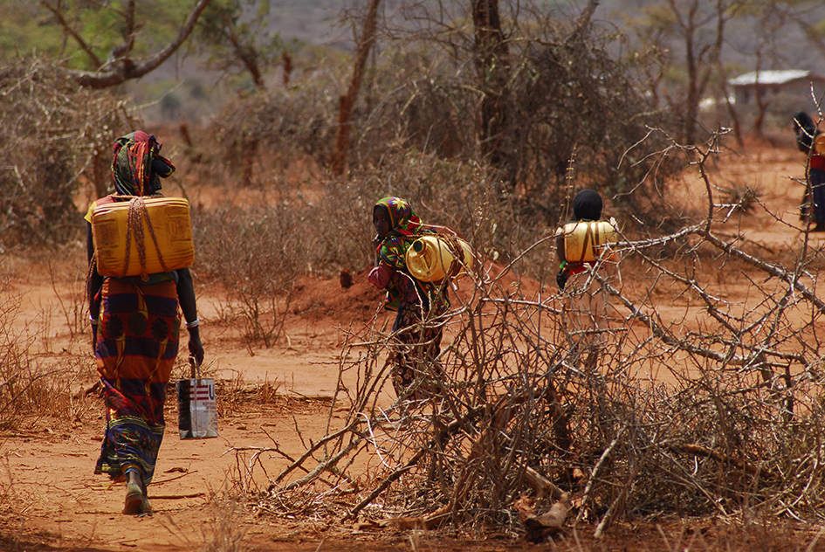
Challenges to food security
Increasing global population
Changing diets
Climate change
and severe
weather events
Gender inequality
© Ray Witlin / World Bank
© Sajal Sthapit / Ecoagriculture Partners
© UNICEF Ethiopia
Notes:
Demographic, economic, and natural forces all conspire to make the challenge of meeting food security more difficult. Specifically, they manifest in the following manner:
Population increase: An increasing global population poses a threat to food security through:
Loss of arable land and increased urbanisation
Higher demand for food
Changing diets: Growing middle-class populations are able to include more animal products in their diets
Livestock are responsible for 18% of GHG emissions (Steinfeld 2016)
Spread of zoonotic diseases and foodborne illness
Climate change: Increased carbon dioxide levels leading to desertification due to water supply problems
Rising ocean levels tend to flood low-lying farmlands with salt water, affecting crop production
Extreme weather events like floods, hurricanes, storm surges, and tsunamis have increased-affect global distribution of food
Some food-producing regions become too hot to grow conventional crops, affect livestock growth and increase crop contamination
Reduced food supply will increase prices
Gender inequality: Women comprise up to 80 percent of farmers in sub-Saharan Africa (FAO 2011)
Many lack access to land tenure, credit, extension services
Studies show that gender inequity can negatively affect natural resources, including by causing deforestation (e.g. Lakerveld et al. 2015; Keane et al. 2016)

Slide 9
Links between ecosystem services, food security and health

Slide 10
Class exercise: How do ES contribute to food security?
Discuss with your neighbour which ES contribute to each of the 4 dimensions of food security:
Availability
Accessibility
Utilisation
Stability
Notes:
[Encourage students to draw on their immediate ecosystems, the services they derive from them and how these contribute to food security locally, nationally and regionally. The purpose of this exercise is to ensure that students understand the key elements of food security.]

Slide 11
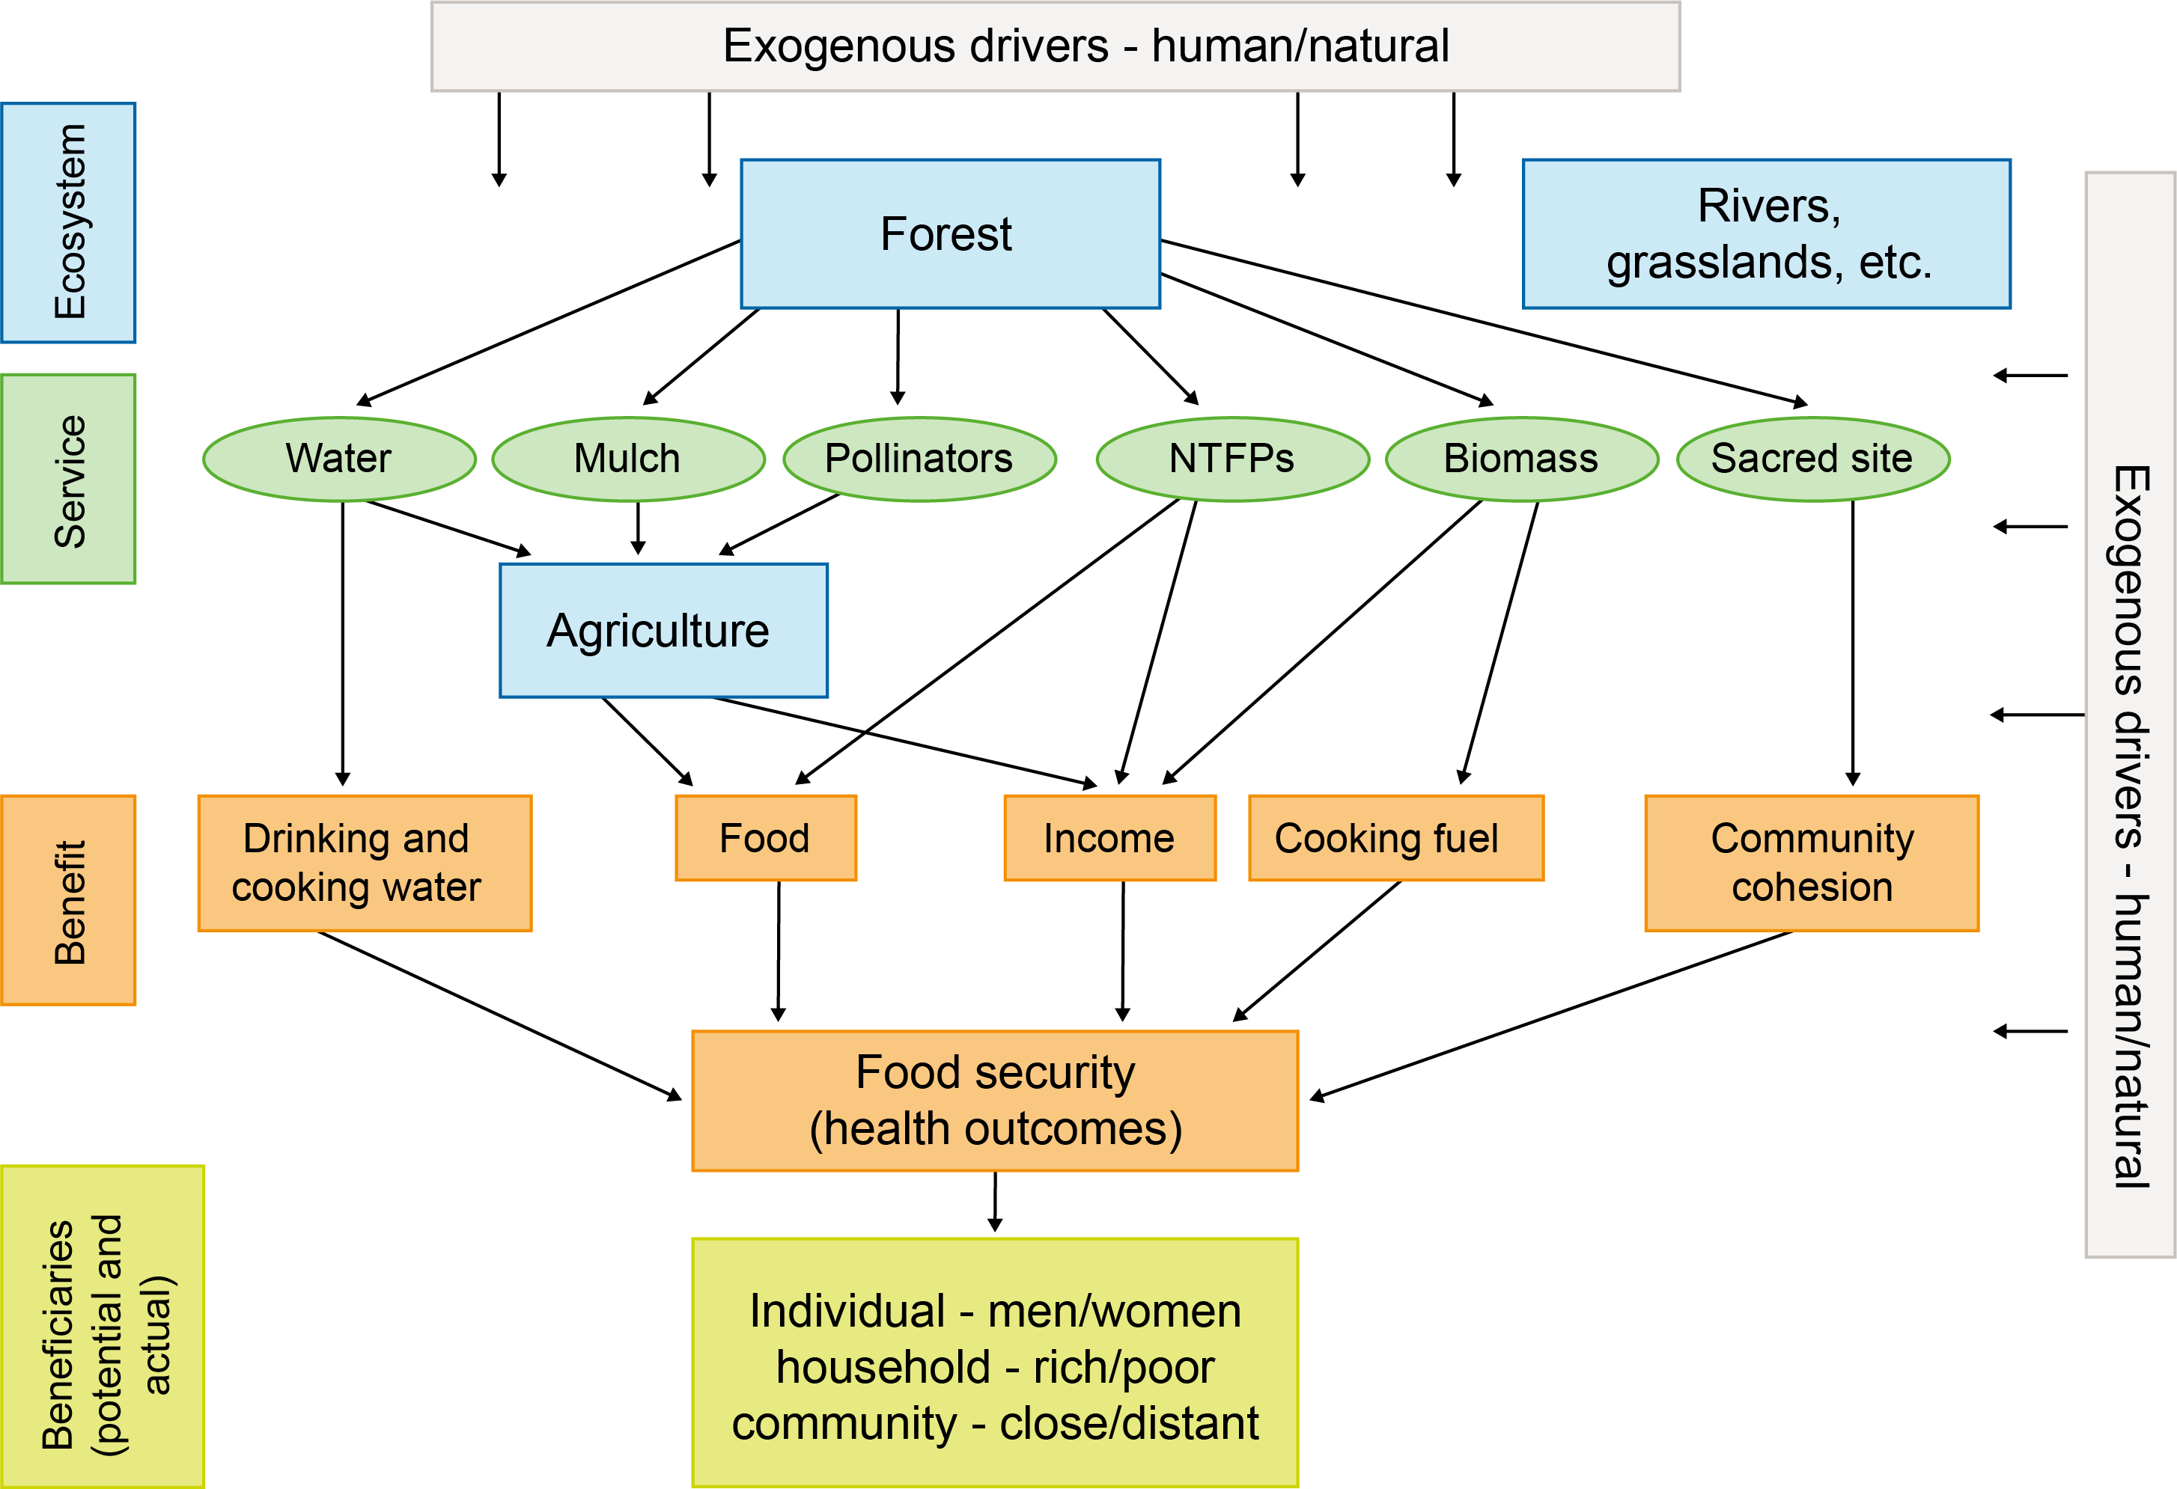
Ecosystem services-benefits-human wellbeing nexus (Poppy et al. 2014)
© Poppy et al, 2014)
Notes:
Food security for many of the world’s rural poor is particularly dependent on their being able to benefit from the flow of ecosystem services.
The diagram shows linkages between different ecosystems and human wellbeing.
Agricultural ecosystems are managed by humans in such a way as to optimise provisioning ecosystem services. At the same time, the production of such services depends upon supporting and regulating ecosystem services, which may derive from other less managed ecosystems, like forests and grasslands.
The benefits obtained from multiple ecosystem services combine to contribute to Food Security.
Different groups of people (e.g. rich/poor) may depend on different ecosystem services for their food security.
[Discuss the fact that the diagram does not capture two-way relationships (e.g. health outcomes may affect agriculture and also community cohesion; decisions about agriculture may affect forest, water quality, etc.)]

Slide 12
Sustainable food systems
Notes:
In our last session we talked about social-ecological systems. Food systems are a good example of SES which can be analysed at multiple scales from local to global.

Slide 13
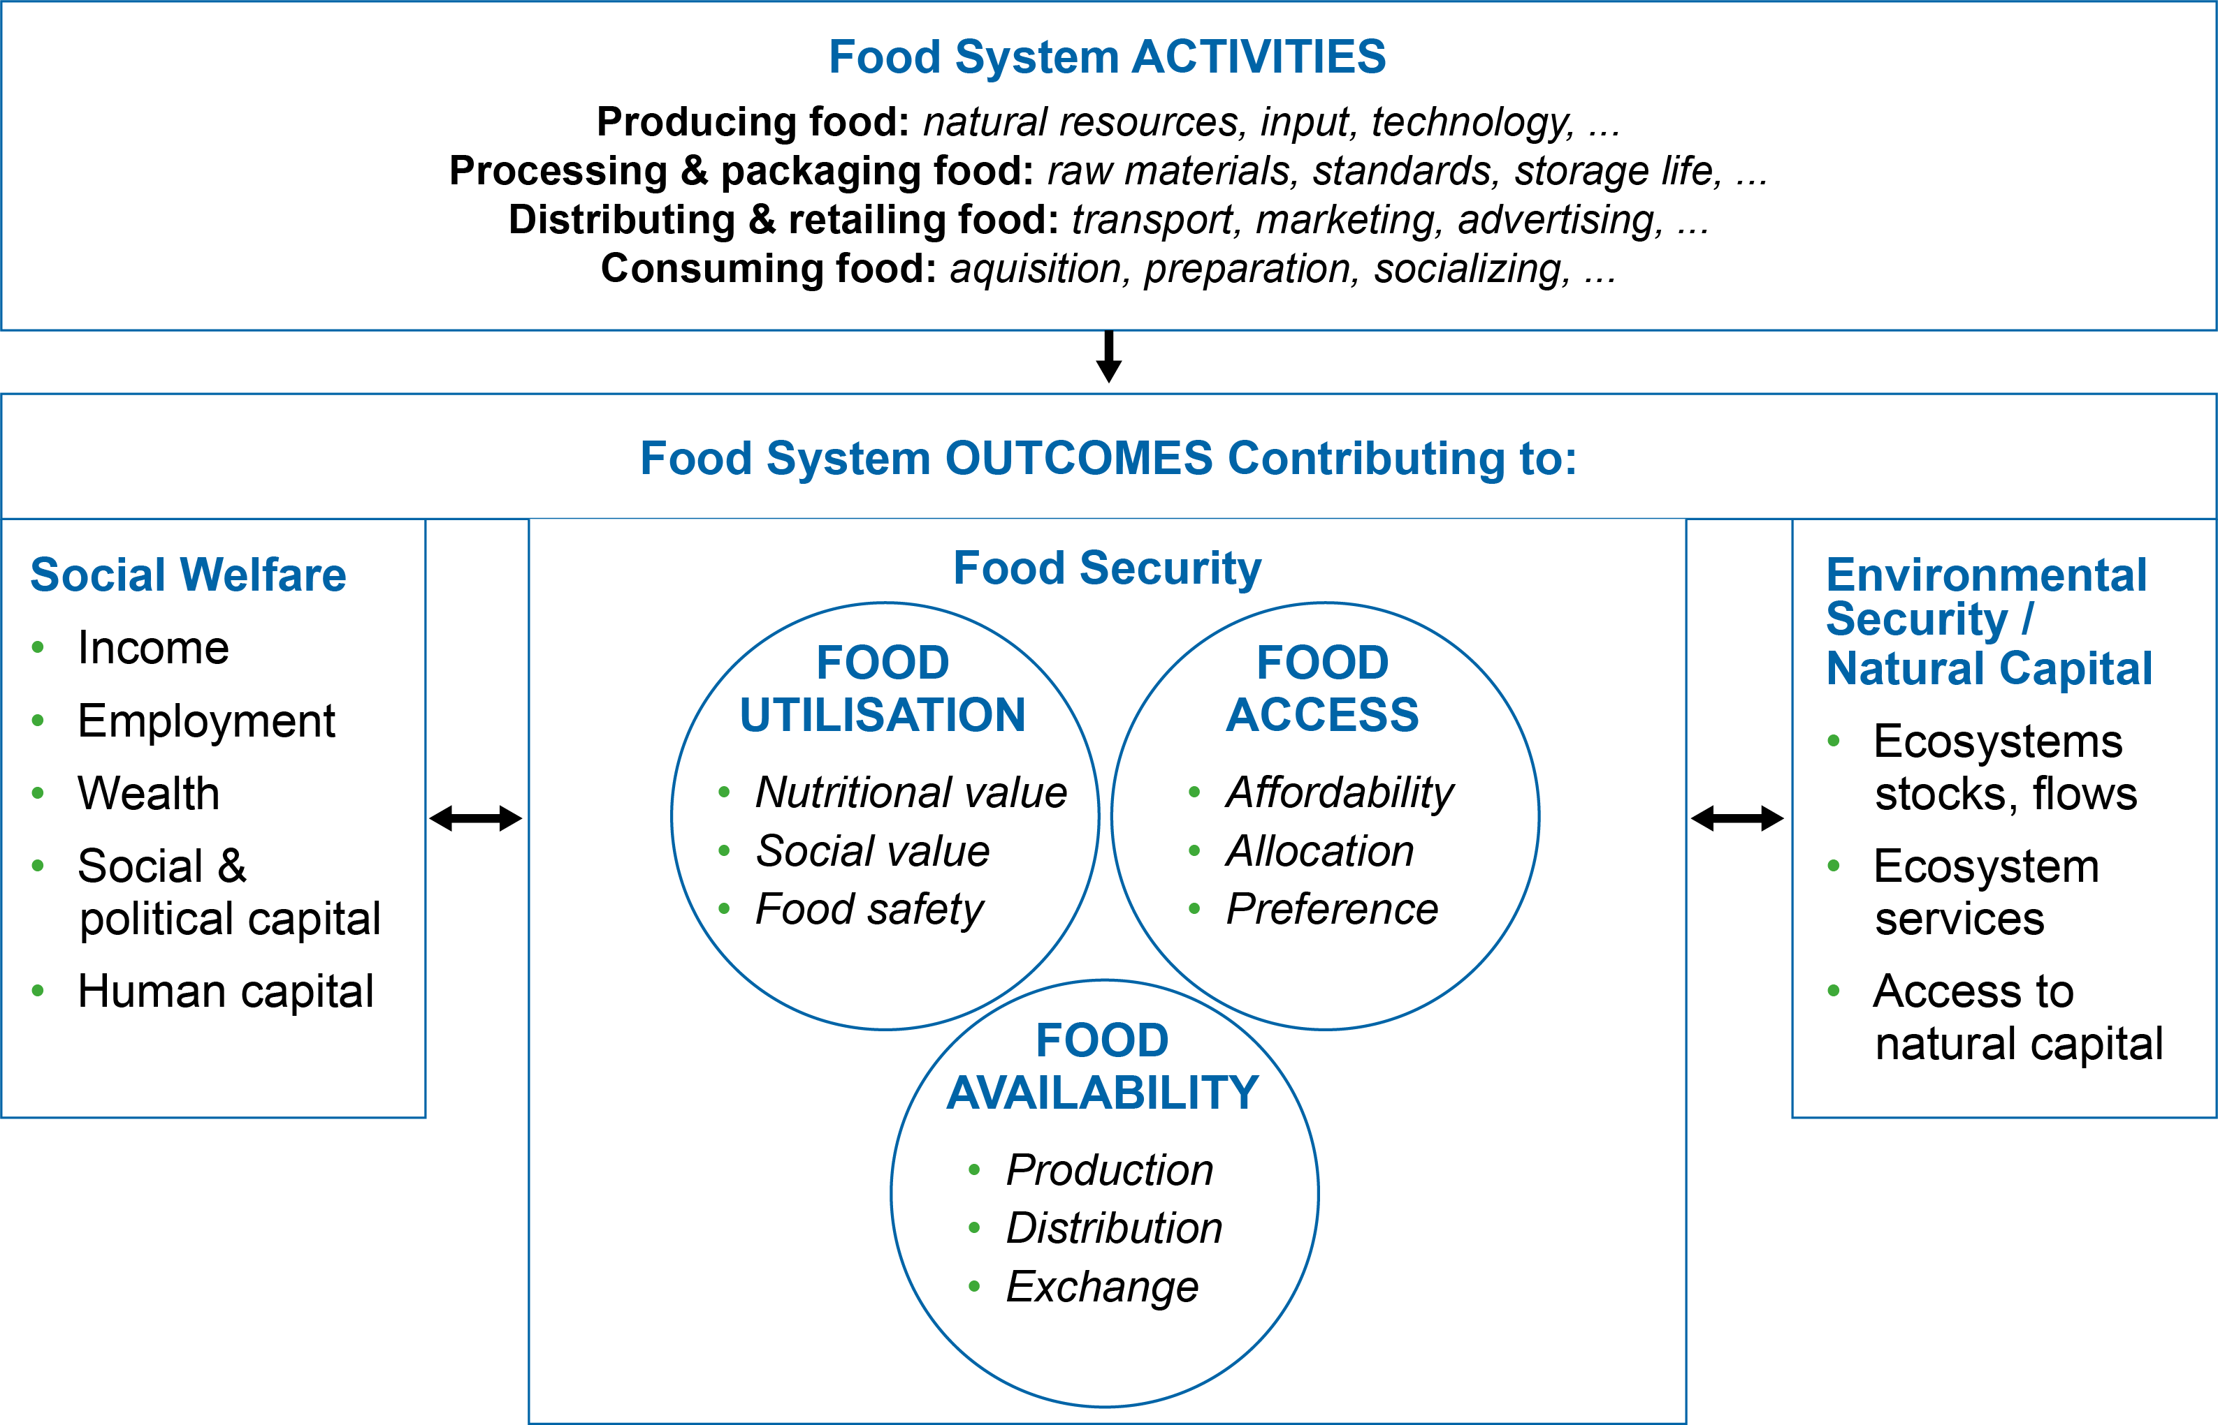
Components of food systems (Ericksen 2008)
Reprinted from Global Environmental Change Vol.18, Issue 1, Polly J. Ericksenm, 'Conceptualizing food systems for global environmental change research', pp.234-245 © 2008, with permission from Elsevier.
Notes:
The framework allows for analysis of interactions between food systems, the environment and socio-economic/policy context.
The centre of the diagram shows three dimensions of food security. Food security outcomes are produced by food system activities (top box), which go all the way from producing food to distributing it, consuming it, and (not shown) also dealing with its waste.
There are two-way arrows to the social system (e.g. if you have good food security you are also likely to have better employment prospects; similarly, if you have good income, this will allow you to buy better food) and to the environmental system (e.g. food production can have very negative impacts on the environment; at the same time if you live in a degraded environment, then your opportunities for achieving food security will be more limited).

Slide 14
Key drivers of change in food systems (Foresight 2011)
Global population increase
Changes in nature and size of per capita demand
Future governance of food systems (national and international)
Climate change & interaction with policies to reduce greenhouse gases
Competition for key resources
Changes in values and ethical stances of consumers
Threats will converge in next 40 years
  “This is a unique time in history – decisions made now and over the next few decades will disproportionately influence the future”
Notes:
Discuss the key points highlighted below:
Point 1= We have demonstrated the increasing human population and its implications for food security, ecosystem degradation and ecosystem services (cf. Previous Topics)
Point 3 = Globalisation of markets, New food superpowers (China, Brazil, India, Russia), Consolidation of private sector
Point 5: Key resources = land, energy, water. Global energy demand expected to go up by 45% from 2006 to 2030. Fertiliser prices went up 5x between 2005-8 due to increasing oil prices
Point 6: Meat consumption 32kg per capita p.a. at present. Forecast to increase to 52kg by 2050. Ethical values – e.g. views on farming systems, animal welfare, GMOs, food sovereignty

Slide 15
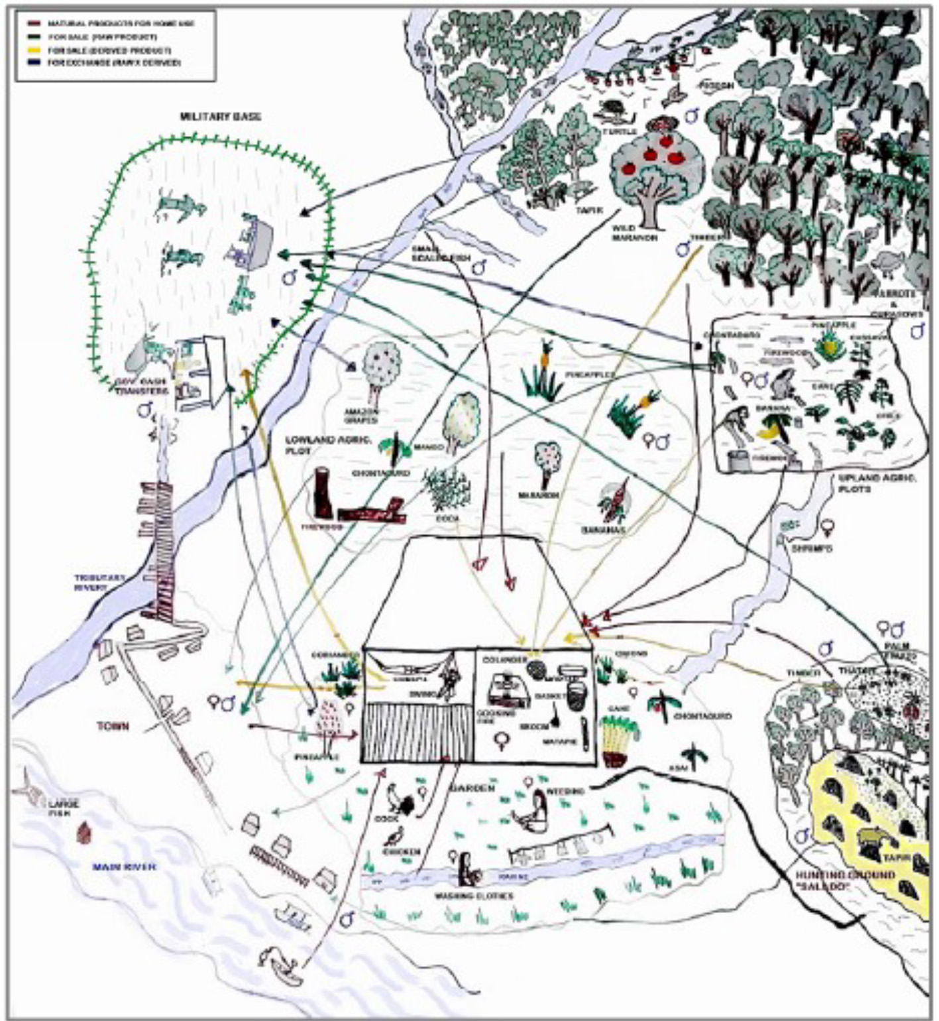
Class Exercise: Draw a household food system diagram
Where do household members obtain their food from?
What inputs do they need to produce (or cook) food?
What external impacts affect their access to food?
How do their activities affect other people?
Think about intra-household differences
Would the diagram look different if drawn for a different season?
© Angela Yang
© Peter Etelej
© Schreckenberg et al. (2016)
Notes:
[This class exercise aims to help students expand on what they have learnt so far.]

Slide 16
Policies to move towards Zero Hunger

Slide 17

© United Nations
SDG1: No Poverty. End poverty in all its forms everywhere (Target1.1: By 2030, eradicate extreme poverty for all people everywhere)
SDG2: Zero Hunger. End hunger, achieve food security, and improved nutrition and promote sustainable agriculture (mostly by 2030)
Very close link between the two goals as poor people spend at least 50-70% of their income on food
Notes:
SDG2 has an ambitious aim of reaching zero hunger. For poor people this is very closely related to ending poverty (SDG1) as they spend the majority of their income on food.

Slide 18
Two key investments required
(FAO, IFAD and WFP 2015)
Social protection: to bring all up to the $1.25 (now updated to $1.90) extreme poverty line
Accelerate pro-poor (rural) growth
Requires investment of US$267 bn per year from 2016 to 2030, of which rural areas would receive US$181 bn.
  Equivalent to 0.3% of world economic output in 2014.
  OR US$160 annually for each of the extreme poor over the
  15-year period.
Notes:
Contrary to earlier policy solutions ensuring food security, which focused on increasing food availability, current policy recognises that the majority of people rely heavily on the market to obtain their food. Of the two key policies now being put forward to achieve zero hunger, only the second is linked to agriculture and food production.
Social protection – at $1.25 (updated to $1.90 in 2015) recipients should have enough to feed themselves but not much more. So you then either need to give them more so they can start saving and investing, or go for the pro-poor growth to increase their opportunities.
Of the $267bn, $116bn would be for social protection (of which $75bn for rural areas), and the rest for pro-poor growth investments.
Social protection could be argued to be just about consumption but it is clear that it allows for even tiny savings and better nutrition leads to higher productivity. Therefore social protection is an investment in human capacity.

Slide 19
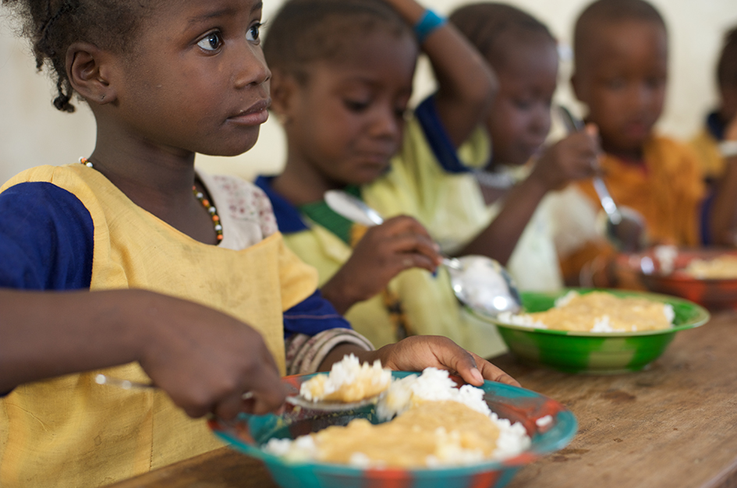
What is social protection?
Cash transfers
  E.g. India National Rural Employment Guarantee Scheme
Food distribution
  School feeding programmes
  ‘Purchase from Africa for Africans’
Seeds and tools distribution
Buffer stocks of food
  Active management of stocks
  Robust national stockpiling
  Global collective action to manage stocks to prevent extreme price spikes
Index-insurance schemes – insure against an objectively measured index, e.g. rainfall deficit
© Julien Harneis
Notes:
Bullet 1 – India’s NREGS programme guarantees all rural men and women 100 days of paid work per year. Jobs can be anything from breaking stones to helping out in vaccination programmes but the key benefit is they get an income which they can use to buy whatever food they prefer to eat. (this is better than giving them food for work as the food for these programmes tends to be imported and can undermine local food production).
Bullet 2 – School feeding programmes now in 130 countries.

Slide 20
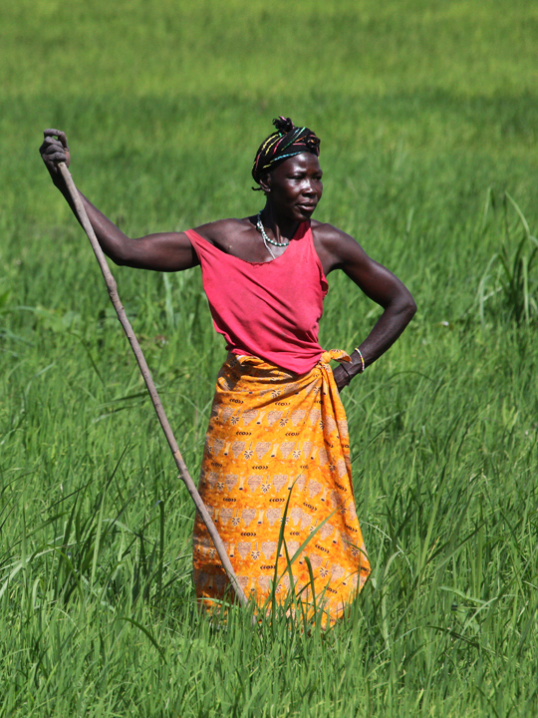
How do you accelerate rural pro-poor growth?
Invest in smallholder agriculture
Ensure access to land and water for small farmers, especially women’s security of tenure
Extension of credit for agriculture and processing of natural resource products
Make fertilisers affordable to the poor
Provide access to electricity
Better market infrastructure, policies and information systems
Research to support small-scale farmers
© Steve Evans

Slide 21
Promoting environmentally sustainable food systems
Limit agricultural expansion
Encourage new crops and greater genetic diversity
Protect the ecological foundation of food
Integrated farming systems
Avoid dangerous climate change
Alternative sources of energy for agricultural intensification
Notes:
In addition to contributing to the achievement of zero hunger, food systems must also be environmentally sustainable. This can involve many factors.

Slide 22
Class exercise: How do different food production systems compare?
Factor | Intensive cereals | Agroforestry | Livestock | Aquaculture | GM crops | Urban agric
Food availability
Food access
Food utilisation
Food stability
Impacts on non-food ES
Impacts on different social groups
Try scoring each: negative (xxx), not sure (???), positive (✓ ✓ ✓)
Notes:
[This exercise can be done quite quickly as a class discussion – takes about 10 minutes for a fairly superficial review of different systems. It can also be a more substantial exercise that you set students to do over a week – or as a group-based piece of assessed coursework – and ask them to report back to the class with a proper presentation]
Split into groups of 4. Take 10 minutes to discuss one agricultural system you know something about and try to fill in the column for that system.
Report back to the group with a quick description of the system you are thinking about, and how it performs in relation to each of the factors in the table.
[You can aggregate the scores from each group of students – eventually, it becomes clear that no single system scores highly on all fronts. So we need a range of different systems for different contexts.]

Slide 23
References
Key readings
Barrett, C.B. (2010) Measuring Food Insecurity. Science 327: 825-828.
Ericksen, P.J. (2008) Conceptualizing food systems for global environmental change research. Global Environmental Change 18: 234-245.
FAO, IFAD and WFP. (2015) Achieving Zero Hunger: the critical role of investments in social protection and agriculture. FAO, Rome.
FAO, IFAD, UNICEF, WFP and WHO. (2017) The State of Food Security and Nutrition in the World 2017. Building resilience for peace and food security. FAO, Rome.
Poppy, G. et al. (2014) Food security in a perfect storm: using the ecosystem services framework to increase understanding. Philosophical Transactions of the Royal Society B 369: 1-13.
Other readings
FAO. (1996) Rome declaration on world food security and world food summit plan of action, World Food Summit 13-17 November 1996. FAO, Rome.
Foresight. (2011) The Future of Food and Farming: Final Project Report. The Government Office for Science, London.
Notes:
References cited in the speakers’ notes:
FAO (2009) Declaration of the World Summit on Food Security, WSFS 2009/2. FAO, Rome
FAO (2011) Global Food Losses and Food Waste - Extent, Causes and Prevention. FAO, Rome.
Keane, A. et al. (2016) Gender Differentiated Preferences for a Community-Based Conservation Initiative. PLoS ONE 11: 1-15.
Lakerveld, R.P. et al. (2015) The social distribution of provisioning forest ecosystem services: Evidence and insights from Odisha, India. Ecosystem Services 14: 56-66.
Steinfeld, H. et al. (2006) Livestock’s Long Shadow: Environmental Issues and Options. FAO ftp://ftp.fao.org/docrep/fao/010/A0701E/A0701E00.pdf, 1-377.

Slide 24
Guided reading
Please read:
Schaafsma, M. and Bell, A. (2018) Ensuring climate-smart agriculture ‘leaves no one behind’. ESPA Policy & Practice Briefing. Available at: https://www.espa.ac.uk/files/espa/ESPA Policy Brief Climate Smart Agriculture FINAL WEB_0.pdf
Questions for discussion:
Drawing on the key messages and points outlined in the paper on how climate-smart agriculture can help achieve sustainable food security at scale while contributing to poverty alleviation, analyse the potential of a food production system such as agroforestry or conservation agriculture (or any other food production system of your choice) to provide sustainable food security and help alleviate poverty.
Identify key challenges in scaling-up the chosen food production system, and ways to overcome those challenges
Are there any trade-offs involved in scaling-up of the production systems, for example with ecosystem services/environmental concerns or for poverty/inequality?
How can the identified trade-offs be minimised?

