Slide 1
Introduction to
Social-ecological Systems
© Helbing 2013, World Economic Forum, reproduced with permission
Topic 03
Notes:
A central theme of this topic is that Social-Ecological Systems (SES) are complex – as you can see in this diagram (Helbing 2013).
But understanding SESs is a challenge worth investing in, as it can help recommend policies that ensure sustainability.

Slide 2
Learning outcomes
Describe the main components and concepts within social-ecological systems
Explain why a social-ecological systems approach is useful for more effective policies and planning
Demonstrate ability to reframe and analyse social-ecological systems from multiple perspectives

Slide 3
Defining social-ecological systems

Slide 4
What is a social-ecological system?
an “integrated complex system that includes social (human) and ecological (nature) subsystems in a two-way feedback relationship”
(Berkes 2011)
Notes:
A justification for talking about social-ecological systems is that “the delineation between social and ecological systems is artificial and arbitrary” (Folke et al. 2016).
Social: Includes the human dimension in its diverse facets, including the economic, political, technological, and cultural.
Ecological: Integration of all living beings and their relationships, humans and human actions included, as well as their dynamic interplay with the atmosphere, water cycle, biogeochemical cycles, and the dynamics of the Earth system as a whole.

Slide 5

Shift in our understanding of connections
Economy
Environment
Society
Notes:
This means we want so move away from this type of thinking towards…. [see next slide]

Slide 6
Shift in our understanding of connections
Economic
systems
Social systems
Ecological systems
Notes:
….this type of thinking based on our understanding of systems connections
Based on https://static1.squarespace.com/static/54f8c6cee4b0e25f5b1af40c/t/590274d3e58c628889ddbf79/1493333209628/

Slide 7
Key concepts in understanding social-ecological systems
Interactions and feedbacks: Challenges assumptions of linear trade-offs in social ecological systems
Multi-scale/level dynamics:
  Geographical scale
  Temporal scale
  Socio-political scale
Diversity
  Social diversity including groups, assets, goals
  Multiple relationships from micro to macro levels
Notes:
A multi-level approach is important in allowing us to examine different levels at which SES interact and feedback
[Discuss with some examples]
SES include interactions at multiple scales and are strongly influenced by external drivers and management:
Geographical scale: local/community level, municipal/regional, national and international-level drivers
Temporal scale: emergence and development of new management initiatives, history
Socio-political scale: different stakeholders – community-based organisations; regional forums
SES include many types of diversity.

Slide 8
Key concepts in understanding social-ecological systems
Threshold: The point where small changes in a social or environmental driver produce large responses in the ecosystem
Tipping points: A threshold at which a relatively small change in conditions leads to a strong change in the state of a system (Brook et al. 2013)
Resilience: Capacity of a system to absorb disturbance and reorganise while undergoing change so as to still retain essentially the same function and structure (Scheffer 2009)
Persistence
Adaptability
Transformability
Notes:
Threshold: The point at which there is an abrupt change in an ecosystem quality, property or phenomenon, or where small changes in a social or an environmental driver produce large responses in the ecosystem
Tipping points – the changes in the system may be irreversible
Resilience was originally introduced by Holling (1973). Resilience is generally taken to comprise three capacities: persistence, adaptability, and transformability

Slide 9
Why do we need to think in terms of SES?
Case study of the Southern Cape, South Africa
(van Wilgen et al. 2008)

Slide 10
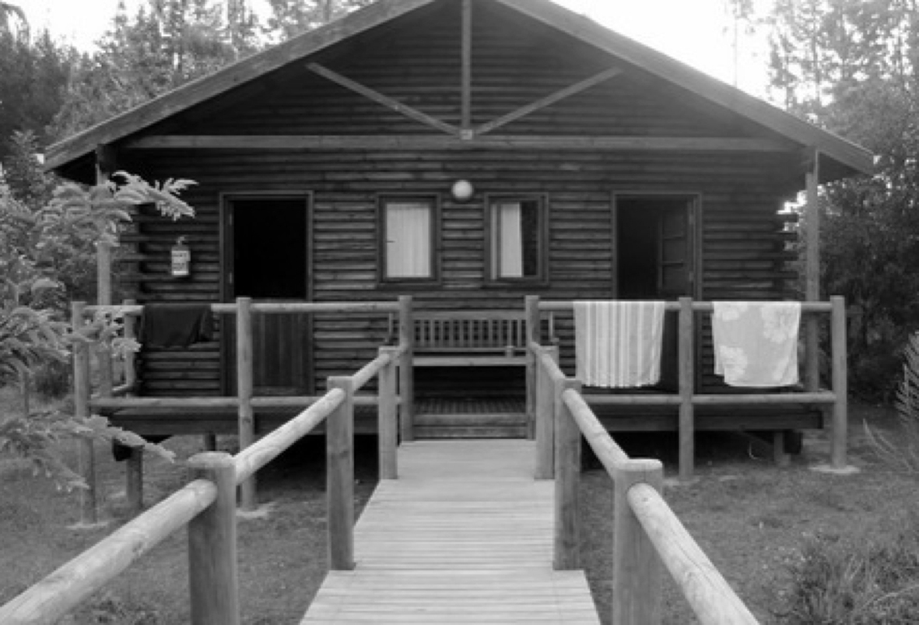
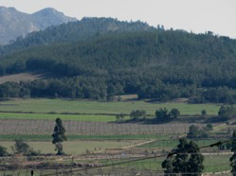
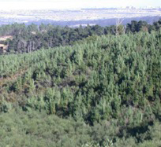
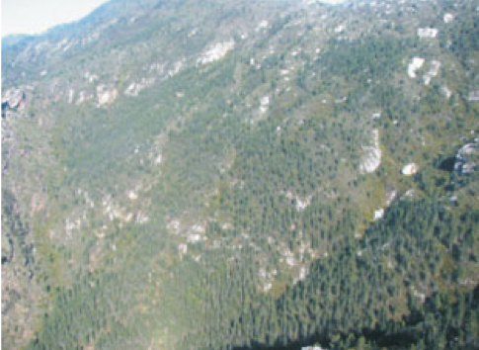
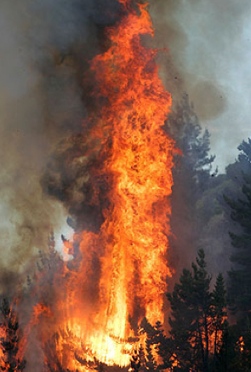
Reprinted from Journal of Environmental Management, Vol.89, Issue 4, B.W. van Wilgen, B. Reyers, D.C. Le Maitre, D.M. Richardson, L. Schonegevel, 'A biome-scale assessment of the impact of invasive alien plants on ecosystem services in South Africa', pp. 336-349. (c) 2008, with permission from Elsevier.
Notes:
This case study is set in the southern Cape of South Africa.
Here pine forestry plantations have changed the landscape, with pine trees becoming highly invasive spreading across the landscape (so human economic activity is driving change with unpredictable ecological effects).
As a result fire, which is a natural component of this landscape, has become more frequent, more intense and damaging properties in the area.

Slide 11
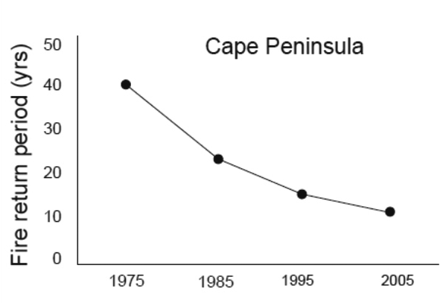
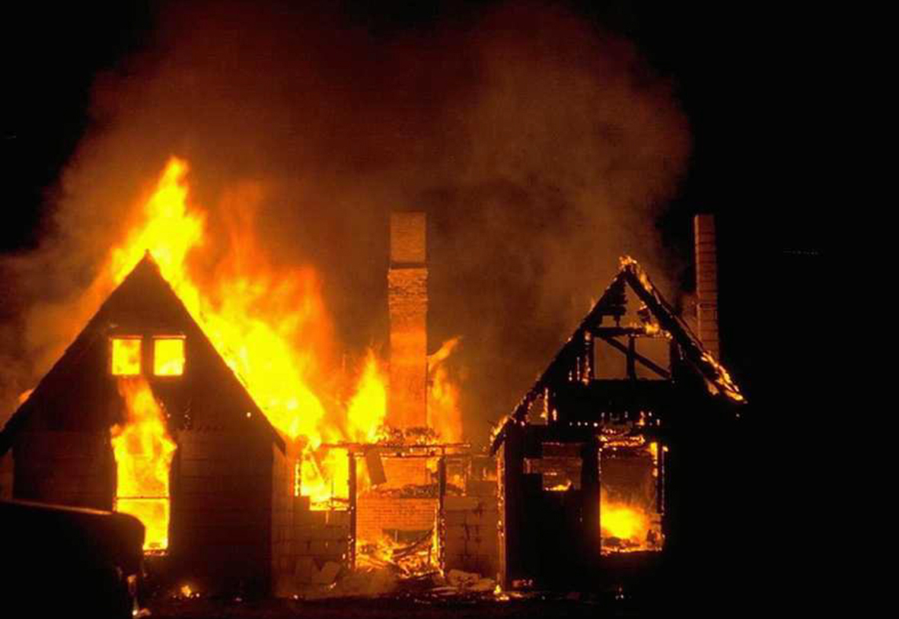
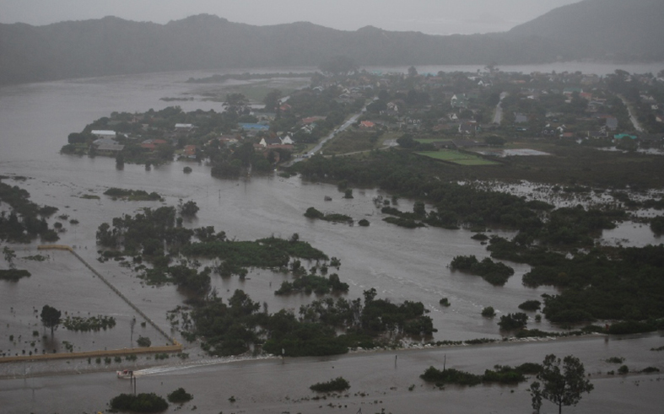
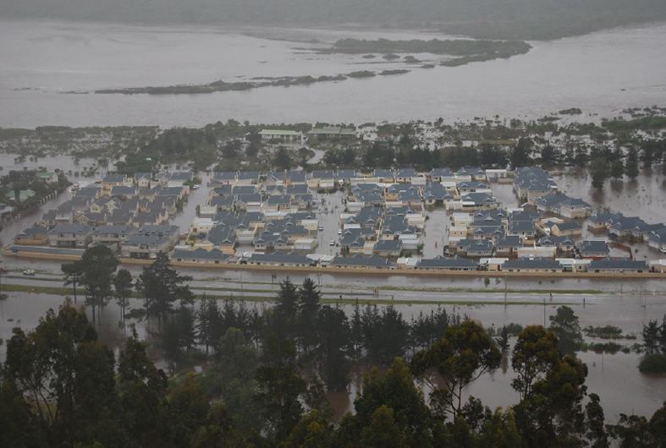
Reprinted from Journal of Environmental Management, Vol.89, Issue 4, B.W. van Wilgen, B. Reyers, D.C. Le Maitre, D.M. Richardson, L. Schonegevel, 'A biome-scale assessment of the impact of invasive alien plants on ecosystem services in South Africa', pp. 336-349. (c) 2008, with permission from Elsevier.
Notes:
The graph shows that the fire return period has decreased from 40 to 10 years since 1975.
So ecological change now exposes people to a high degree of risk.
Fire now being more intense bakes soils increasing runoff in the event of sudden storms and creating floods.
Interestingly, these invasive species also reduce and restrict the annual amount of water available as they consume more water than indigenous species. This is the case for both surface water and ground water. Towns and settlements have less water available and are frequently faced with drought conditions.

Slide 12
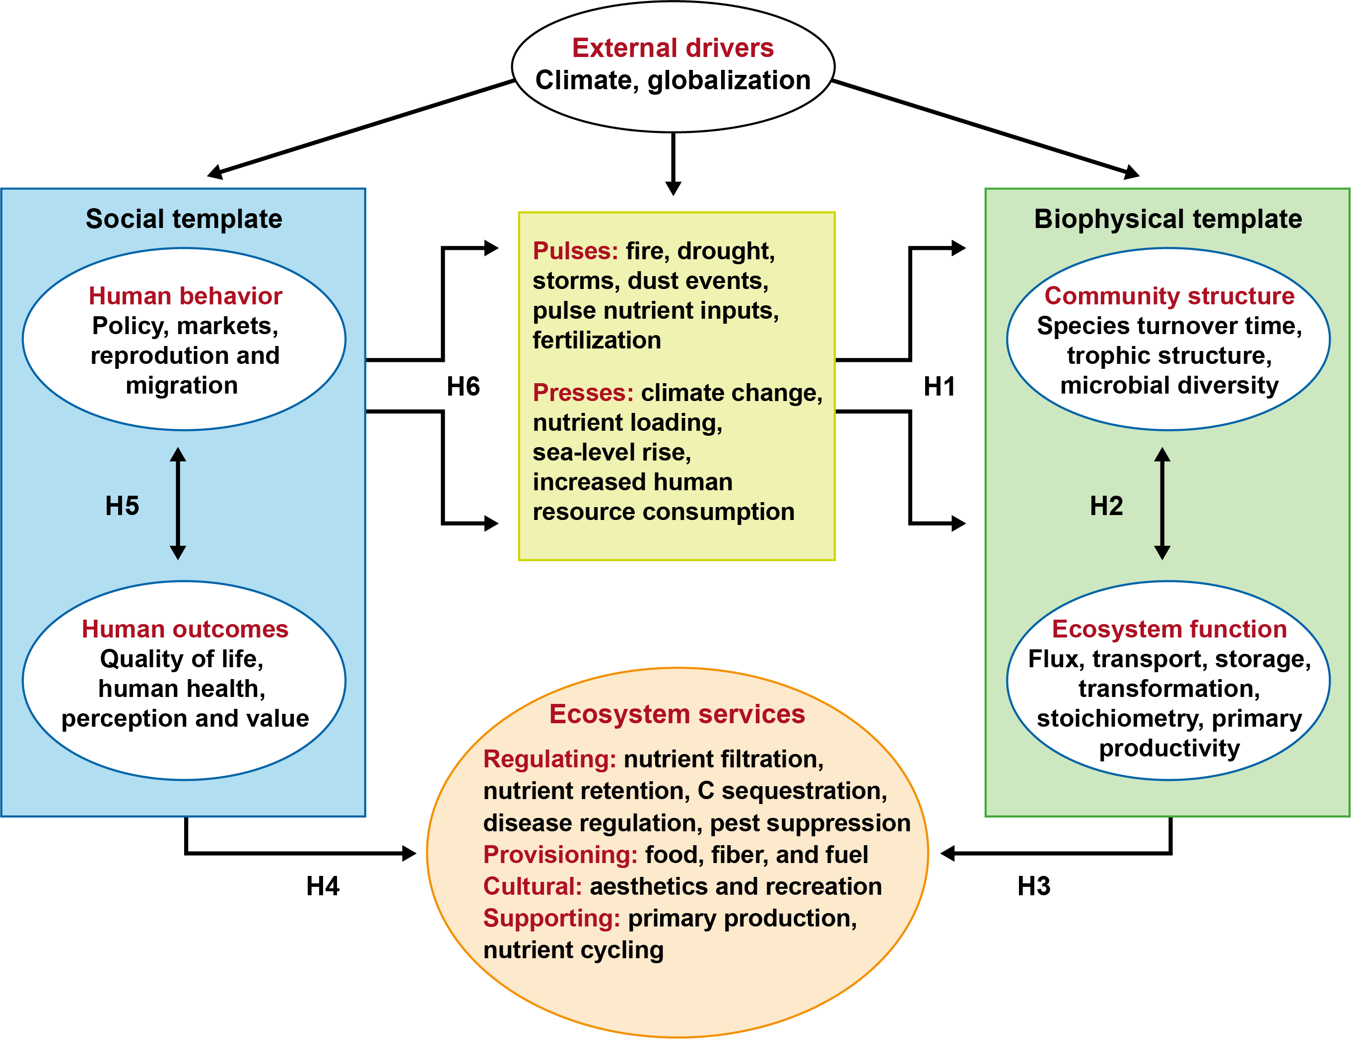
© Collins et al 2011; Frontiers in Ecology
Reprinted from Frontiers in Ecology and the Environment, Vol.9, Issue 6, Scott L. Collins, Stephen R. Carpenter,
Scott M. Swinton, Daniel E. Orenstein, Daniel L. Childers, Ted L. Gragson, Nancy B. Grimm, J. Morgan Grove,
Sharon L. Harlan, Jason P. Kaye, Alan K. Knapp, Gary P. Kofinas, John J. Magnuson, William H. McDowell,
John M. Melack, Laura A. Ogden, G. Philip Robertson, Melinda D. Smith, Ali C. Whitmer, 'An integrated conceptual framework for long-term social-ecological research', pp.351-357. (c) 2010. Reprinted with permission from Wiley.
Notes:
This press pulse framework by Collins et al. (2011) shows the links between society and biophysical environment quite clearly, and is set within the ES context. It sits closer to issues of risk and environmental change though than livelihood strategies.
[Discuss with the students how you could apply this framework to the South Africa case study]

Slide 13
Moving from local to global SES

Slide 14
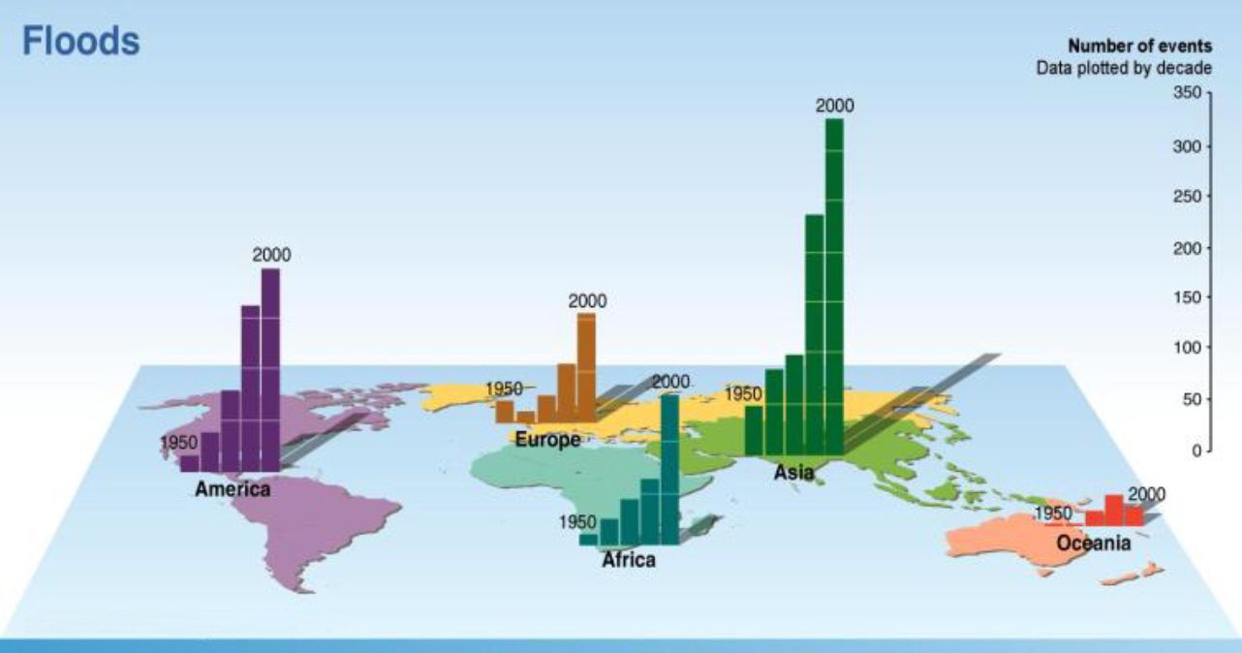
Decreased Resilience = Increased Risk
© Millennium Ecosystem Assessment
Notes:
This graph from the MA (2005) shows that the number of flood events is increasing at the global level as well as at the local level (as in the case study).

Slide 15
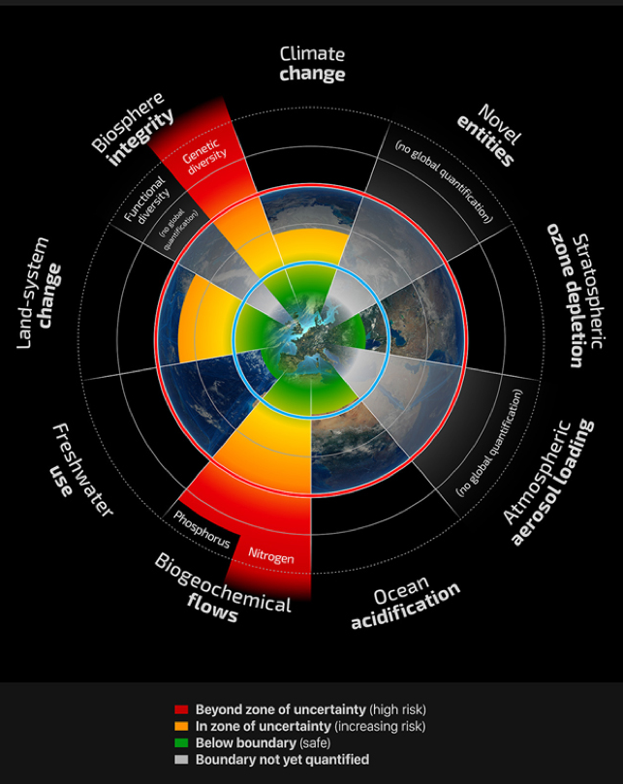
SES at the global scale
Planetary boundaries: a safe operating space for humanity (Rockstrom et al. 2009, updated by Steffen et al. 2015)
Sees earth as a single system with 9 key and interacting processes
These must stay within safe limits
Reprinted from Global Environmental Change, Vol.28, John A. Dearing, Rong Wang, Ke Zhang, James G. Dyke,
Helmut Haberl, Md. Sarwar Hossain, Peter G. Langdon, Timothy M. Lenton, Kate Raworth, Sally Brown, Jacob Carstensen, Megan J. Cole, Sarah E. Cornell, Terence P. Dawson, C. Patrick Doncaster, Felix Eigenbrod, Martina Florke, Elizabeth Jeffers, Anson W. Mackay, Bjorn Nykvist, Guy M. Poppy, 'Safe and just operating spaces for regional social-ecological systems', pp.227-238. (c) 2014. Reprinted under Creative Commons license CC-BY 3.0
Notes:
A seminal paper by Rockstrom et al. (2009), updated by Steffen et al. (2015) introduced the idea of ‘Planetary Boundaries’. This sees the whole earth as a single system in which there are 9 key processes which together need to stay within safe limits (the central green area within the blue circle) for the world to be a ‘safe operating space’ for humans to inhabit.
There are big debates about whether these are the right processes and how to measure them.
A key focus of the paper is that the processes interact – there are feedbacks between them – and that there are thresholds (red circle, which could be irreversible) beyond which human survival would be difficult.

Slide 16
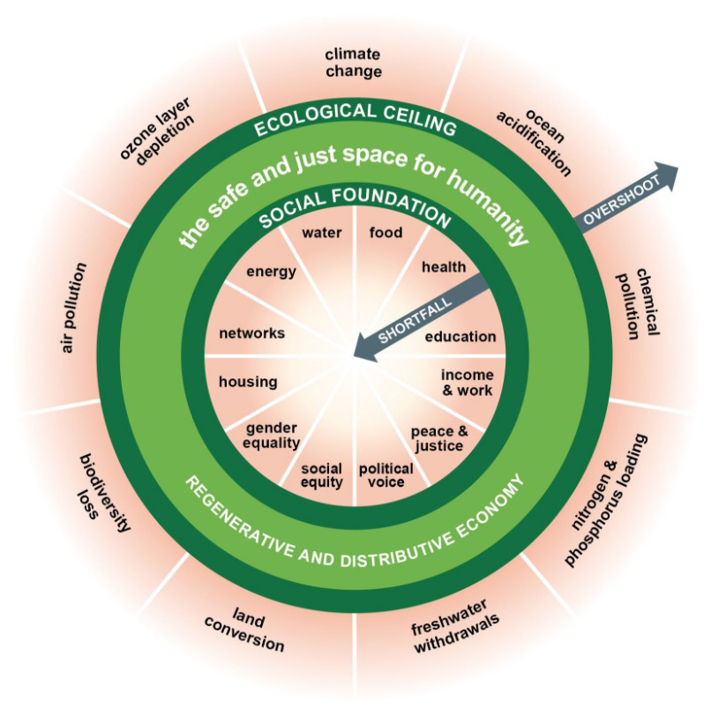
SES at the global scale
‘the doughnut’ = safe and just space for humanity (Raworth 2012)
We cannot overshoot the planet’s ecological ceiling
But we must bring all people above a social foundation
https://www.kateraworth.com/doughnut/
Reprinted from Global Environmental Change, Vol.28, John A. Dearing, Rong Wang, Ke Zhang, James G. Dyke,
Helmut Haberl, Md. Sarwar Hossain, Peter G. Langdon, Timothy M. Lenton, Kate Raworth, Sally Brown, Jacob Carstensen, Megan J. Cole, Sarah E. Cornell, Terence P. Dawson, C. Patrick Doncaster, Felix Eigenbrod, Martina Florke, Elizabeth Jeffers, Anson W. Mackay, Bjorn Nykvist, Guy M. Poppy, 'Safe and just operating spaces for regional social-ecological systems', pp.227-238. (c) 2014. Reprinted under Creative Commons license CC-BY 3.0
Notes:
Kate Raworth (former chief economist at Oxfam) took up the idea of planetary boundaries, and – at the Rio+20 conference – argued that we must also consider the rights of many people to develop above a basic social foundation (comprising issues such as food, health, energy and water but also gender equality and political voice). She put forward the idea of a doughnut, representing a ‘safe and just’ space for humanity.
This representation of a planetary SES begs the question of the level at which decisions should be taken. Can national governments each take decisions (e.g. on reducing carbon emissions) which together will produce an outcome that is appropriate for the whole planet?
[NB We will discuss the linkages between decision-making at different levels more in Topic 6 on ecosystem governance]

Slide 17
Other frameworks for analysing social-ecological systems

Slide 18
Why use a framework?
“A framework is...useful in providing a common set of potentially relevant variables and their subcomponents to use in the design of data collection instruments, the conduct of field work, and the analysis of findings…” (Ostrom 2009)
Frameworks can help to define a common vocabulary for different people to discuss the same scenario.
Class exercise:
What criteria would you use to choose an appropriate framework in a specific situation?
Notes:
[Possible answers: Students might come up with a number of criteria like:
the purpose of the framework and its relevance to the issues in their specific study,
the scales (temporal, social and spatial) at which the framework needs to operate;
the disciplinary focus of the framework (does it treat the human and ecological dimensions in equal depth?) and how it relates to their study.]

Slide 19
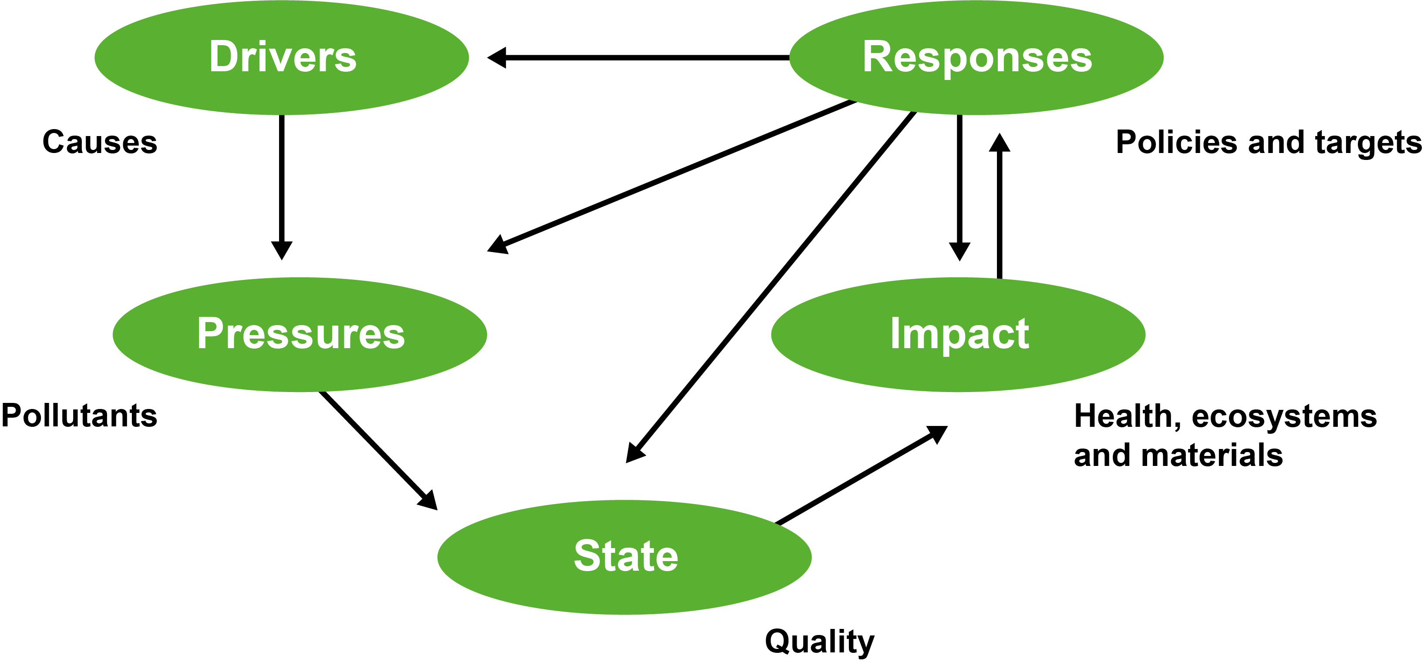
The DPSIR Framework
© Kristensen 2004
Kristensen, P. (2004) 'The DPSIR Framework', https://wwz.ifremer.fr/dce/content/download/69291/913220/.../DPSIR.pdf
Notes:
DPSIR- Develop an improved understanding of, indicators for, and appropriate responses to impacts of human activities on environment along the causal chain drivers-pressure-state-impact-responses (Svarstad et al. 2008).
DPSIR framework depicts a chain of causal links starting with ‘driving forces’ (economic sectors, human activities) through ‘pressures’ (emissions, waste) to ‘states’ (physical, chemical and biological) and ‘impacts’ on ecosystems, human health and functions, eventually leading to political ‘responses’ (prioritisation, target setting, indicators).
Kristensen (2004) describes each of the components in detail with examples.

Slide 20
The DPSIR Framework
Strengths
Simple to understand and use
Can be applied to a wide range of environmental issues, and in a standard way
Understood and used by large number of organisations
Can be used as a tool to organise & communicate complex (social-ecological) information to policy makers & other stakeholders
Weaknesses
Too simple & static to capture complex social-ecological system dynamics & trends (i.e. oversimplifies the problems)
Discrepancies in understanding & applying DPSIR information categories (i.e. differing definitions & interpretations of Drivers, Pressures, Responses, etc.)
Produces potentially biased analysis & results (based on subjectivity of the individual(s) applying the framework – see Svarstad et al. 2008)

Slide 21
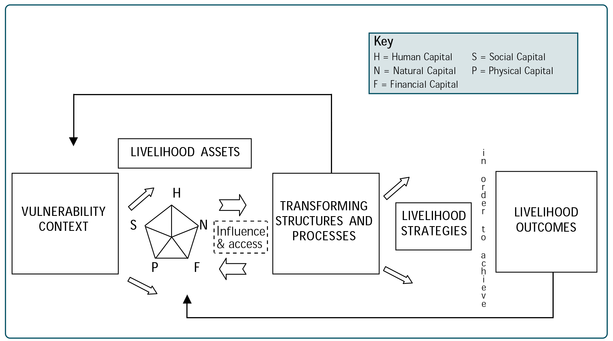
The Sustainable Livelihoods Framework
© DFID 1999: SLA Guidance Sheet 1, p.1
Notes:
Sustainable Livelihoods Framework-Analyses which combination of livelihood assets (or capitals – in the original diagram) enable households to follow what combination of livelihood strategies with sustainable outcomes (DFID 1999; Scoones 2009).
The ‘pentagon of assets’ includes human, natural, financial, social and physical.
The framework depicts stakeholders as operating in a context of vulnerability, within which they have access to certain assets. Assets gain weight and value through the prevailing social, institutional and organisational environment (policies, institutions and processes). This context decisively shapes the livelihood strategies that are open to people in pursuit of their self-defined beneficial livelihood outcomes. The livelihood outcomes feed back to the household’s assets.

Slide 22
SLF: Strengths and weaknesses
Strengths
“Genuinely transdisciplinary as … produced, disseminated and applied in the borderland between research, policy, and practice.” (Knutsson 2006)
Responds to people’s own multi-dimensional view of livelihoods
Very widely used in development initiatives
Weaknesses (Scoones 2009)
Lack of engagement with economic globalisation processes
Lack of attention to power and politics
Lack of rigorous attempts to deal with long-term change in environmental conditions
Failure to grapple with debates about long-term shifts in rural economies and questions of agrarian change
Notes:
Knuttsson (2006) argues that one reason why the SLF did so well and only took 5 years to go from academia to policy uptake, was that it was responding to a real policy issue at the time, how to deal with the complexity of rural livelihoods, and how to assess progress.

Slide 23
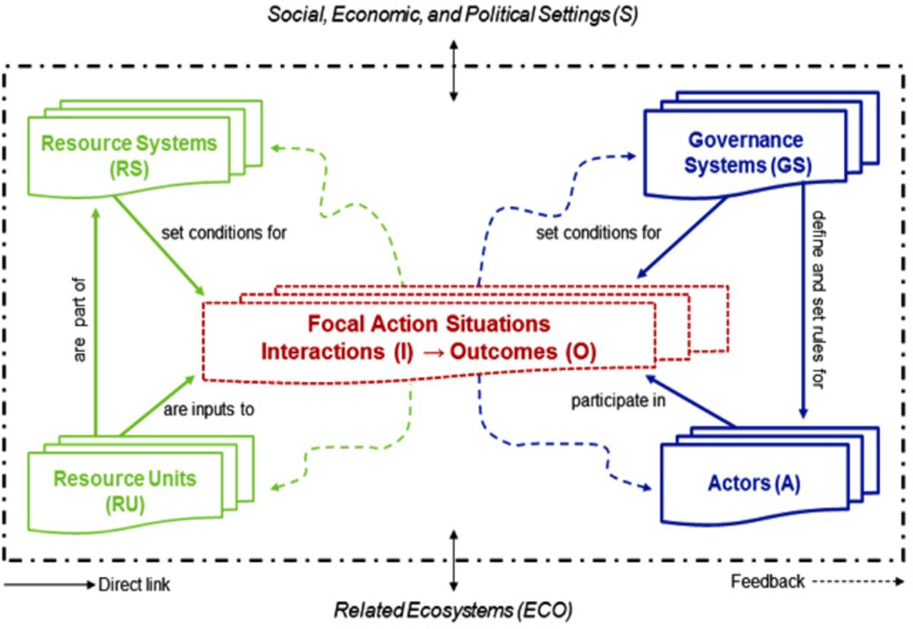
Social-Ecological Systems Framework
(McGinnis and Ostrom 2014)
© McGinnis and Ostrom 2014
Reprinted from Ecology and Society, Vol.19, No.2, Michael D. McGinnis and Elinor Ostrom,
'Social-ecological system framework: initial changes and continuing challenges', (c) 2014.
Reprinted under Creative Commons license CC BY-NC 4.0.
Notes:
This framework builds on decades of work by Elinor Ostrom on common pool resource systems (like lakes and forests) and the conditions under which community-level resource governance can succeed.
The SES framework provides a common language for (i) comparing cases; (ii) organising variables; (iii) facilitating selection of variables in a case study (McGinnis and Ostrom 2014).
The framework describes the SES as an interaction between a set of ‘first tier’ variables including resource units (e.g. trees or fish), resource systems (e.g. a forest or a lake), actors (e.g. different stakeholder groups) and governance systems (e.g. community resource management institutions). Beneath each first tier variable sits a set of second tier variables that allow you to describe the SES in more detail (e.g. under the ‘interaction’ variable, one might find ‘harvesting rate’ to represent how actors impact on the ecological system by using resources, and ‘sharing of information’ to represent how actors assess the condition of the resource).

Slide 24
Strengths and weaknesses of Ostrom’s SES framework
Strengths
Structures the analysis of complex processes
Linkages (to related ecosystems or external drivers) and dynamics are in-built
Gives equal weight to social and ecological components of the system
Requires interdisciplinary and cross-sectoral collaboration – leading to better understanding and decision-making
Weaknesses
Works well for the analysis of territorial and well defined case studies, but less so for broader (national) scales or for spatially scattered actions and initiatives

Slide 25
References
Key readings
McGinnis, M.D. and Ostrom, E. (2014) Social-ecological system framework: Initial changes and continuing challenges. Ecology and Society 19(2): 30.
Raworth, K. (2012) A safe and just space for humanity: can we live within the doughnut? Oxfam Policy and Practice: Climate Change and Resilience 8: 1-26.
Rockström, J. et al. (2009) Planetary boundaries: Exploring the safe operating space for humanity. Ecology and Society 14(2): 32.
Scoones, I. (2009) Livelihoods perspectives and rural development. The Journal of Peasant Studies 36:171-196.
van Wilgen, B.W. et al. (2008). A biome-scale assessment of the impact of invasive alien plants on ecosystem services in South Africa. Journal of Environmental Management 89(4): 336-349.
Other readings
Berkes, F. (2011) Restoring unity: the concept of social-ecological systems. World Fisheries: A Social- Ecological Analysis (eds R.E. Ommer, R.I. Perry, K. Cochrane & P. Cury), pp. 9-28. Wiley Blackwell, Oxford.
Brook, B.W. et al. (2013) Does the terrestrial biosphere have planetary tipping points? Trends in Ecology and Evolution 28: 396-401.
Knutsson, P. (2006) The Sustainable Livelihoods Approach: A framework for knowledge integration assessment. Human Ecology Review 13(1): 90-99.
Ostrom, E. et al. (2009) A general framework for analysing sustainability of social-ecological systems. Science 325: 419-422.
Scheffer, M. et al. (2009) Early-warning signals for critical transitions. Nature 461: 53-59.
Steffen, W. et al. (2015) Planetary boundaries: Guiding human development on a changing planet. Science 347(6223): 1259855.
Svarstad, H. et al. (2008) Discursive biases of the environmental research framework DPSIR. Land Use Policy 25: 116-125.
Notes:
References cited in the Speakers’ notes:
DfID. (1999) Sustainable Livelihoods Guidance Sheets Introduction: Overview. Department for International Development, London, UK.
Folke, C. et al. (2016) Social-ecological resilience and biosphere-based sustainability science. Ecology and Society, 21.
Helbing, D. (2013) Globally networked risks and how to respond. Nature 497: 51-59.
Holling, C.S. (1973) Resilience and Stability of Ecological Systems. Annual Review of Ecology and Systematics 4: 1-23.
Kristensen, P. (2004) The DPSIR Framework. Paper presented at the workshop on a comprehensive/detailed assessment of the vulnerability of water resources to environmental change in Africa using river basin approach. UNEP headquarters, Nairobi, Kenya. Available at: https://wwz.ifremer.fr/dce/content/download/69291/913220/file/DPSIR.pdf
MA. (2005) Ecosystems and Human Well-Being. Island Press, Washington, DC.

Slide 26
Guided reading
Please read:
Galafassi, D. et al. (2017) Learning about social-ecological trade-offs. Ecology and Society 22(1): 2. https://doi.org/10.5751/ES-08920-220102
Questions for discussion:
Think of a social-ecological system with which you are familiar. Drawing on the methods outlined in the paper, design a process to engage all stakeholders to:
  Identify possible trade-offs between different ecosystem services, between wellbeing of different groups of people and/or between different values; and
  Negotiate options to mitigate these trade-offs.

