Slide 1
Exploring Human Wellbeing
Topic 02
© iStockphoto.com/guenterguni
Notes:
In our first session we looked at the concept of ecosystem services and compared several frameworks that represent how ecosystem services are linked to poverty alleviation or wellbeing. Today we are going to look at the topic of wellbeing in more detail.

Slide 2
Learning outcomes
Explain wellbeing as a multi-dimensional concept
Analyse how wellbeing aspirations of different people depend (and impact) on different ecosystem services
Be aware of gender differences in the relationship between ecosystem services and wellbeing
Notes:
After this session you should be able to:
Explain wellbeing as a multidimensional concept and understand why there has been a shift from talking about poverty to focusing on wellbeing
Analyse how the different wellbeing aspirations of different groups of people depend on ecosystem services (and we will look at a few methods available for helping with this)
Be aware of gender as a key factor to consider in this regard.

Slide 3
Why are we interested in wellbeing?
Ecosystem services are indispensable to the wellbeing of all people in all places (directly or indirectly)
Many unresolved questions:
What is the relationship between the flow of ecosystem services and the level of human wellbeing?
How does the relationship change over space and time?
What trade-offs exist between how different people use ecosystem services to meet their wellbeing aspirations?
Who experiences gains and losses of wellbeing under conditions of ecosystem change?
Notes:
Human wellbeing (HWB) is a central component of the ecosystem services (ES) concept. As we said in our introductory session, the whole idea of ecosystem services is a fundamentally anthropocentric view of the environment – services are only important if there are people (or ‘beneficiaries’) to enjoy those services.
We are ALL dependent on ecosystem services in some way, some of us more directly and some more indirectly.
We want to better understand the relationship between the flow of ecosystem services and HWB, as it can be both positive and negative (e.g. think about pests and diseases).
The relationship between ES and HWB may also change over time (as people’s needs and desires change) and in different places.
All these different aspirations that people have for their own wellbeing and how they use ES to achieve their wellbeing can often result in trade-offs (e.g. you may want to dam a river for hydropower but I may want to keep it undammed to protect biodiversity).
When there is ecosystem degradation, we need to know who is going to be affected and in what way so that we can mitigate or compensate for their losses.

Slide 4
Wellbeing: a multi-dimensional concept

Slide 5
Class exercise: What makes you happy?
Talk to your neighbour for 3 minutes and identify the most important factors that contribute to your wellbeing
Notes:
[The aim of this exercise is to get students to think broadly about their wellbeing, not just focusing on environment-related issues. Write up answers on the board and start grouping them into various categories, e.g.:
Material items that constitute basic needs (food, shelter, water, health)
Material items of greater (luxury?) value like mobile phones, radios, bikes
Non-material items like education, employment, their family and friends, their church, security, the freedom/opportunity to choose to do new activities
Conclude that we have a common set of basic needs but, going beyond basic survival, we then become very different in what makes us happy – and our wellbeing aspirations will continue to change as our life circumstances change (e.g. as we get older, or move to a different place)]

Slide 6
How is poverty assessed?
Conventional measures focus on income per capita per day
What is the poverty line in this country?
Some metrics may look at fulfilment of basic needs (e.g. Basic Needs Index)
Declaration of Human Rights Article 25:
“Everyone has the right to a standard of living adequate for the health and well-being of himself and of his family, including food, clothing, housing and medical care and necessary social services”
Are these sufficient to capture all aspects of what we need for our wellbeing?
MA framework talks of ‘freedom of choice and action’
IPBES framework talks of ‘good quality of life’
Notes:
Conventionally poverty is often assessed using very simple indicators, most commonly US$ income per capita per day. Having a simple figure is useful to enable comparisons between people and places, and to monitor changes over time.
Question to students: Does anybody know what the poverty line is in our country? And what proportion of the population are considered to be below/above it? [Reflect on the fact that even people below the poverty line may consider many aspects of their life to be good.]
As we established in our previous exercise, income alone does not capture the full extent of our wellbeing. Therefore many different approaches exist to measuring how good our lives are. Some focus just on the basic needs we have to survive. [You may want to look at http://ophi.org.uk/multidimensional-poverty-index/ for the multi-dimensional poverty index used by UNDP in its annual Human Development Report]
Note that the Declaration of Human Rights takes an expanded basic needs approach which includes access to social services, and introduces the idea of wellbeing – but is still very focused on material aspects.
But in the context of ecosystem services, we tend to go beyond basic needs, e.g. the MA framework considers the ‘freedom of choice and action’ while the IPBES framework talks of ‘good quality of life’

Slide 7
Shifting from a poverty framing to one of ‘wellbeing’ (Coulthard et al. 2018)
Poor people are not defined by their poverty alone. Poverty focuses on what people lack, and misses the (often innovative) strategies they pursue to achieve wellbeing.
A positive focus on wellbeing is a more respectful and well-rounded way of trying to understand a person’s life, avoiding labelling and disempowerment of ‘the poor’.
Offers a more holistic account, centred on the person, and a more socially enriched analysis.
Notes:
There have been many advances in measuring poverty, moving away from simple income and expenditure measures to a multi-dimensional poverty index. This leads to some blurring between multi-dimensional poverty and multi-dimensional wellbeing.
However, there are several reasons why using a wellbeing framing is often more appropriate than talking about poverty:
Poor people are not defined by their poverty alone. Poverty focuses on what people lack, and misses the (often innovative) strategies they pursue to achieve wellbeing.
A positive focus on wellbeing is a more respectful and well-rounded way of trying to understand a person’s life, avoiding labelling (and stigmatisation) and disempowerment of ‘the poor’ or seeing them as ‘hapless victims’ who have no agency.
Offers a more holistic account, centred on the whole person rather than compartmentalising their lives into a few economic decisions, and a more socially enriched analysis.

Slide 8
Multidimensional Wellbeing
Drawing on Sen, wellbeing comprises of:
What people have
What they can do
And, how they think about what they have and can do
Multidimensional wellbeing considers:
objective conditions of people,
their subjective assessment of their lives and conditions, and
their relational dimensions including social relationships and how these shape wellbeing achievements
Wellbeing is differentially experienced and perceived across cultures and socioeconomic gradients
Notes:
There is no universal definition of wellbeing.
Thinking about wellbeing dates back to Amartya Sen’s capabilities framework in the 1980s (Sen 1999). He argued that judgements of a quality of life should focus on what people are able (or have the capability) to achieve, rather than solely on what they have or what they lack.
An important contribution to the debate was the World Bank publication ‘Voices of the Poor’ (Narayan 2000), which for the first time really let poor people speak for themselves and gave insights into their own perception of what they required to be able to participate in society.
Modern definition of multidimensional wellbeing looks at three dimensions:
Objective conditions of people (these can be objectively measured, there is some overlap with ‘material’ conditions, e.g. income, food security, health)
Subjective dimensions – this is how people assess their own life. Two people with the same income or material assets may feel very differently about their quality of life
Relational dimension – recognises the importance of our relations with each other (and with nature)
Very importantly, we now recognise that wellbeing is experienced differently by different people.

Slide 9
How do ecosystem services contribute to wellbeing?
Notes:
We have looked at definitions of wellbeing more generally. Now let us look specifically at how ES can contribute to HWB.

Slide 10
Case study: Community-based forest management (CBFM) in Tanzania (Gross-Camp 2017)
Methods
Worked in 8 villages (4 with CBFM and 4 without) in Tanzania
Used participatory video to understand how people defined wellbeing
Used these local wellbeing indicators in household surveys to assess changes in household-level wellbeing from 2005-2015
Results
CBFM did not lead to differences in household wellbeing
But CBFM villagers were strongly supportive of CBFM as:
They valued the forest as a future source of forest products
CBFM secured land for the community and protected it from exploitation by outsiders
They were proud that their conservation efforts were recognised by outsiders
Notes:
This study shows that wellbeing can be different when considered at household and at community level.
It combined innovative use of participatory video – to enable people to define their own wellbeing indicators – with household surveys.
It found no difference in wellbeing between those households in CBFM villages and those in non-CBFM villages.
However, villagers in CBFM villagers were nevertheless very supportive of their CBFM.
The reasons they gave are all things which are unlikely to be captured in a conventional poverty assessment. They highlight how a community forest can contribute to a community-level sense of wellbeing without having any discernible impact on household wellbeing indicators (like income).

Slide 11
Case study: Ecosystem disservices (Dzingirai et al. 2017)
Social and ecological factors can affect the transmission of disease from animals to humans
Lassa fever (Sierra Leone)
Transmission is through burrowing rats
Rats favour agricultural mounds (for yams and cassava) and homes with mud walls and thatch roofs
Risk is higher for women who weed, water and harvest the agricultural mounds, and for the poor
Trypanosomiasis (Zimbabwe)
Spread by tsetse flies, restricted to small pockets of forest
Risk is higher for recent migrants clearing fields, young men herding livestock, foragers (usually women) and hunters; and is worse in the dry season when flies, humans and livestock congregate in these areas.
More effective interventions need to know who gets sick, when and where.
Notes:
This study looked at the transmission of different zoonotic diseases in Africa.
It highlights that health is an important part of wellbeing (though it is sometimes treated as a separate issue).
It also highlights the need for social differentiation – in this case, the to understand the ways different groups of people interact with the environment (and therefore the disease transmitter) in order to plan interventions properly.

Slide 12
Does improving ecosystem quality improve wellbeing? (Daw et al. 2016)
‘Ecosystem elasticity’ describes how wellbeing responds to changes in ecosystem quality
Positive elasticity can be high (e.g. conservation of charismatic species leads to increased income for tour guides) or low (e.g. improvement in coral reef status leads to a slight enhancement of shoreline protection)
Negative elasticity e.g. when conservation leads to human-wildlife conflict
Reprinted from Ecology and Society, Vol.21, No.2, Tim M. Daw, Christina C. Hicks, Katrina Brown, Tomas Chaigneau, Fraser A. Januchowski-Hartley, William W. L. Cheung, Sergio Rosendo, Beatrice Crona, Sarah Coulthard, Chris Sandbrook, Chris Perry, Salomao Bandeira, Nyawira A. Muthiga, Bjorn Schulte-Herbruggen, Jard Bosire, Tim R. McClanahan, 'Elasticity in ecosystem services: exploring the variable relationship between ecosystems and human well-being' (2016), under Creative Commons license CC BY-NC 4.0
Notes:
The previous two studies illustrate that we should not assume that enhancing ecosystem services will automatically (or dramatically) increase wellbeing.
Tim Daw and colleagues have introduced the idea of ‘ecosystem elasticity’
The figure shows two forms of positive elasticity (high and low), and negative elasticity.
Why is it important to know what kind of ES-HWB relationship you are dealing with? Because interventions need to be designed differently depending on the situation, e.g. if people benefit directly and strongly (i.e. high positive elasticity) they are much more likely to support the intervention than if this is not the case. Thus, in situations of low positive elasticity (or indeed negative elasticity), it might not be reasonable to expect communities to get heavily involved in community conservation.

Slide 13
Class exercise: thinking about elasticity
Talk to your neighbour for 5 minutes and think of examples of:
High positive elasticity
Low positive elasticity
Negative elasticity
Notes:
[Perhaps ask students specifically to focus on examples from your country. Pick a few pairs to present to the others and then ask for any additional examples. If you have time, take the discussion further to think about the kinds of interventions that are made to enhance these ecosystems and determine whether an understanding of elasticity would affect how the intervention is designed.]

Slide 14
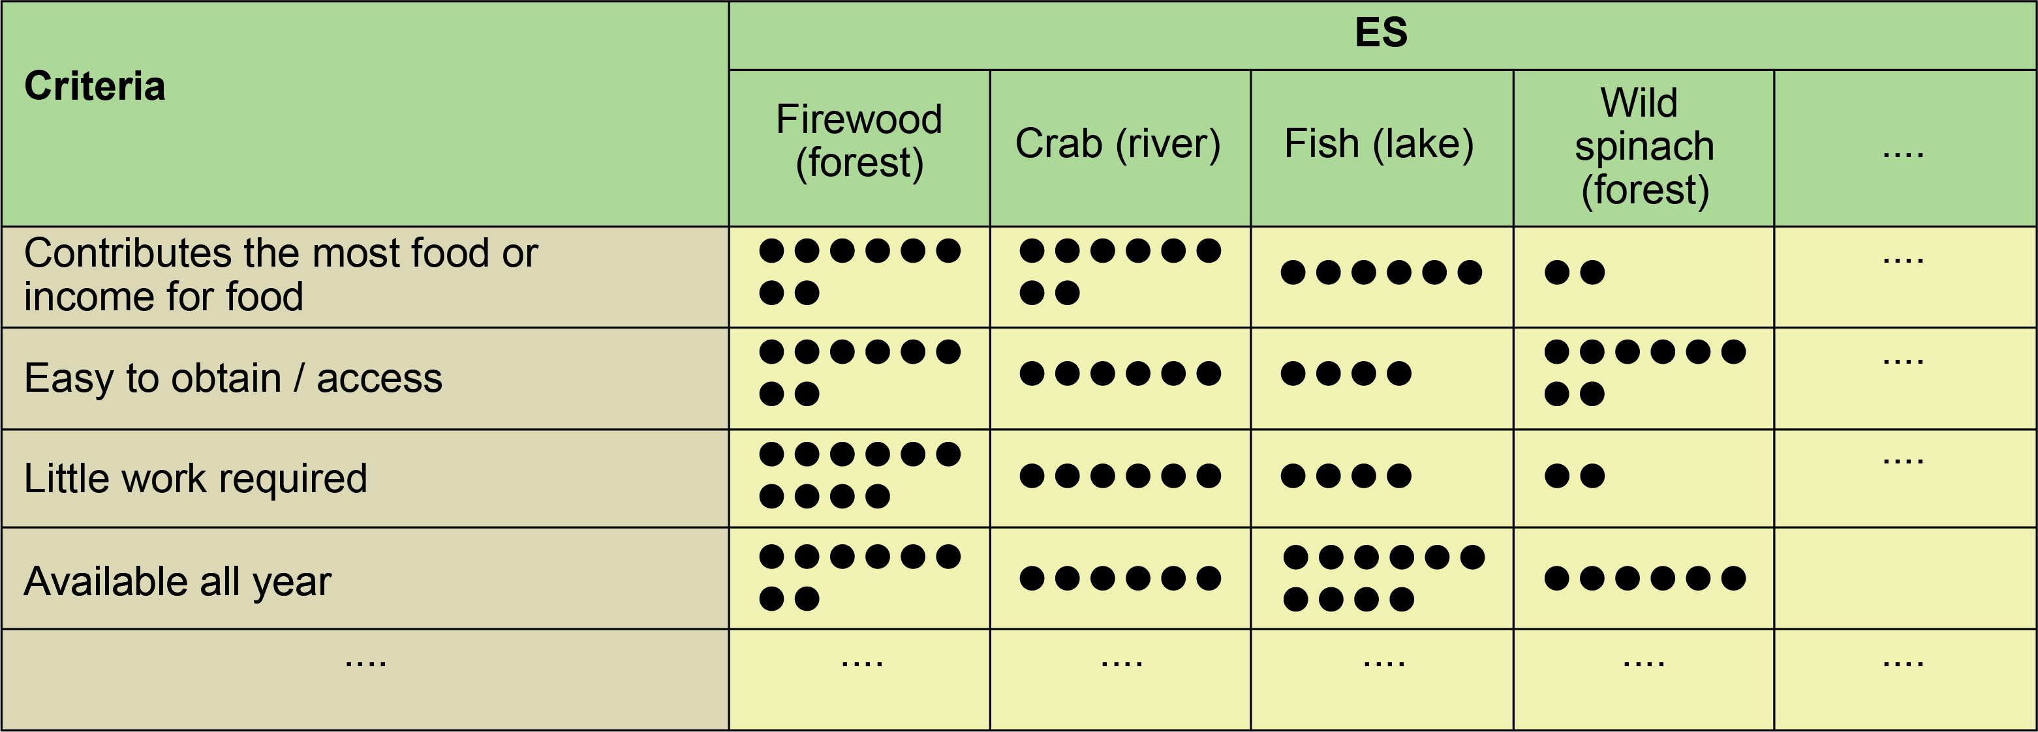
Methods for assessing how ES contribute to wellbeing (Schreckenberg et al. 2016)
Participatory methods can be useful for understanding how people rely on ES – they can be used separately for different social groups
Matrix scoring to understand why people prefer certain ES
Participatory mapping for location of ES
Trend analyses to show how use of (availability of) ES has changed over time
© Schreckenberg et al. (2016)
Notes:
What kinds of methods can we use to assess the contribution of ES to HWB?
Several participatory research methods can be useful, and they are easy to apply to different social groups
The diagram gives an example of matrix scoring used to promote discussion about the different criteria people use when thinking about which ES they prefer.

Slide 15
Using the Global Person Generated Index to assess perceived impacts of conservation interventions on wellbeing (Rasolofoson et al. 2018)
GPGI captures multiple dimensions of wellbeing
Allows people to select, rate and weigh the relative importance of domains that matter most for their wellbeing
GPGI score can be compared between different social groups and used to assess impact of interventions on wellbeing.
1. What three things matter to you for a good life?
2. How are you doing in each of these areas from very bad to very good?
GPGI
3. Use the beans to show the relative importance of these in your life
4. How much of your performance in each domain is a result of studying at this University?
Participatory impact evaluation
Notes:
Another useful method is the Global Person Generated Index (GPGI). The GPGI was developed by the Wellbeing in Developing countries project and has been tested in many countries. It involves 4 main steps:
[Ask for a volunteer and make sure you have a board or flipchart and pens, or do the exercise on the floor with 10 beans, sweets, bits of paper, etc.]
Lets try out a simplified version
[Ask the volunteer:] 1. “What three things matter to you for a good life?” [Write these on a board or flipchart, or mark them out on the floor]
[Ask the volunteer:] 2. “How are you doing in each of these areas from very bad to very good”
[Give the volunteer a pen and ask them to distribute 10 points (or 10 beans if using the floor) between the domains in terms of importance:] 3. “Please use the beans to show the relative importance of these in your life”
[Remind them that if using this for real you would do participatory work before developing the method in an area to decide what to prompt (based on what would be likely responses, e.g. so that people don’t forget health for example.)]
These GPGI scores can be compared between different social groups, e.g. this study found that GPGI was higher (though not statistically so) for richer than for poorer households and was higher for healthy people compared with unhealthy people.
4. This study wanted to determine how much a conservation intervention (community forestry in some villages and strict conservation in other villages) had impacted the person’s performance in each domain. The results in this case found no significant difference in how the two conservation interventions affected GPGI, though they did affect different domains.
In our case, let’s ask: “How much of your performance in each domain is a result of studying at [insert name of your own university] University?”

Slide 16
Gendered perspectives on ecosystem services and wellbeing

Slide 17
What is gender?
Gender refers to the socially constructed roles, behaviours, activities and attributes that a given society considers appropriate for men and women.
Gender roles are the particular economic, social roles and responsibilities considered appropriate for women and men in a given society.
Gender is not just about women. Gender relations affect household security, family wellbeing, production and many other aspects of life.
Notes:
While sex and its associated biological functions are programmed genetically, gender roles and the power relations they reflect are a social construct – they vary across cultures and through time, and thus are amenable to change. (MWIA 2002)
Question to students: Can you give me some examples of gendered roles in our society, thinking in particular of roles that relate to ES in some way? [Possible answers: students will probably come up with women being responsible for collection of water and firewood, perhaps also other wild-harvested products, and certain aspects of agriculture (often sowing and weeding), whereas men are responsible for clearing fields. Could discuss the implications of this, e.g. degradation of firewood or water sources will particularly affect women and may reduce the time they have available to invest in other (re)productive activities.]
Question to students: What is the legal situation in this country with respect to women’s and men’s rights? [Possible answer: hopefully they will respond that women and men have the same rights – which means that their views in relation to ES should carry equal weight.]

Slide 18
Gender and ecosystem services
Gender highly prominent in the development agenda since 1980s
But a ‘blind spot’ in the ecosystem services literature (Brown and Fortnam 2018)
Why does this matter?
Gender is likely to determine how people benefit from ES
Sustainable Development Goals aim to ’leave no-one behind’
The intersection of gender with factors like age, caste and ethnicity can further reduce the inability of women to make their voices heard.
Notes:
Although gender has been so prominent in the development literature since the 1980s, there is very little literature specifically on ES and gender.
For example, there was very little mention of gender issues in the Millennium Ecosystem Assessment. And a recent review of 462 papers dealing with ES and HWB found that only 5 papers focused on gender (Cruz-Garcia et al. 2017)
Why does it matter?
Firstly, men and women are likely to benefit differently from ES so that ignoring their separate perspectives makes ecosystem service frameworks weakly aligned with the central concerns of global development around equity, justice, knowledge and voice.
Secondly, the global development agenda, as articulated through Agenda 2030 and operationalised in the Sustainable Development Goals (SDGs), seeks to ‘leave no-one behind’. In other words, inclusive and sustainable development cannot be achieved without detailed consideration of social difference and, in particular, gender.
At the same time, it is important to remember that there are many other factors that can affect how women benefit (or not) from ecosystem services. Factors like age or ethnicity can affect both men and women, but when affecting women – this constitutes a ‘double whammy’.

Slide 19
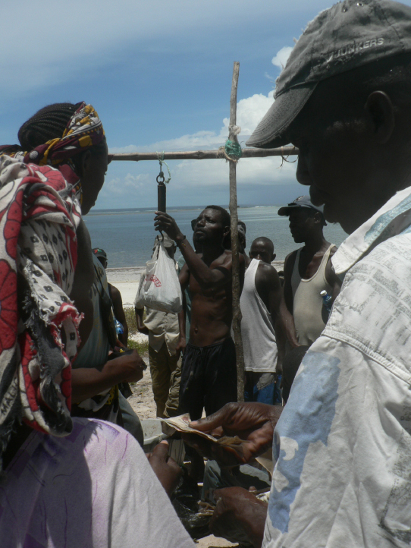
Gendered trade-offs in Ecosystem Services Men and women perceive, value and benefit from ecosystem services differently
Reprinted with permission from Tim Daw / ESPA SPACES
Notes:
Studies have overlooked gender trade-offs. Howe et al. (2014) established that none of the 92 studies reviewed analyse gender trade-offs
Men and women perceive and value ecosystem services differently - mixed evidence for this
Some literature suggests men are more likely to be using provisioning ES, while women may be more likely to use regulating ES (and these are often less visible and less valued).
Not all women are the same!
Are women more dependent on ecosystem services than men?
They tend to be more dependent on common pool resources or open access resources (e.g. for collecting firewood and water)
Convergence of domestic and productive tasks e.g. collecting water and firewood

Slide 20
Class exercise: Why might there be a bias against women in ecosystem service assessments and decision-making?
Reprinted with permission from Joachim Cheupe / ESPA SPACES
Notes:
The literature suggests that there is often a bias against women in assessments and decision-making about ES. Why might this be?
[Reasons could include:
Invisibility of women’s activities and views
Assumptions that communities are homogenous
Focusing on income generating /provisioning vs subsistence / broader ecosystem services (with women more likely to be interested in lower value and less visible ES)
Poor participation by women in decision-making, agenda-setting and framing of ecosystem services interventions
Physical spaces are gendered (women may not be able to access remote areas)
Livelihood strategies are gendered (specialisation vs diversification)]

Slide 21
Factors hindering integration of gender and ecosystem services
Participation in decision-making is often not meaningful
To give women true agency in decision-making, they need to have sufficient capacity to make decisions and influence the decisions of others
Few interventions on ecosystem services take rights-based approaches to transform the structures by which women are inhibited from benefiting from ecosystem services
Notes:
[In relation to Bullet 1, note that we will talk more about the challenges of achieving effective participation in Topic 7 on Equity and Justice]

Slide 22
In summary…
Wellbeing is multidimensional (objective, subjective, relational)
It varies from person to person and can change over time
Different people rely to a different extent on ES for their wellbeing
There is a particular need to understand how ES-HWB relationships vary by gender (as well as for other societal groups)
There may be trade-offs between how different people use ES to meet their wellbeing aspirations

Slide 23
References
Key readings
Brown, K. and Fortnam, M. (2018) Gender and ecosystem services: a blind spot. Chapter 16 in Schreckenberg, K., Mace, G. and Poudyal, M. (eds) Ecosystem services and poverty alleviation: Trade-offs and governance. Routledge.
Coultard, S. et al. (2018) Multiple dimensions of wellbeing in practice. Chapter 15 in Schreckenberg, K., Mace, G. and Poudyal, M. (eds) Ecosystem services and poverty alleviation: Trade-offs and governance. Routledge.
Daw, T.M. et al. (2016). Elasticity in ecosystem services: exploring the variable relationship between ecosystems and human well-being. Ecology and Society 21(2):11. http://dx.doi.org/10.5751/ES-08173-210211
Other readings
Dzingirai, V. et al. (2017) Zoonotic diseases: who gets sick, and why? Explorations from Africa. Critical Public Health 27: 97-110.
Gross-Camp, N. (2017) Tanzania’s community forests: their impact on human well-being and persistence in spite of the lack of benefit. Ecology and Society 22(1):37. https://doi.org/10.5751/ES-09124-220137
Rasolofoson, R.A. et al. (2018) The potential of the Global Person Generated Index for evaluating the perceived impacts of conservation interventions on subjective wellbeing. World Development 105: 107-118.
Schreckenberg, K. et al. (2016) Participatory data collection for Ecosystem Services Research: A Practitioner’s Manual. ESPA Working Paper Series No. 3. 127pp. Available at: http://www.espa.ac.uk/files/espa/PRA-Manual.pdf
Notes:
References cited in the Speakers’ notes:
Cruz-Garcia, G.S. et al. (2017) To what extent have the links between ecosystem services and human well-being been researched in Africa, Asia, and Latin America? Ecosystem Services 25: 201-212.
Howe, C. et al. (2014) Creating win-wins from trade-offs? Ecosystem services for human well-being: A meta-analysis of ecosystem service trade-offs and synergies in the real world. Global Environmental Change 28: 263-275.
MWIA. (2002) Training Manual for Gender Mainstreaming Health. Medical Women’s Association. Available at: http://mwia.net/wp-content/uploads/2013/07/TrainingManualonGenderMainstreaminginHealth.pdf
Narayan, D. et al. (2000) Voices of the Poor: Can Anyone Hear Us? Oxford University Press, New York.
Sen, A. (1999) Development as Freedom. Oxford University Press, Oxford.

Slide 24
Case Study for further discussion
Case Study A: Exploring Trade-offs in Wellbeing in Coastal Systems in Kenya
http://www.espa.ac.uk/projects/ne-i00324x-1
Daw, T.M., et al. (2015) Evaluating taboo trade-offs in ecosystems services and human well-being. Proceedings of the National Academy of Sciences 112: 6949–6954
ESPA. (2014) Sustainable Poverty Alleviation from Coastal Ecosystem Services (SPACES). (Available on: http://www.espa-spaces.org/resources/spaces-data-explorer/)
Notes:
[Please refer to the accompanying case study summary for Case Study A.]

