Slide 1
Ecosystems and
Ecosystem Services
Topic 01
© ESPA/Mairi Dupar

Slide 2
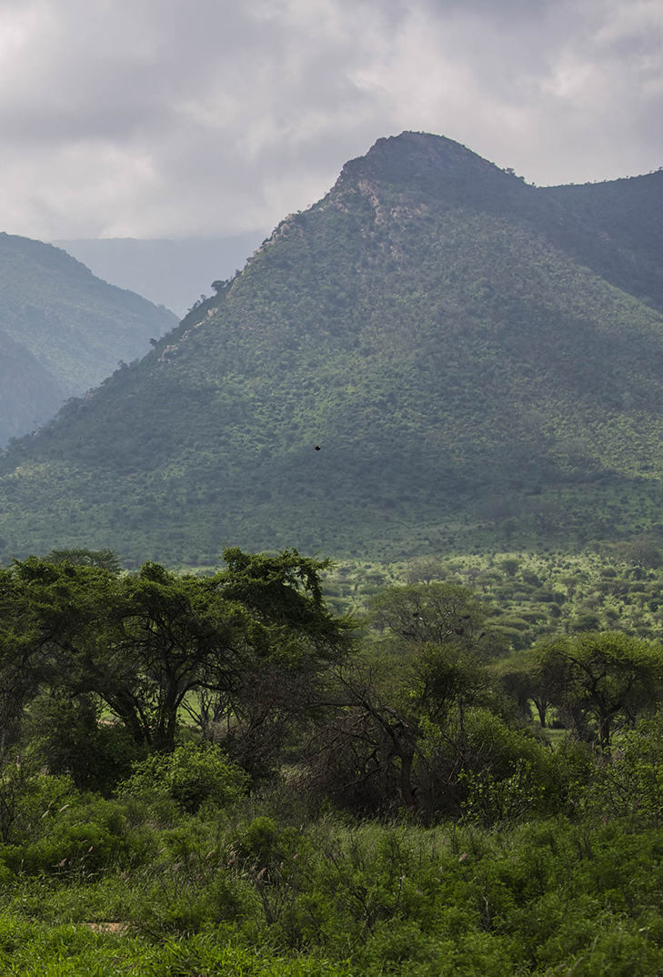
Learning outcomes
Explain the concept of ecosystem services
Compare and contrast different frameworks for analysing the links between ecosystem services and human wellbeing
  MA, ESPA, IPBES
Justify why a holistic understanding and application of ecosystem services for poverty alleviation theory is critical for the attainment of the SDGs
© Ninara
Notes:
Broadly speaking our topic today is about the interaction between people and their environment.
We will start off by looking at the origin and definition of the concept of ecosystem services..
We will then take a more detailed look at some of the major conceptual frameworks that have been used to describe the relationship between people and ecosystem services. We will specifically be looking at 3 main frameworks:
Millennium Ecosystem Assessment (MA 2005)
Ecosystem Services for Poverty Alleviation (Fisher et al. 2014)
IPBES (Intergovernmental Science-Policy Platform on Biodiversity and Ecosystem Services) framework (Diaz et al. 2015)
Finally we will consider why and how taking an ecosystem services approach can contribute to achieving the Sustainable Development Goals (SDGs).

Slide 3
Defining ecosystem services

Slide 4
What are ecosystem services?
“the benefits people obtain from ecosystems”
(MA 2005)
Note: that the concept of ecosystem services takes a very anthropocentric perspective
Notes:
The Millennium Ecosystem Assessment (MA) in 2005 defined Ecosystem Services as “the benefits people obtain from ecosystems”, giving examples such as clean air to breathe, pest and disease control, carbon sequestration and storage, etc.
The key thing to note about this definition is that it takes a highly anthropocentric perspective and focuses specifically on the benefits or ‘services’ that ecosystems provide to people. There is less interest in ecosystems for their own sake (and this is a criticism that is sometimes levelled at the concept of ecosystem services).

Slide 5
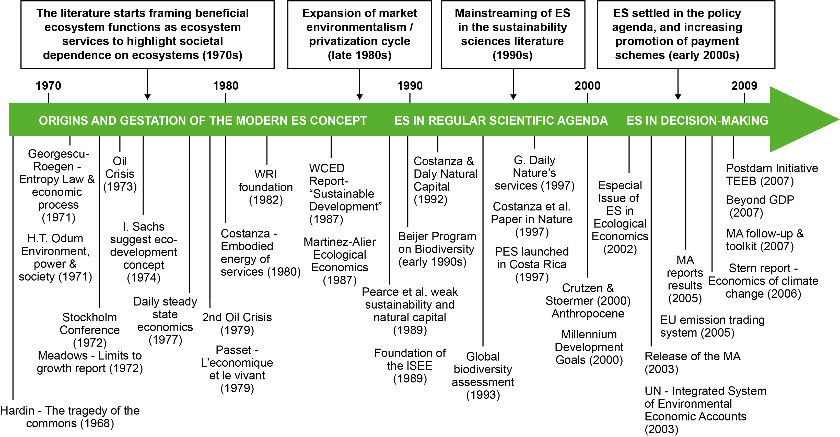
Origin of the Concept of Ecosystem Services
Three stages: (i) Origin and Genesis; (ii) Scientific Agenda; and (iii) Policy Agenda (Gomez-Baggethun et al. 2010)
Reprinted from Ecological Economics, Vol. 69, Issue 1, Erik Gomez-Baggethun, Rudolf de Groot, Pedro L. Lomas, Carlos Montes, 'The history of ecosystem services in economic theory and practice: From early notions to markets and payment schemes', p.1209-1218, Copyright 2010, with permission from Elsevier.
Notes:
The concept of ES can be traced back to the 1970s, when growing concern about environmental degradation led to an interest in highlighting society’s dependence on ecosystems.
There was increasing interest – as part of market liberalisation in the late 1980s – in the idea that market-based approaches might be able to contribute to sustaining the environment.
The wider recognition of the term Ecosystem Services can be traced back to the attempts to assign value to nature’s services through a collaboration of a group of ecologists and economists in the late 1990s (Costanza et al. 1997).
2005 saw publication of the Millennium Ecosystem Assessment which marked the start of a very strong policy focus on ecosystem services.
An important thing to note about the diagram is that many different events and studies have contributed to the development of the concept of ecosystem services, and – as the arrow indicates – it continues to evolve.

Slide 6
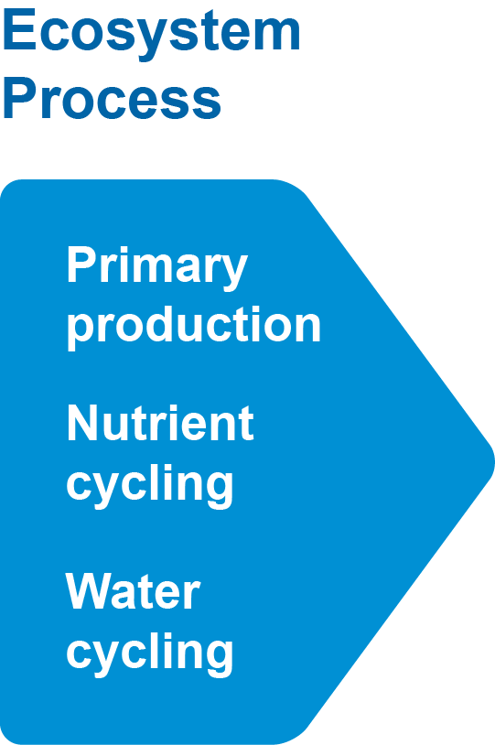
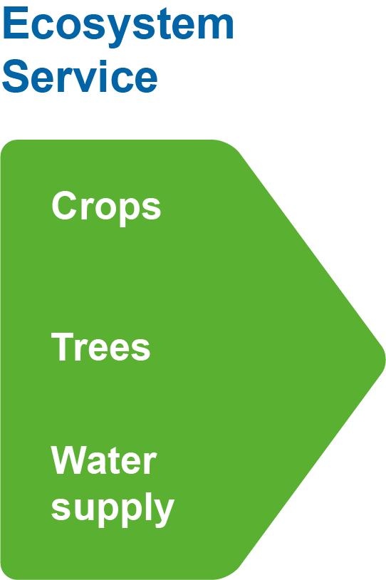
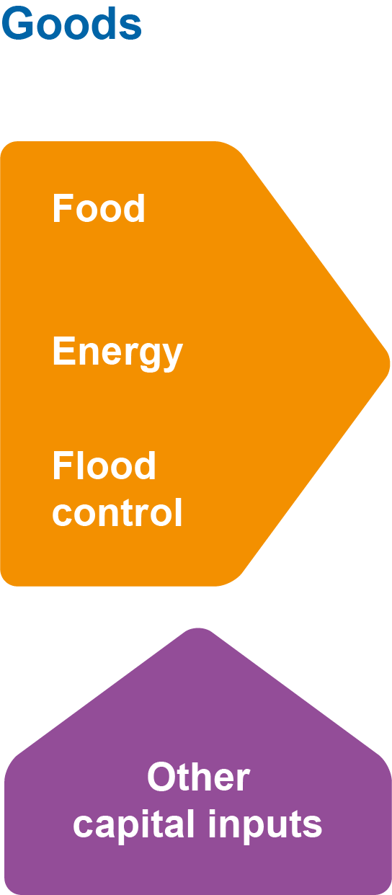

From ecosystems to benefits to people (after Fisher et al. 2008)
Notes:
How do we obtain these benefits from ecosystems?
First we need ecosystem processes – such as primary production, nutrient cycling and water cycling – all of which are necessary to produce ecosystem services.
Ecosystem services include crops, trees, water supply, etc. All of these are potentially useful to people.
But the services are not automatically beneficial to people. For example to obtain food from crops we first need to harvest and cook them – so we need to invest labour to do this. Similarly, we need to invest labour and technology to cut down trees to produce timber or firewood.
The final part of the diagram shows the ‘benefits to people’.
Two important things to note:
The term ecosystem services is often used quite loosely to cover all the last 3 elements of this diagram. That is mostly how we will use it in this course. However, there are times, e.g. when putting economic values on ecosystem services, that it is important to clearly distinguish ecosystem services, goods and benefits. We will come back to this in a later topic.
Although we are all ultimately dependent on ecosystem services for our food, clothes, energy, water and the air we breathe – the longer the distance between the original ecosystem and the benefit, the harder it is for people to recognise the importance of the environment in their lives. For example, people living in towns may feel much less connected to the environment than rural people.

Slide 7
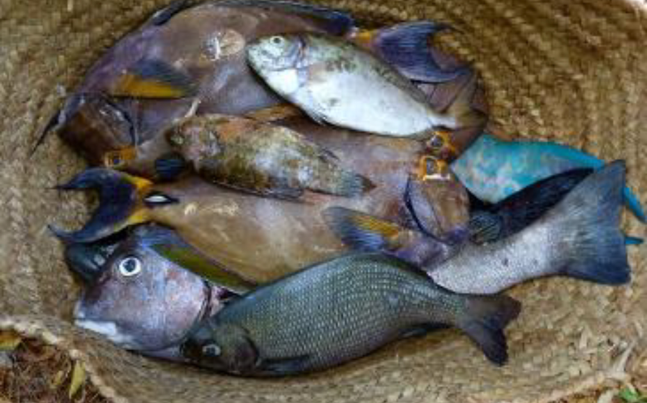
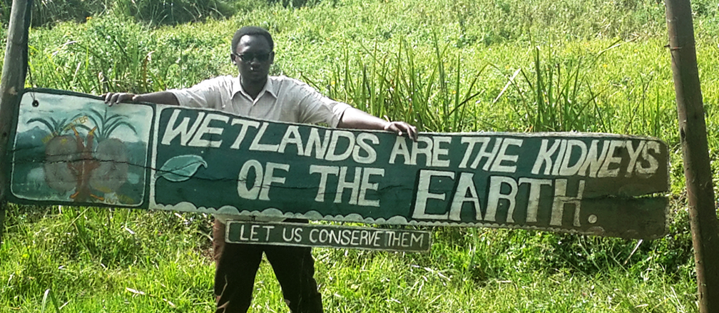
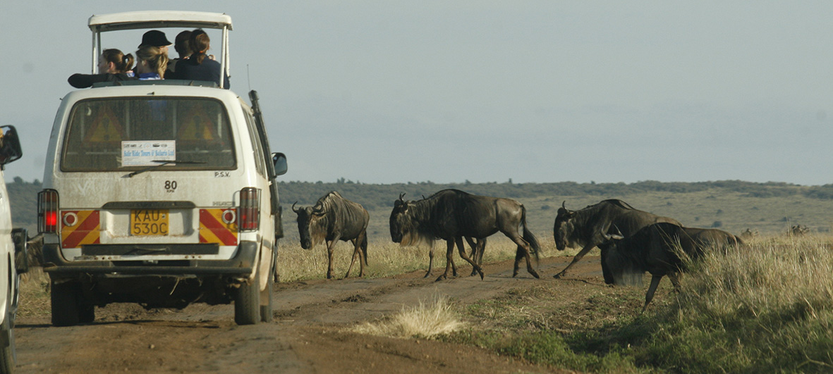
Ecosystem Service categories (MA 2005)
Provisioning Services - food, freshwater, fuel, fibre
Regulating Services - climate and flood regulation, water filtration
Cultural Services - aesthetic, spiritual, educational, recreational
Supporting Services - nutrient cycling, soil formation
N.B. Other categorisations exist,
e.g. by Diaz et al. (2018):
Material, non-material and regulating
© Angela Yang
© Peter Etelej
© DEMOSH
Notes:
Ecosystem services are central to human survival, and to social and economic development especially for the poor and vulnerable sectors of the society
Ecosystems provide individuals, households, businesses and industries with a wide range of services
In 2005, the Millennium Ecosystem Assessment identified and categorised ecosystem services into four categories:
Provisioning services: Food, Fibre, Genetic Resources, Biochemicals, Fresh Water
Regulating services: Air quality regulation, Climate regulation, Water regulation, Erosion regulation, Water purification, Waste treatment, Disease regulation, Pest regulation, Pollination, Natural hazard regulation
Cultural services: Spiritual and religious values, Aesthetic values, Recreation and ecotourism
Supporting services: Nutrient cycling, soil formation, (provides living spaces for plants or animals thereby maintaining the diversity of plants and animals). NB this service underpins all the others.
NB. Although the four categories defined by the MA are still the most widely used, there is much debate about how best to categorise ecosystem services. For example, a recent paper by Diaz et al. (2018) makes the point that cultural services should not be a separate category as culture cuts across many of the other categories (take the example of some foods – these can be both a provisioning service and a cultural service). This paper has therefore suggested categorising ecosystem services as material, non-material and regulating.

Slide 8
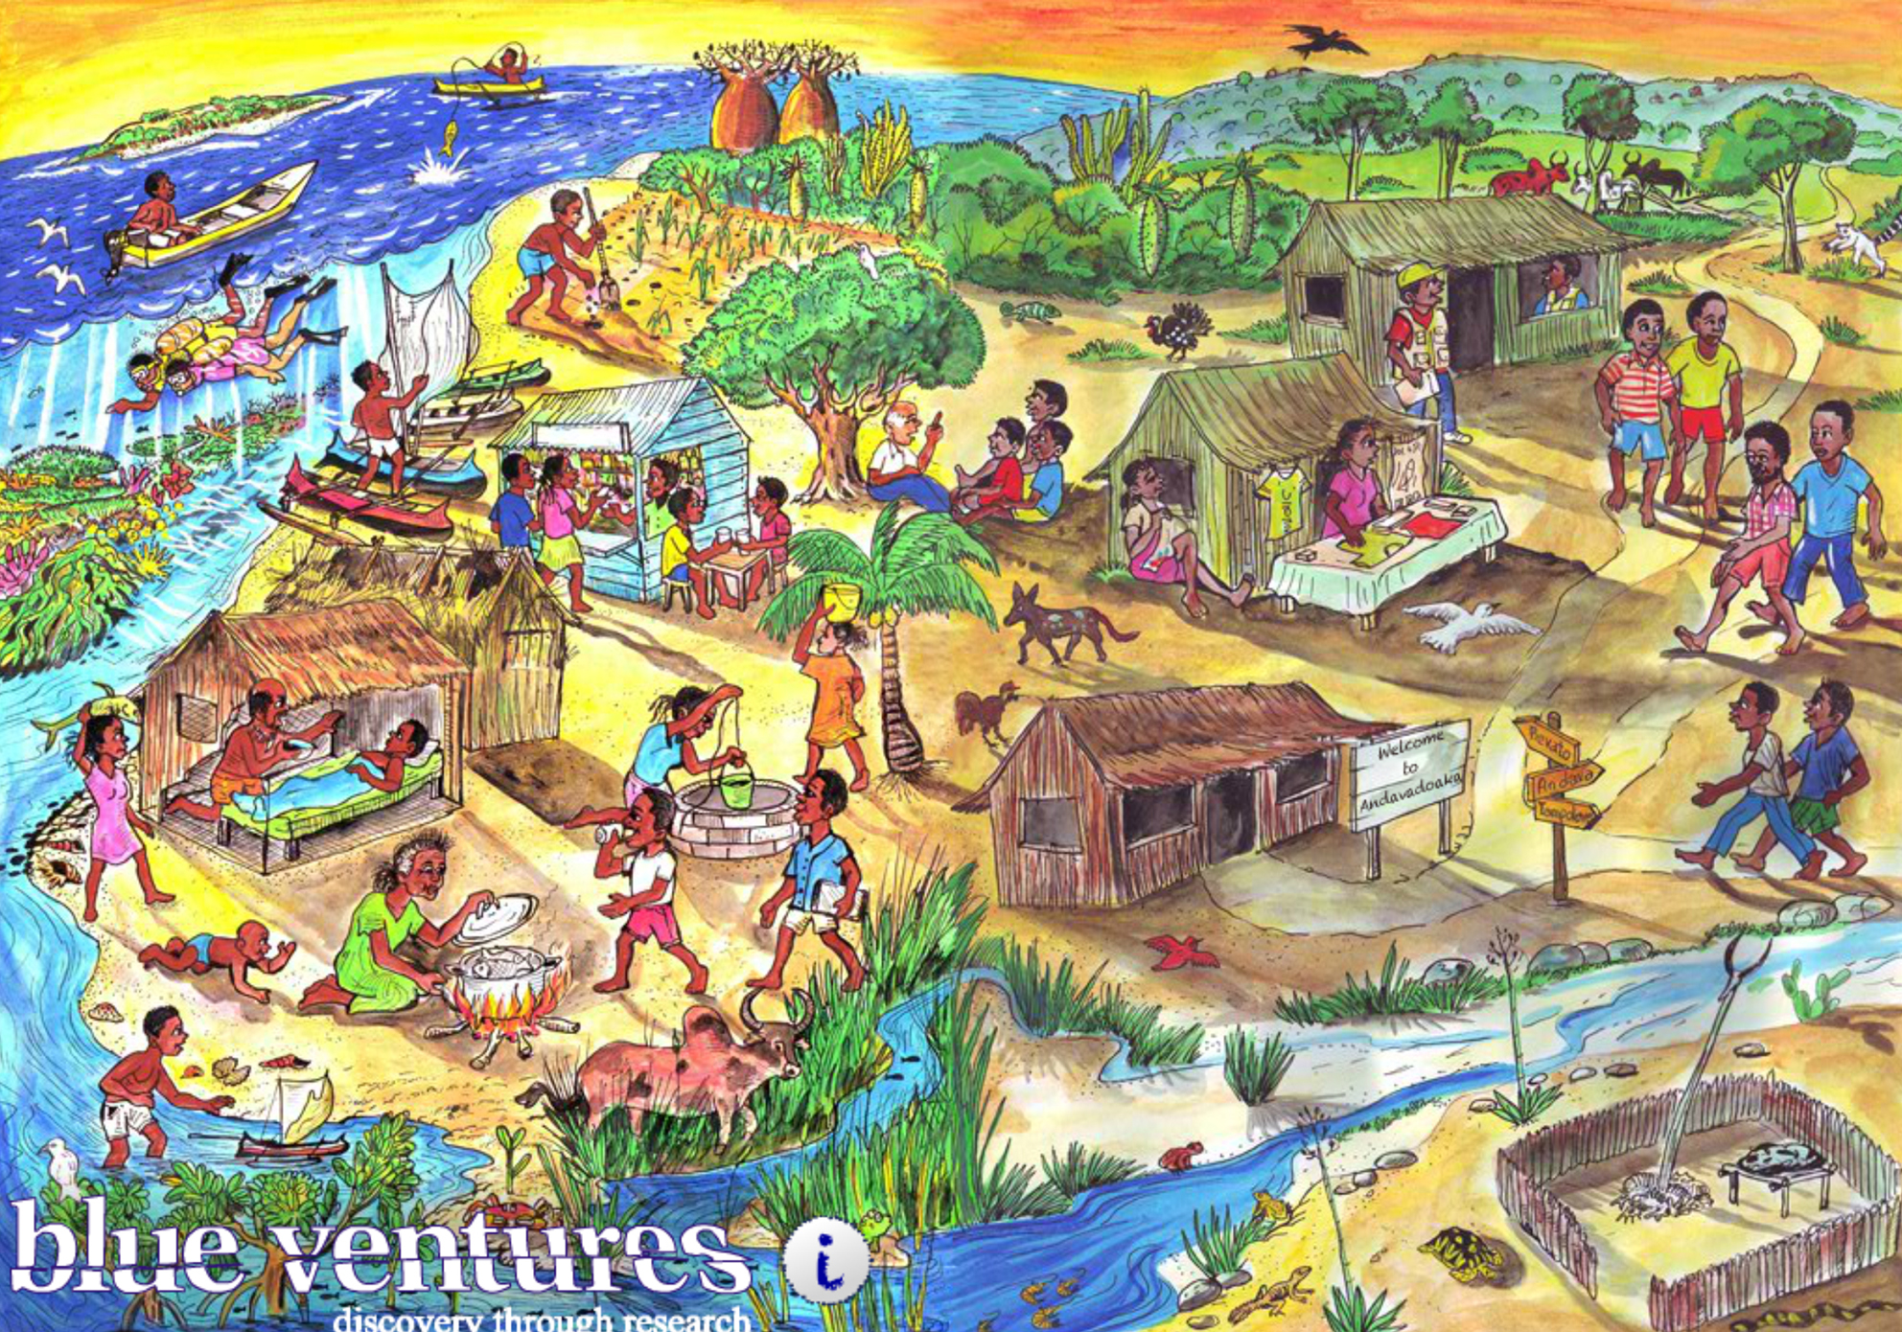
Class exercise: How many ES can you spot?
© Blue Ventures
Notes:
Take 3 minutes to talk to your neighbour and see how many ecosystem services you can spot. Try to spot some in each of the four main categories we talked about.

Slide 9
Other key concepts (to be covered in more detail in future sessions)
Poverty (or wellbeing) – Topic 2
  Is multi-dimensional (objective, subjective and relational)
  Can be measured in absolute or relative terms
Social-ecological systems – Topic 3
  Humans are part of – not apart from – nature
  Emphasis on the embedded and interdependent nature of society and ecosystems and how they shape one another (Folke et al. 2016)
Environmental justice – Topic 7
  Three interlinked dimensions: Recognition, Procedure and Distribution
Notes:
Here we introduce very briefly three other key concepts, which we will cover in more detail in subsequent sessions.
Poverty/wellbeing: As our focus is on ecosystem services for poverty alleviation, it is important to have a clear idea of what we mean by poverty. Recent literature prefers to talk of ‘wellbeing’ than poverty, one reason being that wellbeing focuses more on what people have (giving them greater agency) than what they lack.
Both poverty and wellbeing have multiple dimensions
Poverty is sometimes measured in absolute terms (e.g. $ income per day) or presented relative to a baseline (e.g. national poverty line)
Social-ecological systems: There are many definitions but all move away from a simple and linear relationship between society and nature, seeing them rather as interdependent with many feedbacks between them.
Environmental justice (also often called equity): An increasingly important concept in development, with 3 dimensions:
Recognition of people’s rights, values, etc.
Procedures that allow effective participation of all relevant stakeholders and rightsholders.
Distribution of positive and negative impacts in a manner considered fair by stakeholders.

Slide 10
Three key conceptual frameworks describing the relationship between ecosystem services and people
Notes:
The provision of ecosystem services (ES) is widely assumed to contribute to poverty alleviation, particularly in rural areas of developing countries and consequently the degradation of these services is also assumed to result in negative effects on human wellbeing (Tallis et al. 2008), or to undermine efforts to reduce poverty (Sjostedt 2012).
However, arguments remain about the direction of causality – whether poverty creates, or is a result of, environmental degradation (Sandker et al. 2012).
Beyond large scale correlative studies mapping global patterns of wealth, biodiversity and environmental change (Turner et al. 2012), little attention has been paid to understanding the ways in which ES actually contribute to poverty alleviation, or even if it is possible in practice.
Frameworks have been developed that can help in understanding the relationships between ecosystem services and poverty alleviation. Today we will look at three that are either very well-known or very comprehensive.

Slide 11
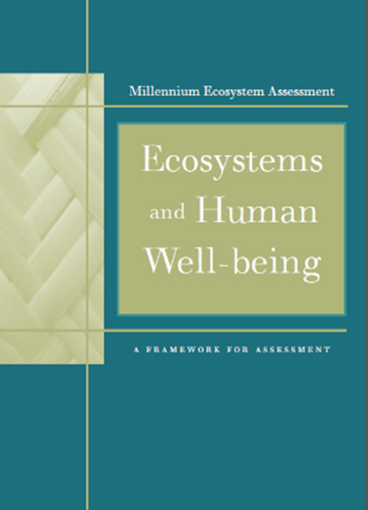
Millennium Ecosystem Assessment (MA 2005)
Launched in 2001 by the
UN Environment Programme (UNEP) to assess the consequence of ecosystems change for human wellbeing and recommend actions needed
Identified and categorised ecosystems and their resulting services
Identified the links between these services and human societies, and
The direct and indirect drivers and feedback loops.
© Millenium Ecosystem Assessment
Notes:
The Millennium Ecosystem Assessment was carried out to assess the consequences of ecosystem change for human wellbeing and to establish the scientific basis for actions needed to enhance the conservation and sustainable use of ecosystems and their contributions to human wellbeing and poverty alleviation.

Slide 12
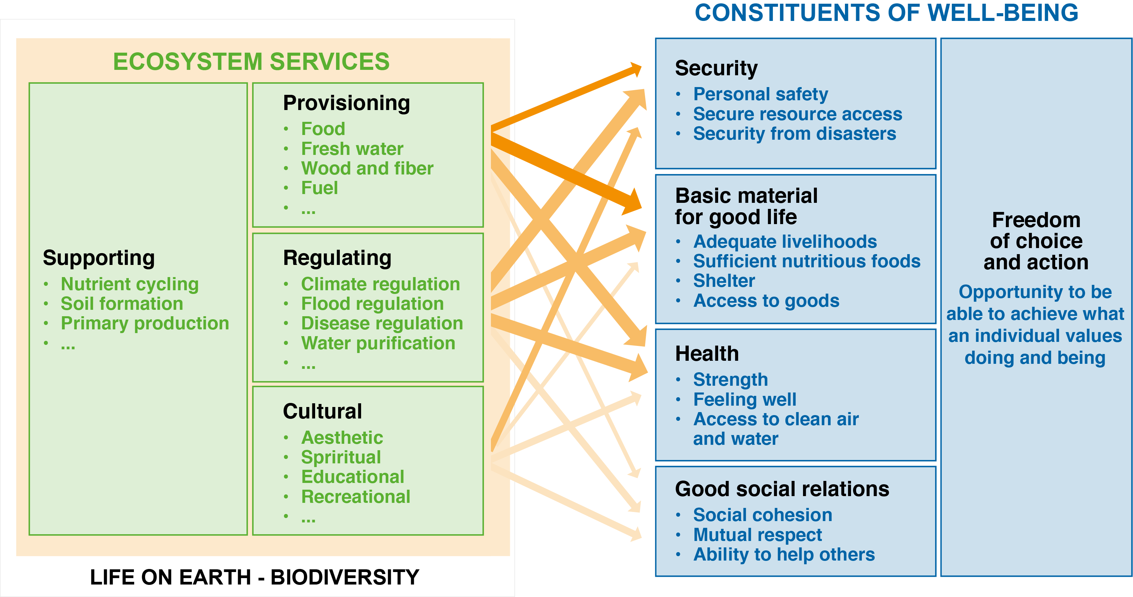
Linkages Between Ecosystem Services and Human Wellbeing (MA 2005)
© Millenium Ecosystem Assessment
Notes:
The Millennium Ecosystem Assessment framework is a presentation of the linkages between ecosystem services (4 categories; note how they are embedded within ‘life on earth-biodiversity’) and human wellbeing (5 constituents, where security, basic material for good life, health and good social relations, all contribute to people having ‘freedom of choice and action’).
The thickness of the arrows indicated strength of relationships.
NB. A good discussion of the relationship between biodiversity and ecosystem services is provided by Mace et al. (2012), which explains that biodiversity might have a role as a regulator of ecosystem processes (e.g. various pollinating insects), but it may also be an ecosystem service in itself (e.g. varieties of cultivated apples or other crops).

Slide 13
MA Framework: Considering ‘Drivers of Change’
Recognition of importance of indirect and direct ‘drivers of change’ in ecosystems
  Indirect: demographic, economic, socio-political, science & technology, cultural & religious
  Direct: e.g. changes in local land use, species introduction, external inputs, resource consumption, climate change, natural drivers (e.g. flooding, volcanoes)
Interactions can occur at varying spatial (local to global) and temporal (short- to long-term) scales
Notes:
The MA framework recognises the importance of different natural and human-induced drivers of change in ecosystems (and the subsequent impact on wellbeing).
Indirect drivers include: demographic factors, economic (e.g. globalisation, markets, trade), socio-political (e.g. governance, legal framework), science and technology, and cultural and religious (e.g. beliefs and consumption choices)
Direct drivers include things such as: changes in local land use, species introduction and removal, external inputs (e.g. to agriculture), harvesting and resource consumption, climate change, natural drivers (e.g. flooding, volcanoes)
The interactions between these drivers of change and ecosystem services may take place at different spatial and temporal scales. For example, international demand for timber may lead to a regional loss of forest cover, which increases flood magnitude along a local stretch of a river.

Slide 14
Limitations of the MA framework
Builds on consensus of multiple stakeholders; doesn’t identify responsibilities for action – no focus on governance.
Recommended solutions rely heavily on scientific information and pay less attention to political will.
Identifies a variety of causes of environmental degradation, but no underlying common element.
Does not make explicit the poverty aspects associated with wellbeing – assumes ES help the poor through undefined trickle-down effect.
Notes:
Limitations of the MA
Builds on consensus of multiple stakeholders; this is good but fails to identify specific stakeholders responsible for various challenges it identifies (tried to make everyone happy/satisfied). Looking back at the original diagram – the many arrows between the ES and wellbeing boxes represent a complexity of undefined governance actions.
Relies very heavily on scientific information in recommending solutions to ecosystem services degradation, and pays less attention to political will.
Identifies a variety of causes of ecosystem degradation, but fails to articulate the underlying, common element in all the identified sources
Generally, the MA framework did not make explicit the poverty aspects associated with wellbeing and took for granted that ecosystem services help the poor through an undefined trickle-down effect

Slide 15
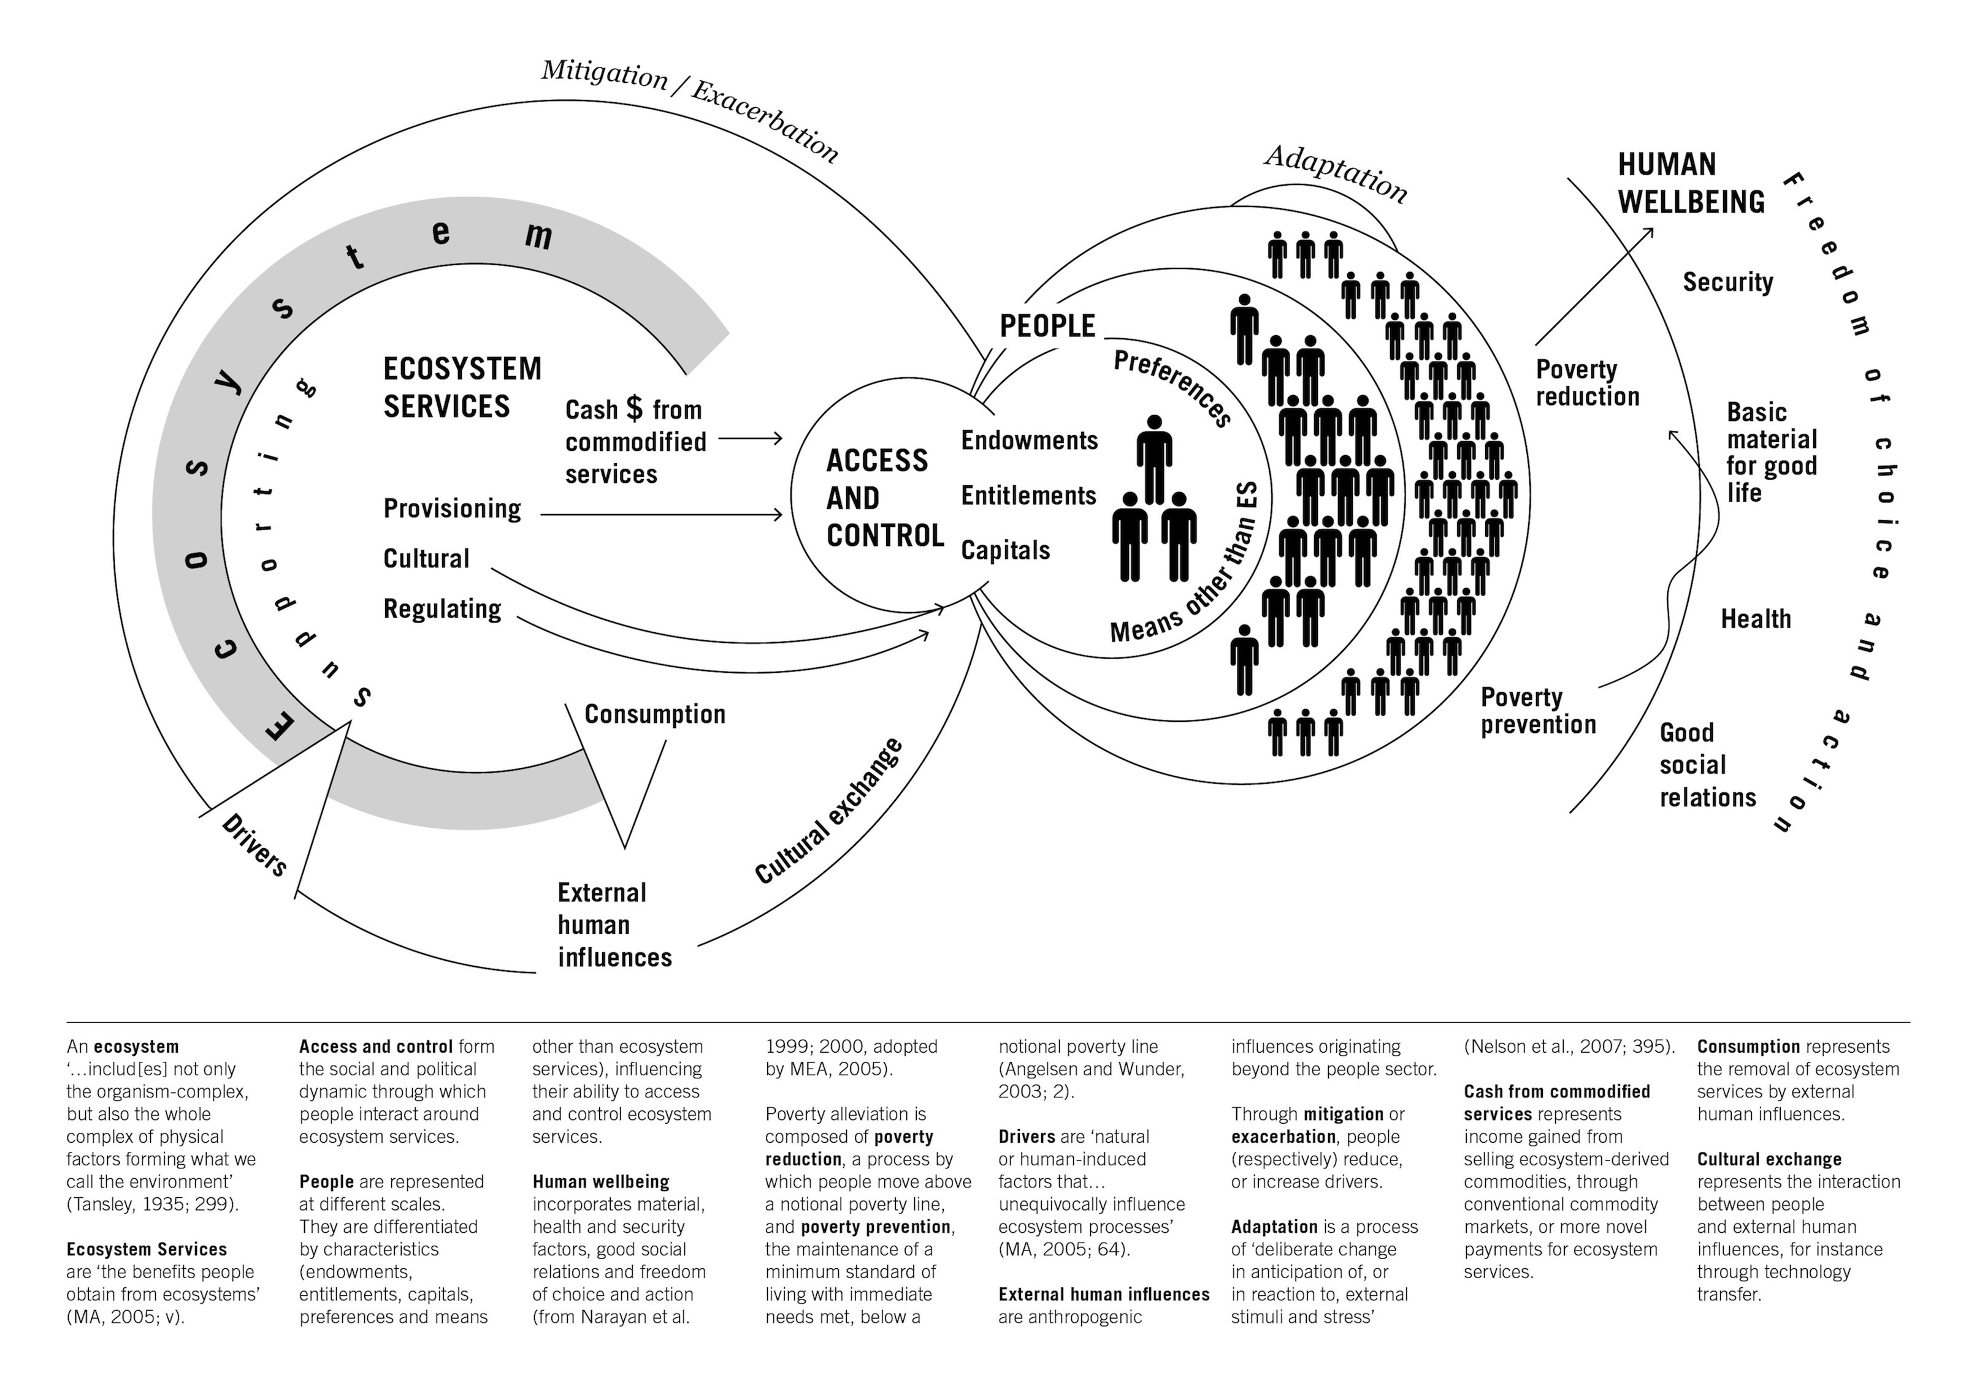
A framework to understand ecosystem services for poverty alleviation
(Fisher et al. 2014)
Reprinted from Ecosystem Services, Vol.7, Janet A. Fisher, Genevieve Patenaude, Kalpana Giri,
Kristina Lewis, Patrick Meir, Patricia Pinho, Mark D.A. Rounsevell, Mathew Williams, 'Understanding the relationships between ecosystem services and poverty alleviation: A conceptual framework', p.34-45, Copyright 2014, with permission from Elsevier.
Notes:
Following a review of different frameworks, Janet Fisher and colleagues tried to bring together key ideas relating to ES for PA in this framework.
The presentation of the ecosystem service categories is derived from the MA (2005)
It also includes the idea of ‘drivers of change’ as in the MA.
On the far right, you see the wellbeing components are also derived from the MA (2005)
A new feature is the visual representation of people – individuals, local and global communities – all with their different wellbeing preferences
Another new aspect is the focus on ‘access and control’ in the centre of the diagram. This highlights the importance of access and control in mediating the ways in which people can use ecosystem services to meet their wellbeing preferences.
Finally, the framework specifically highlights poverty reduction and poverty prevention (which together make up poverty alleviation) – focusing attention on the way ES can contribute to the wellbeing of poor people. Users of the framework can specify their own interests and/or metrics for poverty assessment.
Ultimately, the framework can be used to establish how different people draw on different ecosystem services to construct their own wellbeing in a particular situation.

Slide 16
What is unique about the Fisher et al. (2014) framework?
Social differentiation: required for any discussion of poverty alleviation, attributes and scale interactions
Access and control of ES – these are often more important (for the poorest) than aggregate availability
Distinctions between ES categories, e.g. provisioning and cash (from commodification of ES), with latter particularly easy to control
Poverty reduction versus prevention
Distinction between mitigation (of ES degradation) and adaptation (to changed ES conditions) activities
External human influences (consumption and cultural exchanges)
Notes:
Note the emphasis on people existing at different scales – from individual to household to community to national and global populations. Recognises that communities are not homogeneous, and that different people have different wellbeing aspirations.
Note also the central position of ‘access and control’, emphasising the institutions that influence how people can access different ecosystem services.
Makes the distinction between direct use of ES and commodified use of ES (e.g. sale of ES to obtain cash, which is then used to purchase items needed for wellbeing)
Poverty reduction – moves people above the national poverty line; Poverty prevention – supports basic minimum needs, but still below the national poverty line.
The framework highlights the possibility to mitigate environmental degradation and/or to take action by adapting to ecosystem changes.
It also specifically looks at different types of human influences, i.e. the fact that local availability and use of ecosystem services can be affected by decisions taken by people living elsewhere, e.g. consumption preferences in one part of the world can lead to unsustainable production systems elsewhere.

Slide 17

Intergovernmental Science-Policy Platform on Biodiversity and Ecosystem Services (IPBES) framework
Established in 2012
To provide policy relevant knowledge on biodiversity and ecosystem services to inform decision making
Currently 124 Members (Governments)
Focus on global, regional and thematic assessments of biodiversity and ecosystem services
© IPBES
Notes:
The goal of IPBES is to strengthen the science-policy interface for biodiversity and ecosystem services for the conservation and sustainable use of biodiversity, long-term human well-being and sustainable development
It was set up to function in a similar way to the IPCC (Intergovernmental Panel on Climate Change), but with the focus on biodiversity and ecosystem services.
Regional assessments are due out in 2018, followed by a global assessment. One thematic assessment (of global pollination services) already exists (IPBES 2016) – has been very influential in highlighting the value of pollinator insects to agriculture, and leading to changes in policy to protect them.

Slide 18
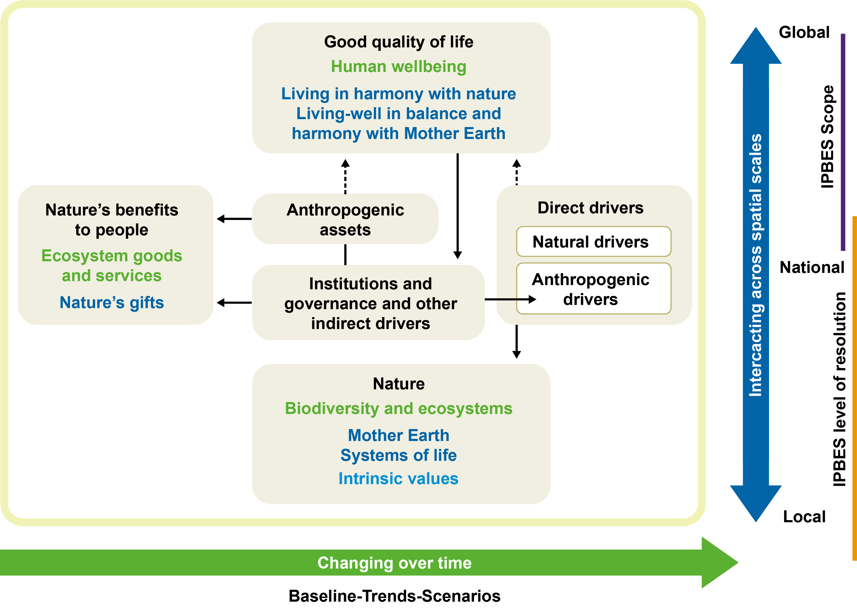
IPBES conceptual framework (Diaz et al. 2015)
Reprinted from Current Opinion in Environmental Sustainability, Vol.14, Sandra Diaz et al, 'The IPBES Conceptual Framework - connecting nature and people', p.1-16, reprinted under Creative Commons license CC BY-NC-SA 3.0
Notes:
Key features of the framework are:
Nature
Nature’s benefits to people
Good quality of life
The role of institutions, governance and decision-makers – at the heart of the framework
Like the other frameworks it recognises different kinds of drivers
Multiple knowledge systems as indicated using different fonts and colours.
The headline labels in black font indicate the broad, highly inclusive categories (common names)
The green and blue labels indicate the more specific categories (Western science and other knowledge systems, respectively)
Recognition of different interactions at different temporal and spatial scales
Recognises complexity of linkages, with most components linked to most other components by arrows (direct and indirect linkages)

Slide 19
What is new in the IPBES framework?
Governance is at the heart of the framework
Framework draws on and speaks to multiple knowledge (and value) systems
  Black labels – common name (useful for policy)
  Green labels – scientific term
  Blue labels – indigenous knowledge and world views
It is still evolving, e.g.
  Pascual et al. (2017): ‘nature’s benefits to people’ should be ‘nature’s contributions to people’ (NCP) to recognise existence of ‘disservices’
Notes:
Unlike either of the two previous frameworks, this one puts governance at the very heart of the framework.
It is unusual because some of the key concepts are labelled in 3 colours to reflect different knowledge systems, and the fact that scientific terms (like ecosystem services) often don’t mean much to the general public and decision-makers.
Discussion about this framework is still going on amongst IPBES experts. A paper by Pascual et al. (2017) argues for a change from ‘nature’s benefits to people’ to ‘nature’s contributions to people’ (NCP) to – amongst other things – recognise that there are ecosystem disservices (e.g. pests and diseases) as well as services. A paper by Diaz et al. (2018) reflects the importance of culture in the NCP box and revises the MA ES categories into material, non-material and regulating (i.e. removing the ‘cultural’ ES) category as many ES cannot easily be pigeon-holed into just one category (e.g. certain foods may be cultural as well as provisioning services).
What this demonstrates is that none of the frameworks is perfect on its own and there is a great deal of research to improve them.
Pascual and Howe (2018) argue that it is better to have multiple frameworks than to aspire to a single one that will suit all contexts.

Slide 20
Application of the ES for PA approach

Slide 21
Key features of an Ecosystem Services for Poverty Alleviation approach
(Poppy et al. 2014; ESPA 2018)
Thematically:
Scales and systems: Understanding the spatial and temporal scale of ecosystem services – and thinking about them in a holistic, integrated ‘systems’ manner
Wellbeing: Disaggregating the beneficiaries of different ecosystem services, and understanding the multi-dimensional nature of wellbeing
Justice: Supporting the negotiation of trade-offs between the (conflicting) demands of different ecosystem services users
Methodologically: requires an interdisciplinary team, bringing together social and natural sciences
Notes:
As we have seen, there are multiple ways of portraying the relationship between ecosystem services and people.
There is no single Ecosystem Services for Poverty Alleviation framework.
However, drawing from Poppy et al. (2014) and the ESPA programme Summary for Policy Makers, we can highlight three features that are critical for an ES for PA approach.
We will be looking at each of these in more detail in the coming sessions.
Social-ecological systems operating over different spatial and temporal scales
Wellbeing
Environmental justice

Slide 22
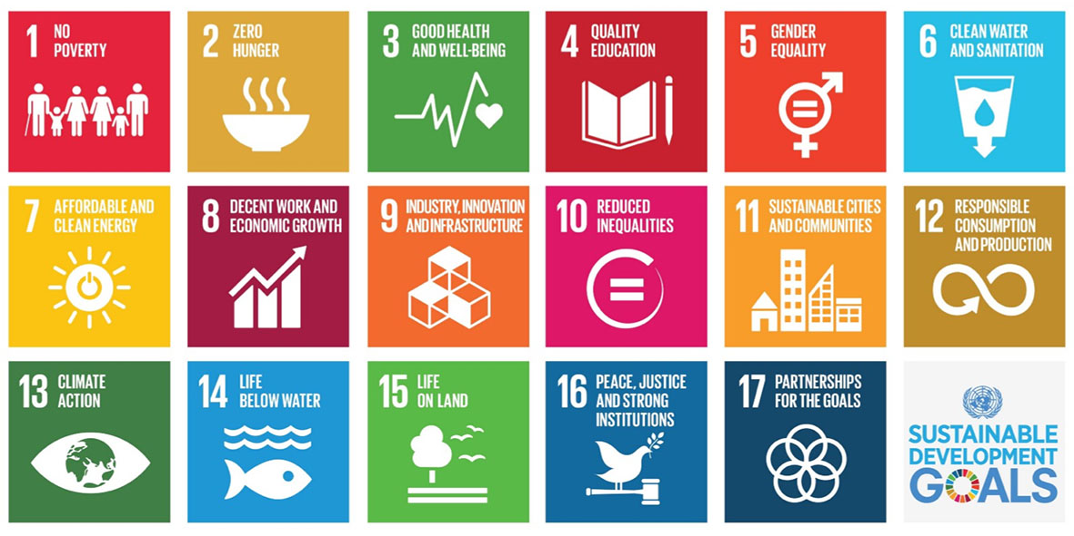
Class exercise: How can an ES for PA approach contribute to sustainable development?
© UN
Notes:
Question to students: Talk to your neighbour about how an ES for PA approach can contribute to achieving the SDGs.
[Possible answer: There are some SDGs for which an ES for PA approach seems particularly useful (e.g. SDG15), but once you start looking carefully, you realise that ES for PA is an approach that deals with social-ecological systems in a holistic manner and could therefore be a useful foundation for tackling all the SDGs.]

Slide 23
References
Key readings
Díaz, S. et al. (2015) The IPBES Conceptual Framework - connecting nature and people. Current Opinion in Environmental Sustainability 14: 1-16.
Fisher, B. et al. (2008) Ecosystem services and economic theory: Integration for policy-relevant research. Ecological Applications 18: 2050-2067.
Fisher, J.A. et al. (2014) Understanding the relationships between ecosystem services and poverty alleviation: A conceptual framework. Ecosystem Services 7: 34-45.
Pascual, U. et al. (2017) Valuing nature’ s contributions to people : the IPBES approach. Current Opinion in Environmental Sustainability 26: 7-16.
Other readings
Díaz, S. et al. (2018) Assessing nature’s contributions to people. Recognizing culture, and diverse sources of knowledge, can improve assessments. Science 359: 270-272.
ESPA (2018) An environment for wellbeing: Pathways out of poverty – Policy messages from the ESPA programme. Ecosystem Services for Poverty Alleviation, Edinburgh.
Gomez-Baggethun, E. et al. (2010) The history of ecosystem services in economic theory and practice: from early notions to markets and payment schemes. Ecological Economics 69: 1209-1218.
MA (2005) Ecosystems and Human Well-being: Biodiversity Synthesis. Island Press, Washington, DC.
Poppy, G. et al. (2014) Food security in a perfect storm: using the ecosystem services framework to increase understanding. Phil. Trans. R. Soc. B 369: 1-13.
Notes:
References cited in the Speakers’ notes:
Constanza, R. et al. (1997) The value of the world’ s ecosystem services and natural capital. Nature 387: 253-260.
IPBES (2016). The assessment report of the Intergovernmental Science-Policy Platform on Biodiversity and Ecosystem Services on pollinators, pollination and food production. S.G. Potts, V. L. Imperatriz-Fonseca, and H. T. Ngo, (eds). IPBES Secretariat, Bonn, Germany. Available at: https://www.ipbes.net/sites/default/files/downloads/pdf/individual_chapters_pollination_20170305.pdf
Mace, G.M. et al. (2012) Biodiversity and ecosystem services: a multi-layered relationship. Trends in Ecology & Evolution 27: 19-26.
Pascual, U. and Howe, C. (2018) Seeing the wood for the trees: Exploring the evolution of frameworks of ecosystem services for human wellbeing. Chapter 1 in Schreckenberg, K., Mace, G. and Poudyal, M. (eds). Ecosystem Services for Poverty Alleviation: Trade-offs and Governance. Routledge, Abingdon.
Sandker, M. et al. (2012) Trade-offs between biodiversity conservation and economic development in five tropical forest landscapes. Environmental Management 50(4): 633-644.
Sjosted, M. (2012) Ecosystem services and poverty reduction: How do development practitioners conceptualize the linkages ? European Journal of Development Research 24: 777-787.
Tallis, H. et al. (2008) An ecosystem services framework to support both practical conservation and economic development. Proceedings of the National Academy of Sciences 105: 9457-9464.
Turner, W.R. et al. (2012) Global biodiversity conservation and the alleviation of poverty. BioScience 62: 85-92.

Slide 24
Case studies for further discussion
Case study A: Participatory Modelling Frameworks to Understand Wellbeing Trade-offs in Coastal Ecosystem Services (http://www.espa.ac.uk/projects/ne-i00324x-1)
Daw, T.M., et al. (2015) Evaluating taboo trade-offs in ecosystems services and human well-being. Proceedings of the National Academy of Sciences 112: 6949-6954.
Case study B: Ecosystem Disservices from Tanzania's Wildlife Management Areas
Bluwstein, J., Moyo, F. & Kicheleri, R. (2016) Austere conservation: Understanding conflicts over resource governance in Tanzanian Wildlife Management Areas. Conservation and Society 14: 218-231.
ESPA (2018) An environment for wellbeing: Pathways out of poverty – Policy messages from the ESPA programme. Ecosystem Services for Poverty Alleviation, Edinburgh.
Case study C: Cape Town Water’s Crisis
Drollette Jr, D. (2018) Day Zero: Lessons from Cape Town's crisis. Bulletin of the Atomic Scientists. Available at: https://thebulletin.org/day-zero-lessons-cape-towns-crisis11519 [accessed 18 July 2018]
Notes:
[Please refer to the accompanying case study summaries for case studies A, B and C.]

