Slide 1
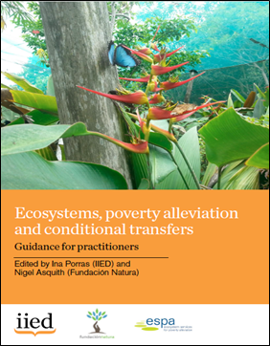
Ecosystems, poverty alleviation and conditional transfers
http://pubs.iied.org/16639IIED/
Module 3 – Sustainable Finance
Ina Porras and Nigel Asquith, 2018

Slide 2
Modules
1
Context
2
Experiences
3
Financing
4
Implementation

Slide 3

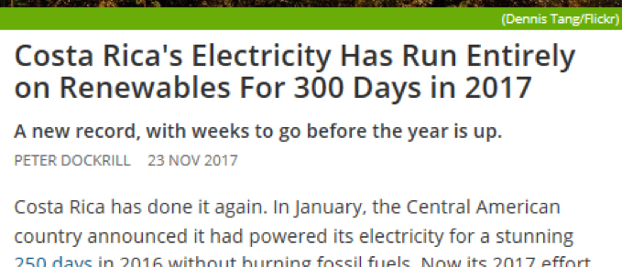
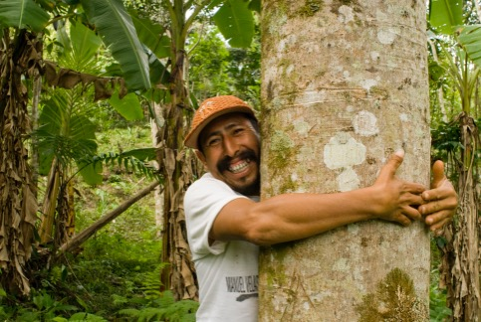
Impacts on wealth
Impacts on people
Impact on nature
© Ina Porras (IIED)
© Jeronimo Goméz Pérez
Notes:
Our instrument is to look at direct conditional transfers as instruments that seem to have impacts on nature, wealth and people. We seek to understand their trade-offs and help design pragmatic programmes to enhance complementarities and inclusion of poor people.
Waterfall photo: Credits: Ina Porras (IIED). Protected forests around river in Costa Rica.
Tree photo credits: Jeronimo Goméz Pérez, community technician of AMBIO’s reforestation and forest management Scolel´te Program in Mexico, under Plan Vivo.
This picture was taken in a plot of Samaria K´antajal (Chilón Municipality, Chiapas, México) by Britt Basel.

Slide 4
Sources of finance
POLITICAL SUPPORT
Public budgets
Financing:
Charging users for ES
Implementation
(technical and governance)
International finance
Voluntary contributions
Transferring resources to ecosystem managers
Conservation finance
Multiple sources, but Governments vital for scaling up
Source: Porras and Asquith (2018)
Notes:
Figure credits: Ina Porras and Nigel Asquith.
Governments in India, China and South Africa pledge significant budget allocations to CT/PES. Costa Rica and Mexico show that it is possible to earmark water and fuel taxes for environmental activities. Local schemes such as Watershared in South America demonstrate a willingness from local governments and water utilities to pay towards watershed conservation.
Climate change and SDG agendas bring the environment back onto the discussion table, as well as the potential to scale up financial flows towards conservation and restoration of ecosystems.
This section focuses on how PES/CT programmes are financed and presents strategies to secure sustainable financing to scale up and achieve long-term impacts of the programmes. It is based on lessons from ongoing programmes reviewed in Module 2 and emerging systems from international climate and conservation finance.
We identify three main types of funding for CT/PES (Figure 4): a) direct deals and voluntary contributions, especially for carbon and watershed local deals; b) public budgets, through ear-marking, general budget or public debt; and d) international finance, for example linked to REDD+ and climate change resources.
An incipient sector is linked to d) conservation finance, which focuses on the potential of initiatives to generate financial returns to investments. Political support and viability underscores any strategy for sustainable financing.

Slide 5
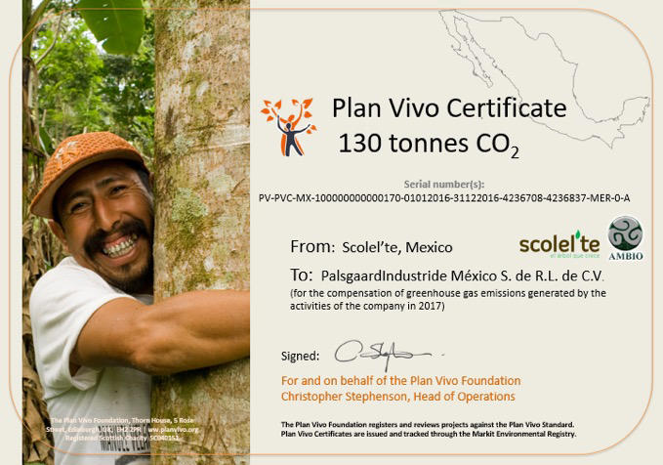
New sources of financing
Social protection and environment joint budgets
Environmental tax reform
Ear-marked taxes
Direct deals: carbon, water
Conservation investment
© Angela Yang
© Peter Etelej
Notes:
Offset photo credit: Plan Vivo Certificate. Scolel´te, Cooperativa Ambio, Mexico.

Slide 6
Sustainable financing
Government budget (new taxes, re-pricing, earmarking, fiscal reform, linking directly to social protection)
Direct deals (Voluntary contributions following negotiation (e.g. water funds) and sales directly in market (e.g. carbon offsets))
Concessional loans (alongside grants, and government investments)
Risk-sharing instruments (Adding value through value chains, mainstreaming eco-investments in infrastructure)
Source: Porras and Asquith (2018)
Notes:
Figure source: Porras and Asquith, 2018.
Political support is important, but ultimately sustainable finance will determine whether a programme emerges and reaches sufficient scale. Making financing sustainable is critical if projects and programmes are to take the step from one-off, usually donor funded pilots, to a programme with financial stability that allows for replication and scaling-up. Grants and other forms of donor-funding have been very useful to kick-start projects like Watershared, and to partially cover entry costs to international carbon markets (technical studies, registration fees, etc). But it is important to have a clear strategy for ongoing revenues. Local governments and water users in Bolivia now provide 80% of Watershared payments (Asquith 2016), and sales from carbon offsets generate important revenues in Mexico, Uganda and Kenya.
See also: STEELE, P., RAI, N. & NHANTUMBO, I. 2015. Beyond loans: instruments to ensure the poor access climate and development finance. London. . (http://pubs.iied.org/17318IIED.html ) for financial instruments for the poor. Appropriate financial instruments are key to reach the poor. Mainstream financial institutions rely on instruments such as high interest loans, that tend to exclude poorer groups because of high transaction costs, low profit margins and limited credit worthiness.

Slide 7


The principle of direct deals
Who/how much: Who benefits, how much is the value? Are downstream beneficiaries organized –e.g. water utility/municipality? Do they already pay for water?
How: Instruments to capture these benefits, e.g. taxes, charges, fees, price premiums, ear-marked taxes, general government budget
Resource management: e.g. trust funds, finance offices, financial and administrator experts.
Watershed 2
Substantial potential payments
Watershed 1
Low ability to pay
Two environmentally identical watersheds, with different number of downstream beneficiaries and ability to pay.
Source: Based on Pagiola and Platais, 2005
Notes:
Source: Based on Pagiola and Platais, 2005. Permission to use adapted figure granted by author.
Two identical watersheds in Dominican Republic (Rio Ocoa, Rio Nizao). Roughly same structure, hydrology, soils, and conservation problems.
Downstream users vary – Rio Nizao provides water for several hydroelectric projects in cascade, irrigation and large cities. Rio Ocoa provides water for a small community with rural agriculture.
Economic value of ecosystem services are linked to the users – and their willingness/ ability to pay for the ES. While the amount of water is similar in both watersheds, the economic value of the ecosystem services varies a lot.

Slide 8
Finance: exploring, adapting, reacting
Programme is
continually experimenting with different financing strategies
 | CAF-forest subsidy (1) | Gov budget | Ecomarkets WB loan | KfW grant | Hydro-CNFL | Beverage company FI&F | Hydro-various deals | OTC ES certificates | Total (adjusted, 2017 prices) | Total (unadjusted by inflation)
1995 | 1.36 |  |  |  |  |  |  |  | 1.4 | 8.3
1996 | 1.47 |  |  |  |  |  |  |  | 1.5 | 7.5
1997 | 1.63 |  |  |  |  |  |  |  | 1.6 | 7.3
1998 | 2.16 | 1.15 |  |  |  |  |  |  | 3.3 | 13.5
1999 | 1.45 | 2.20 |  |  |  |  |  |  | 3.6 | 13.4
2000 | 1.30 | 1.99 |  |  |  |  |  |  | 3.3 | 10.9
2001 | 1.23 | 2.31 | 0.65 |  | 0.07 |  | 0.01 |  | 4.3 | 12.7
2002 | 1.20 | 2.95 | 2.84 |  | 0.08 | 0.02 | 0.01 |  | 7.1 | 19.4
2003 | 0.96 | 1.34 | 2.84 | 1.65 | 0.15 | 0.02 | 0.02 |  | 7.0 | 17.4
2004 | 1.06 | 1.48 | 3.46 | 0.79 | 0.15 | 0.00 | 0.00 |  | 7.0 | 15.5
2005 | 0.21 | 1.56 | 3.54 | 1.04 | 0.20 | 0.02 | 0.02 |  | 6.6 | 12.9
2006 |  | 6.21 | 3.12 | 0.94 | 0.24 | 0.02 | 0.02 |  | 10.6 | 18.4
2007 |  | 7.73 |  | 0.83 | 0.26 |  | 0.06 |  | 8.9 | 14.2
2008 |  | 8.29 |  | 0.64 | 0.23 |  | 0.03 | 0.06 | 9.2 | 13.0
2009 |  | 9.34 | 4.21 | 0.30 | 0.29 |  | 0.05 | 0.16 | 14.2 | 18.6
2010 |  | 17.74 | 6.36 | 0.00 | 0.15 |  | 0.02 | 0.08 | 24.3 | 29.9
2011 |  | 16.85 | 9.67 | 0.26 | 0.60 |  | 0.02 | 0.01 | 27.4 | 32.1
2012 |  | 19.93 | 4.94 |  | 0.11 |  |  | 0.00 | 25.0 | 28.0
2013 |  | 19.99 | 11.18 |  | 0.16 |  |  | 0.24 | 31.3 | 33.4
2014 |  | 20.44 |  |  | 0.14 |  |  | 0.21 | 20.6 | 21.0
2015 |  | 26.27 |  |  | 0.32 |  |  | 0.20 | 26.6 | 26.8
2016 |  | 24.74 |  |  | 0.03 |  |  | 0.29 | 24.8 | 25.2
2017 |  | 28.85 |  |  | 0.02 |  |  | 0.004 | 28.9 | 28.9
Total | 14.02 | 221.36 | 52.80 | 6.45 | 3.19 | 0.07 | 0.26 | 1.25 | 298.1 | 428.2
 | 5% | 74% | 18% | 2% | 1% | 0.0% | 0.1% | 0.4% | 100%
Previous forest subsidy provides policy background.
They are integrated with PES from 2005 onwards
Direct negotiation with HEP provides basis for water tax revamp (25% earmarked for PES). Large utility (CNFL) continues providing extra funding for works in their watersheds.
Government funding are the main source of funds.
OTC sales (certificates) show the potential for internal markets but revenues collected still low.
Sources of finance for PES in Costa Rica (USD million)
Notes:
Figure source: Prepared by Ina Porras and Adriana Chacon-Cascante. http://pubs.iied.org/G04272/
*Note: (1) Certificado de abono forestal (CAF) pre-dates PES, and was a subsidy for reforestation. It overlapped with PES between 1998-2005, and phased out since 2006. Note (2). Totals not adjusted by inflation. Source of data: FONAFIFO statistics.
Prepared by Porras and Chacón-Cascante
Source: PES Handbook – Porras & Asquith (2018)
Sustainable financing
Financial resources come mostly from domestic sources through a combination of instruments:
Fuel tax: Initially as a percentage of collection and now a fixed annual amount, it is linked to carbon emissions (average US$11.6m per year).
Water tax: Early one-to-one watershed agreements with hydroelectric companies gave way in 2006 to an allocation from water fees (25 per cent of collected revenue goes to PES, and 25 per cent to public parks and conservation areas). Average revenues from this source reached US$3.6m between 2007 and the first half of 2010.
Loans from the World Bank to kick-start the programme, combined with some smaller grants, notably from the German Development Bank (KFW) and the Global Environmental Facility (GEF).
Agreements with private and semi-private companies interested in promoting forest protection for water protection, biodiversity conservation or landscape beauty in their areas (for example, the tourism sector, conservation groups).
To date, most of the funding for PES comes from the government, either through central budget allocation or as loan repayments to the World Bank (through Ecomarkets). Agreements with individual companies (CNFL, Florida Ice & Farm, and several hydroelectric companies) provide small amounts of financial resources (less than 2 per cent of all payments made since the beginning of the programme) but have been instrumental in creating demand and support for the water tax adjustment (which succeeded in unlocking significant new revenues). Over-the-counter sales of ES certificates (CSA) remain small but internally promising as a way of raising resources to invest at local level. One of the reasons why they have not taken off is their relative high transaction costs in relation to money raised, compared to the other sources, especially earmarking.

Slide 9
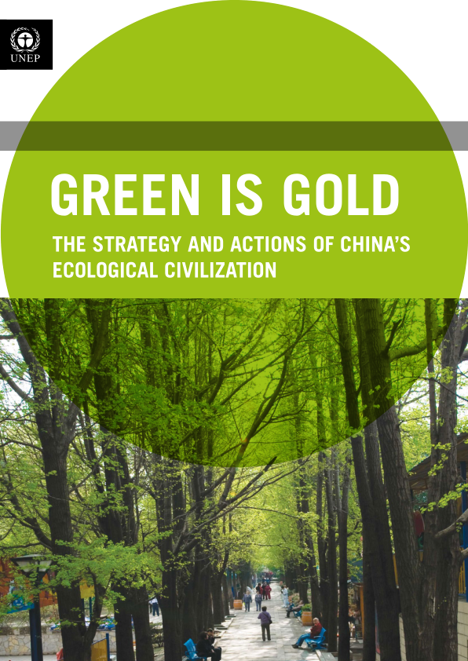
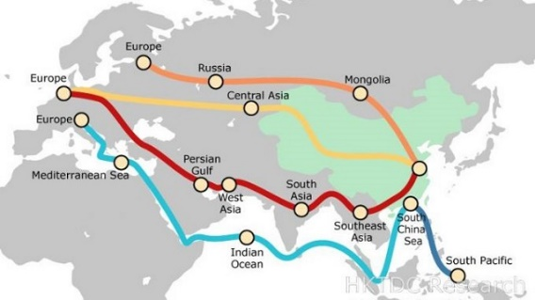
Mainstreaming ecosystem services proposition
China’s Eco Civilisation
Green is gold
Eco-zoning
Eco-compensation
Poverty alleviation
Belt and Road Initiative
Notes:
Figure sources:
Green is Gold: Green is gold: The strategy and actions of China's ecological civilization. UN Environment Programme. https://reliefweb.int/report/china/green-gold-strategy-and-actions-chinas-ecological-civilization
Belt and Road figure: Routes of the China proposed Belt and Road Initiative. World Bank Banks Belt and Road Initiative added by Shayne Heffernan on September 12, 2017 http://www.livetradingnews.com/world-bank-banks-belt-road-initiative-54558.html#.WvG3pExFyEk.

Slide 10
Tools to help improve efficiency in expenditures
Climate Public Expenditure and Institutional Review (CPEIR)
Biodiversity Finance Initiative (BIOFIN)
Environmental fiscal reform
Notes:
The Climate Public Expenditure and Institutional Review (CPEIR), for example, helps countries track existing budget climate expenditures across different sectors. The framework looks at six dimensions of public expenditure: fiscal sustainability, strategic resource allocation, the role of the government, efficiency and effectiveness of spending, incidence of spending and capability of institutions and alignment of incentives (International Bank for Reconstruction and Development and World Bank, 2014). This type of review is useful to help understand the potential impact of new measures -such as a carbon tax – on growth. Information on this tool can be found in: www.climatefinance-developmenteffectiveness.org/.
The Biodiversity Finance Initiative (BIOFIN) provides a framework to understand the process to mobilise resources for biodiversity and sustainable development – see Figure 7. Similar to the CPEIR, it measures current biodiversity expenditures but provides additional steps to identify financial needs, suitable financial solutions and guidance on how to implement actions. For example, establishing biodiversity business challenge funds, merging conservation funds, or establishing central procurement units or staff incentives to increase delivery of resources (UNDP, 2016).
Reforming environmental taxes and subsidies
Environmental taxes play an important role in funding CT/PES, as presented in the previous sections. But governments can go a step forward redesigning market signals, addressing price distortions and potentially reducing free-riding on natural resources and ecosystem services traditionally considered `free’. This is particularly important to understand how to mainstream environmental investments, including CT/PES, in the wider economic context.
Environmental fiscal reform (EFR) aims at restructuring the tax system, with a shift from traditional taxes to new areas. These taxes use “polluters pay” and “beneficiary pay” principle to generate revenues and promote more efficient use of resources. Environmental taxes are considered less harmful to growth than other taxes to traditional areas of taxation, such as income, savings and capital grains, labour or corporate taxes. They are also important fiscal tools to target activities with a harmful impact on the economy, and promote green growth economic recovery (DG TAXUD, 2015; United Nations, 2012).
This fiscal reform goes towards ‘tax neutrality’: adding some taxes, eliminating others, and redirecting subsidies from environmental harmful activities, which act as ‘perverse incentives’, towards activities that promote green growth and poverty reduction. This includes the reduction and phasing out of these subsidies, and redirection of public spending towards socially and environmental beneficial activities, in line with the Aichi target three, which calls for this elimination by 2020 (Secretariat of the Convention on Biological Diversity, 2011). For example:
Raising additional revenues and promote efficiencies: A study for the European Union shows that EU28 could raise €208 billion in additional revenue by 2030 through suggested environmental reforms, equivalent to a 1.05 per cent increase in GDP (Hogg et al., 2016). The environmental benefits from the reforms amount to €14 billion. The scenario for 2030 revenue generation under good practice includes:
Energy €49billion from transport fuels, C&I/heating and electricity.
Transport €117B from vehicle taxes, passenger aviation tax and freight aviation tax.
Pollution and resource taxes €42billion from water abstraction tax, aggregates tax, packaging tax, and other taxes for pesticides, air pollution, landfill, waste water, incineration/ MBT, single use bag tax, and fertilizer tax.
There are examples of environmental tax reform and environmental fiscal reform in China and South-East Asia (United Nations, 2012). Kreiser et al. (2011) present an analysis of the area, focusing on wastewater environmental taxes in DRC, carbon tax policies, green energy taxes in Hong Kong and examples of resource rent taxation regimes in Australia (see for example Kreiser et al., 2011). China issues a draft environmental tax law with levies on air, water, noise and waste polluters in 2015, and fiscal reforms are at the core of China’s Eco-Compensation programme.
Reducing perverse incentives and free up resources. Some of the perverse incentives and subsidies that harm ecosystems and environmentally-friendly activities include:
Subsidies to already under-priced resources, like provision of water and energy at low prices, can lead to excessive consumption and often waste.
Subsidies to inputs of production are expected to increase production, often can lead to over use, for example over fishing, or subsidies to fertilizers or pesticides in agriculture. For example subsidies to bottom trawl fleets can have a major impact on the habitat of fish species.
Subsidies to environmentally-friendly activities need to ensure these are targeted and cost-effective.
There are other forms of perverse incentives beyond subsidies. For example, requirements to remove forests as precondition to receive land tenure or titles, or laws that threaten “idle” lands with higher taxes.
The elimination of these harmful subsidies can increase efficiency –in the same way that the environmental tax reform does, and free up considerable funds which could be used for more pressing environmental needs. Environmental fiscal reform is proposed as a way to close the “time gap”, by providing public funding for green investments and address long-term price signals to the private sector.
Experience of using environmental taxes and fiscal reform in Member States of the European Union suggest that they are an effective and efficient way of helping to achieve environmental policy objectives. Important issues to address in fiscal reform are linked to challenges to implementation. For example, their perception as additional taxes that add burden to people, issues of equity and need to ensure they remain income progressive (not regressive), and the perception that it damages the competitiveness of companies and the economy as a whole – see for example Slunge and Sterner (2012).

Slide 11
The BIOFIN approach and outcomes
Finance gap (unknown)
Finance gap (unknown)
BIOFIN activities to reduce needs:
Realign expenditures,
Avoid future expenditures
Deliver better
Biodiversity finance (US$)
Resources needed
National/ international finance
National/ international finance
BIOFIN activities to increase resources:
Generate revenues,
Realign expenditures
Resources available
Baseline situation
Expected results
Source: UNDP 2016
Notes:
Figure source: based on BIONFIN publication:
UNDP: 2016. BIOFIN Workbook: Mobilizing Resources for Biodiversity and Sustainable Development. http://www.biodiversityfinance.net/sites/default/files/content/publications/undp-biofin-web_0.pdf
Copyright: BIOFIN. “rights: reproduction of this publication for educational or other non-commercial purposes is authorized without prior written permission from the copyright holder provided the source is fully acknowledged”
www.biodiversityfinance.net
UNDP, 2016. BIOFIN Workbook: Mobilizing Resources for Biodiversity and Sustainable Development. The Biodiversity Finance Initiative.
BIOFIN supports countries with a methodology that provides innovative steps to measure current biodiversity expenditures, assess financial needs, identify the most suitable finance solutions and provides guidance on how to implement these solutions to achieve their national biodiversity target.
The BIOFIN methodology takes shape through three assessments that culminate in a Biodiversity Finance Plan. The steps include:
The Biodiversity Finance Policy and Institutional Review (PIR) looks into the policy and instituitional context for biodiversity finance in the country and establishes which are the key stakeholders to involve.
The Biodiversity Expenditure Review (BER) is an analysis of public and private expenditures in the country that benefit biodiversity. The assessment establishes past, present and projected expenditures on biodiversity.
The Financial Needs Assessment (FNA) estimates the finance required to deliver national biodiversity targets and plans, usually described in the NBSAPs.
The Biodiversity Finance Plan (BFP) identify and prioritises a mix of suitable biodiversity finance solutions to reduce the biodiversity finance gap.
The last component of the BIOFIN process is the implementation phase. The BIOFIN national teams make a selection between the prioritised finance solutions and provide technical support for their implementation.
Finance solutions provide impacts allowing to reach the national targets through four main resutls:
Generate revenues, i.e. any existing or innovative mechanism or instrument that can generate and/or leverage financial resources to allocate to biodiversity. Examples include the attraction of impact investment in conservation projects, the review or introduction of green taxes, etc.;
Realign current expenditures, i.e. any measure that can reorient existing financial flows towards biodiversity. This result can be achieved by phasing out and reforming fossil fuel/ energy subsidies and using these freed resources to invest in renewable energy or green infrastructure instead.
Avoid future biodiversity expenditures, i.e. any measure that can prevent or reduce future investment needs by eliminating or amending existing counter-productive policies and expenditures. This can be achieved by taxes that can generate a double dividend, or by fines for stopping ecosystem contamination by alien invasive species.
Deliver financial resources more effectively and efficiently, i.e. any measure or instrument that can enhance cost-effectiveness and efficiency in budget execution, achieve synergies and/or favour a more equitable distribution of resources. Examples include the establishment of biodiversity business challenge funds, the merger of national conservation funds, the establishment of central procurement units or staff incentives to increase delivery of resources.

Slide 12


This work represents the reflections of a wide range of practitioners, researchers and policy makers involved in the daily implementation of conditional transfers and payments for ecosystem services programmes. We would like to thank the ESPA programme for providing the funding to conduct this review, as well as the space to access the very latest scientific advances on ecosystems and poverty alleviation in developing countries. We would like to especially thank Paul Steele, Bhaskar Vira, Esteve Corbera, Virgilio Viana, Mahesh Poudyal, Kate Schreckenberg and Julia Jones for their insightful comments and feedback along various stages of this work. We would also like to specially thank Zaiza Khan and Cinzia Cimmino for their support in editing this document.
All errors and omission remain the responsibility of the authors.
Ina Porras and Nigel Asquith, 2018
For more information and materials visit:
http://www.iied.org/

Slide 13
Notes by slide
2 | This guidance focuses on the use of conditional transfers (CTs) – such as PES – in the context of ecosystems and poverty alleviation. CTs are a type of economic incentive that often works alongside regulatory instruments such as standards and prohibitions. Incentive-based policies provide inducements – monetary and otherwise – to encourage good behaviour (ie investments in watershed protection) or discourage bad practices (ie pollution or forest degradation). In this module we discuss some of the main elements of designing CTs for ecosystems and poverty alleviation. Modules 2 and 3 bring in-depth lessons from practical experiences. How to use this handbook: The handbook is organised into four modules, accompanied by downloadable PowerPoint presentations and links to other downloadable materials. We start with the observation that PES is not a stand-alone concept that was recently developed within the conservation movement. Rather, PES is a form of conditional transfer (CT) with a strong environmental component (Ma et al., 2017; Rodríguez et al., 2011) that in practice often operates alongside other policy instruments (Barton et al., 2017b). We therefore base many of our lessons on the extensive global experiences in conditional transfers for social protection, and in particular the large- scale public works programmes that have already had important environmental impacts (Devereux, 2009; Kakwani et al., 2005; Koohi-Kamali, 2010; McCord, 2013; Uraguchi, 2011). We build on previous publications and guides (see Table 2) with new research findings, such as those from ESPA researchers, and add practical knowledge of practitioners and researchers on key enabling conditions for success, brought together at several recent international workshops in Cambridge, UK (Sept 2016), Kunming-PRC (November 2016) and Chongqing, PRC (December 2017).
3 | Sustainable financing from multiple sources The principles of externalities from PES can provide new forms of financing by unlocking revenues from ecosystem services – for example carbon taxes, water repricing. Political support is important, but ultimately sustainable finance will determine whether a programme emerges and reaches sufficient scale. Making financing sustainable is critical if projects are to take the step from a one-off, usually donor-funded pilot, to a programme with financial stability that allows for replication and scaling-up. Grants and other forms of donor funding have helped to kick-start projects like Watershared, and to partially cover entry costs to international carbon markets (technical studies, registration fees, etc.). But it is important to have a clear strategy to generate ongoing revenues. Local governments and water users in Bolivia now provide 80 per cent of Watershared payments (Asquith, 2016), and sales from carbon offsets generate important revenues in our Mexico, Uganda and Kenya cases. For national programmes, pegging contributions to tax allocations can be a softer (and often more politically viable) form of earmarking. For example, in Costa Rica and Mexico, allocations are roughly linked to fuel and water tax collection and are written into national law. Large countries like China, Mexico, India and Brazil use match contributions from national government with those from provincial/local budgets. This can help leverage funding from the private sector – almost 80 per cent of Bolsa Floresta in Brazil is funded from private sources, including Coca-Cola, Samsung, Abril Media Group and Marriott International, through a REDD+ project selling carbon credits on the voluntary market {Viana, 2013 #2106} (Viana, et al., 2014). Costa Rica has also successfully combined revenues from taxes, voluntary contributions and donor funding. Experience shows it is possible to choose or develop pro-poor financial instruments for ecosystem management, but this needs to be done carefully and with adequate resources. The link to social protection can significantly increase the resources available for environmental management, as is the case in South Africa’s Working for Water programme. Useful innovations to manage these financial flows include developing secure finance management systems, such as independent trust funds, and diversifying the portfolio of economic instruments for capitalisation. Programmes like MGNREGA and Bolsa Floresta in Brazil work as catalysers of large integration of the financial sector and the poorer parts of society.

Slide 14
4 | Governments in India, China and South Africa pledge significant budget allocations to CT/PES. Costa Rica and Mexico show that it is possible to earmark water and fuel taxes for environmental activities. Local schemes such as Watershared in South America demonstrate a willingness from local governments and water utilities to pay towards watershed conservation. Climate change and SDG agendas bring the environment back onto the discussion table, as well as the potential to scale up financial flows towards conservation and restoration of ecosystems. This section focuses on how PES/CT programmes are financed and presents strategies to secure sustainable financing to scale up and achieve long-term impacts of the programmes. It is based on lessons from ongoing programmes reviewed in Module 2 and emerging systems from international climate and conservation finance. We identify three main types of funding for CT/PES (Figure 4): a) direct deals and voluntary contributions, especially for carbon and watershed local deals; b) public budgets, through ear-marking, general budget or public debt; and d) international finance, for example linked to REDD+ and climate change resources. An incipient sector is linked to d) conservation finance, which focuses on the potential of initiatives to generate financial returns to investments. Political support and viability underscores any strategy for sustainable financing.
5 | Having significant, sustainable funding will make the difference for upscaling across space, but importantly across time. Environmetal investments take many years to complete, and are difficult to implement initially. Funding needs to be secured for longer periods of time than 1 or 3 years which are customary in voluntary agreements. There are growing examples of where the money for PES/CT can come from. Governments are still the main source, but increasingly they look at ways to obtain new forms e.g. through new charges (e.g. carbon), and by looking at the landscape of incentives that could complement or negatively affect environmental investments (e.g. perverse incentives). Good tools for macro analysis of finance include the Climate Expenditure Review and the methodologies provided by BIOFIN.
6 | Political support is important, but ultimately sustainable finance will determine whether a programme emerges and reaches sufficient scale. Making financing sustainable is critical if projects and programmes are to take the step from one-off, usually donor funded pilots, to a programme with financial stability that allows for replication and scaling-up. Grants and other forms of donor-funding have been very useful to kick-start projects like Watershared, and to partially cover entry costs to international carbon markets (technical studies, registration fees, etc). But it is important to have a clear strategy for ongoing revenues. Local governments and water users in Bolivia now provide 80% of Watershared payments (Asquith 2016), and sales from carbon offsets generate important revenues in Mexico, Uganda and Kenya. See also: STEELE, P., RAI, N. & NHANTUMBO, I. 2015. Beyond loans: instruments to ensure the poor access climate and development finance. London. . (http://pubs.iied.org/17318IIED.html ) for financial instruments for the poor. Appropriate financial instruments are key to reach the poor. Mainstream financial institutions rely on instruments such as high interest loans, that tend to exclude poorer groups because of high transaction costs, low profit margins and limited credit worthiness.
7 | Funding: Two identical watersheds in Dominican Republic (Rio Ocoa, Rio Nizao). Roughly same structure, hydrology, soils, and conservation problems. Downstream users vary – Rio Nizao provides water for several hydroelectric projects in cascade, irrigation and large cities. Rio Ocoa provides water for a small community with rural agriculture. Economic value of ecosystem services are linked to the users – and their willingness/ ability to pay for the ES. While the amount of water is similar in both watersheds, the economic value of the ecosystem services varies a lot. IMPORTANT ELEMENT TO HIGHLIGHT: Focus initially on those who have higher ability to pay. Source: Pagiola and Platais, 2005.

Slide 15
8 | Continual feedback and exploration of new sources of funding. See CR example. *Note: (1) Certificado de abono forestal (CAF) pre-dates PES, and was a subsidy for reforestation. It overlapped with PES between 1998-2005, and phased out since 2006. Note (2). Totals not adjusted by inflation. Source of data: FONAFIFO statistics. Prepared by Porras and Chacón-Cascante Source: PES Handbook – Porras & Asquith (2018) Sustainable financing Financial resources come mostly from domestic sources through a combination of instruments: Fuel tax: Initially as a percentage of collection and now a fixed annual amount, it is linked to carbon emissions (average US$11.6m per year). Water tax: Early one-to-one watershed agreements with hydroelectric companies gave way in 2006 to an allocation from water fees (25 per cent of collected revenue goes to PES, and 25 per cent to public parks and conservation areas). Average revenues from this source reached US$3.6m between 2007 and the first half of 2010. Loans from the World Bank to kick-start the programme, combined with some smaller grants, notably from the German Development Bank (KFW) and the Global Environmental Facility (GEF). Agreements with private and semi-private companies interested in promoting forest protection for water protection, biodiversity conservation or landscape beauty in their areas (for example, the tourism sector, conservation groups). To date, most of the funding for PES comes from the government, either through central budget allocation or as loan repayments to the World Bank (through Ecomarkets). Agreements with individual companies (CNFL, Florida Ice & Farm, and several hydroelectric companies) provide small amounts of financial resources (less than 2 per cent of all payments made since the beginning of the programme) but have been instrumental in creating demand and support for the water tax adjustment (which succeeded in unlocking significant new revenues). Over-the-counter sales of ES certificates (CSA) remain small but internally promising as a way of raising resources to invest at local level. One of the reasons why they have not taken off is their relative high transaction costs in relation to money raised, compared to the other sources, especially earmarking.
9 | Mainstreaming the environmental agenda into big policy and economic propositions. China for example is building the Eco-Compensation programme as one of the main instruments to deliver in their Eco-Civilization plan, bringing their “Green is Gold” proposition into practice. This extends to the expanding Belt and Road initiative.

Slide 16
10 | There are useful tools to help understand existing expenditures to free-up resources towards PES/CT. The Climate Public Expenditure and Institutional Review (CPEIR), for example, helps countries track existing budget climate expenditures across different sectors. The framework looks at six dimensions of public expenditure: fiscal sustainability, strategic resource allocation, the role of the government, efficiency and effectiveness of spending, incidence of spending and capability of institutions and alignment of incentives (International Bank for Reconstruction and Development and World Bank, 2014). This type of review is useful to help understand the potential impact of new measures -such as a carbon tax – on growth. Information on this tool can be found in: www.climatefinance-developmenteffectiveness.org/. The Biodiversity Finance Initiative (BIOFIN) provides a framework to understand the process to mobilise resources for biodiversity and sustainable development – see Figure 7. Similar to the CPEIR, it measures current biodiversity expenditures but provides additional steps to identify financial needs, suitable financial solutions and guidance on how to implement actions. For example, establishing biodiversity business challenge funds, merging conservation funds, or establishing central procurement units or staff incentives to increase delivery of resources (UNDP, 2016). Reforming environmental taxes and subsidies Environmental taxes play an important role in funding CT/PES, as presented in the previous sections. But governments can go a step forward redesigning market signals, addressing price distortions and potentially reducing free-riding on natural resources and ecosystem services traditionally considered `free’. This is particularly important to understand how to mainstream environmental investments, including CT/PES, in the wider economic context. Environmental fiscal reform (EFR) aims at restructuring the tax system, with a shift from traditional taxes to new areas. These taxes use “polluters pay” and “beneficiary pay” principle to generate revenues and promote more efficient use of resources. Environmental taxes are considered less harmful to growth than other taxes to traditional areas of taxation, such as income, savings and capital grains, labour or corporate taxes. They are also important fiscal tools to target activities with a harmful impact on the economy, and promote green growth economic recovery (DG TAXUD, 2015; United Nations, 2012). This fiscal reform goes towards ‘tax neutrality’: adding some taxes, eliminating others, and redirecting subsidies from environmental harmful activities, which act as ‘perverse incentives’, towards activities that promote green growth and poverty reduction. This includes the reduction and phasing out of these subsidies, and redirection of public spending towards socially and environmental beneficial activities, in line with the Aichi target three, which calls for this elimination by 2020 (Secretariat of the Convention on Biological Diversity, 2011). For example: Raising additional revenues and promote efficiencies: A study for the European Union shows that EU28 could raise €208 billion in additional revenue by 2030 through suggested environmental reforms, equivalent to a 1.05 per cent increase in GDP (Hogg et al., 2016). The environmental benefits from the reforms amount to €14 billion. The scenario for 2030 revenue generation under good practice includes: Energy €49billion from transport fuels, C&I/heating and electricity. Transport €117B from vehicle taxes, passenger aviation tax and freight aviation tax. Pollution and resource taxes €42billion from water abstraction tax, aggregates tax, packaging tax, and other taxes for pesticides, air pollution, landfill, waste water, incineration/ MBT, single use bag tax, and fertiliser tax. There are examples of environmental tax reform and environmental fiscal reform in China and South-East Asia (United Nations, 2012). Kreiser et al. (2011) present an analysis of the area, focusing on wastewater environmental taxes in DRC, carbon tax policies, green energy taxes in Hong Kong and examples of resource rent taxation regimes in Australia (see for example Kreiser et al., 2011). China issues a draft environmental tax law with levies on air, water, noise and waste polluters in 2015, and fiscal reforms are at the core of China’s Eco-Compensation programme. Reducing perverse incentives and free up resources. Some of the perverse incentives and subsidies that harm ecosystems and environmentally-friendly activities include: Subsidies to already under-priced resources, like provision of water and energy at low prices, can lead to excessive consumption and often waste. Subsidies to inputs of production are expected to increase production, often can lead to over use, for example over fishing, or subsidies to fertilisers or pesticides in agriculture. For example subsidies to bottom trawl fleets can have a major impact on the habitat of fish species. Subsidies to environmentally-friendly activities need to ensure these are targeted and cost-effective. There are other forms of perverse incentives beyond subsidies. For example, requirements to remove forests as precondition to receive land tenure or titles, or laws that threaten “idle” lands with higher taxes. The elimination of these harmful subsidies can increase efficiency –in the same way that the environmental tax reform does, and free up considerable funds which could be used for more pressing environmental needs. Environmental fiscal reform is proposed as a way to close the “time gap”, by providing public funding for green investments and address long-term price signals to the private sector. Experience of using environmental taxes and fiscal reform in Member States of the European Union suggest that they are an effective and efficient way of helping to achieve environmental policy objectives. Important issues to address in fiscal reform are linked to challenges to implementation. For example, their perception as additional taxes that add burden to people, issues of equity and need to ensure they remain income progressive (not regressive), and the perception that it damages the competitiveness of companies and the economy as a whole – see for example Slunge and Sterner (2012).

Slide 17
11 | www.biodiversityfinance.net UNDP, 2016. BIOFIN Workbook: Mobilizing Resources for Biodiversity and Sustainable Development. The Biodiversity Finance Initiative. BIOFIN supports countries with a methodology that provides innovative steps to measure current biodiversity expenditures, assess financial needs, identify the most suitable finance solutions and provides guidance on how to implement these solutions to achieve their national biodiversity target. The BIOFIN methodology takes shape through three assessments that culminate in a Biodiversity Finance Plan. The steps include: The Biodiversity Finance Policy and Institutional Review (PIR) looks into the policy and institutional context for biodiversity finance in the country and establishes which are the key stakeholders to involve. The Biodiversity Expenditure Review (BER) is an analysis of public and private expenditures in the country that benefit biodiversity. The assessment establishes past, present and projected expenditures on biodiversity. The Financial Needs Assessment (FNA) estimates the finance required to deliver national biodiversity targets and plans, usually described in the NBSAPs. The Biodiversity Finance Plan (BFP) identify and prioritises a mix of suitable biodiversity finance solutions to reduce the biodiversity finance gap. The last component of the BIOFIN process is the implementation phase. The BIOFIN national teams make a selection between the prioritised finance solutions and provide technical support for their implementation. Finance solutions provide impacts allowing to reach the national targets through four main results: Generate revenues, i.e. any existing or innovative mechanism or instrument that can generate and/or leverage financial resources to allocate to biodiversity. Examples include the attraction of impact investment in conservation projects, the review or introduction of green taxes, etc.; Realign current expenditures, i.e. any measure that can reorient existing financial flows towards biodiversity. This result can be achieved by phasing out and reforming fossil fuel/ energy subsidies and using these freed resources to invest in renewable energy or green infrastructure instead. Avoid future biodiversity expenditures, i.e. any measure that can prevent or reduce future investment needs by eliminating or amending existing counter-productive policies and expenditures. This can be achieved by taxes that can generate a double dividend, or by fines for stopping ecosystem contamination by alien invasive species. Deliver financial resources more effectively and efficiently, i.e. any measure or instrument that can enhance cost-effectiveness and efficiency in budget execution, achieve synergies and/or favour a more equitable distribution of resources. Examples include the establishment of biodiversity business challenge funds, the merger of national conservation funds, the establishment of central procurement units or staff incentives to increase delivery of resources.

